Slide 1
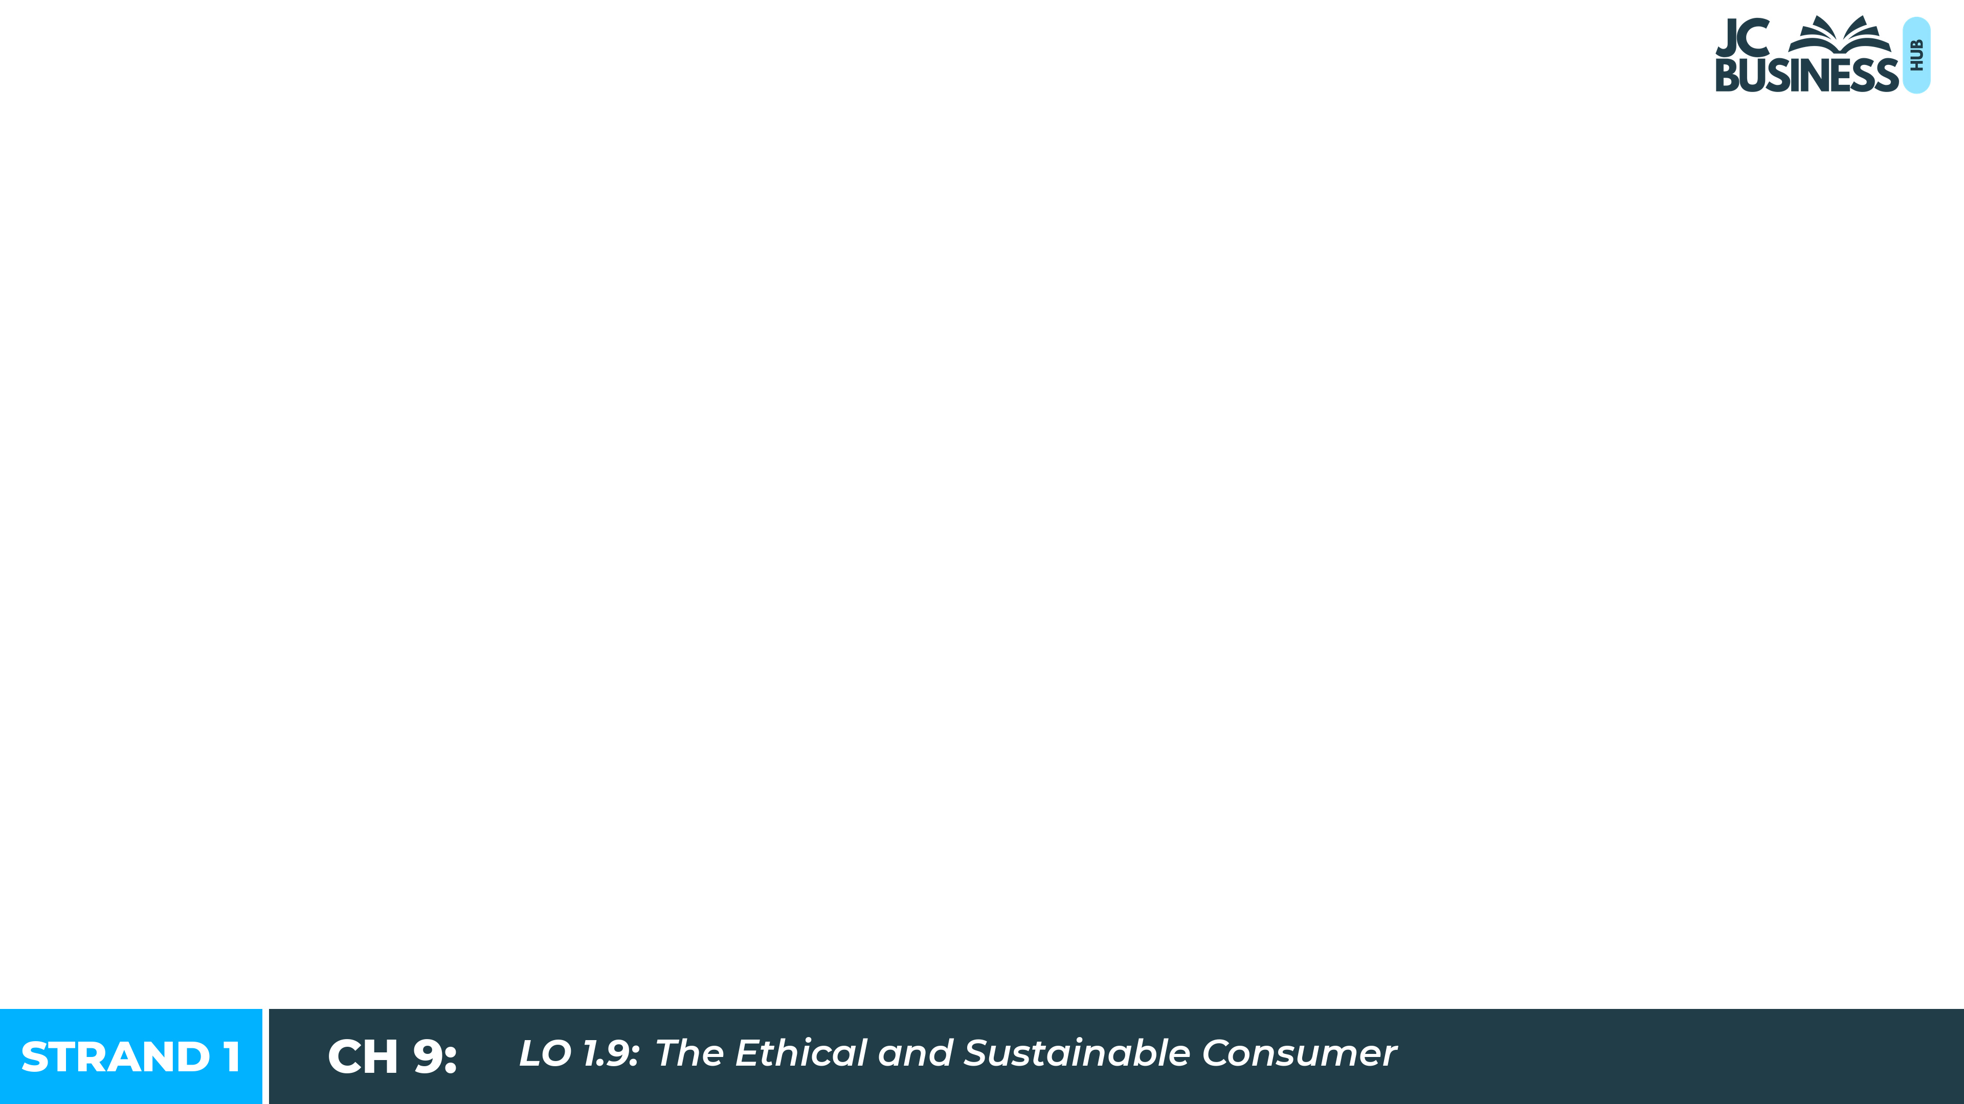
The Ethical and Sustainable Consumer
Learning Outcome 1.9

Slide 2
Introduction
Every time you buy something, you make a choice. Your choices affect more than just you - they affect the people who make the product, the communities they live in, and the environment.
A bar of chocolate is a simple everyday purchase, but the story behind it can be complicated. Who grew the cocoa? Were they paid a fair price? What happens to the packaging after you eat it?
In this chapter, we look at what it means to be an ethical and sustainable consumer, and why your choices matter.

Slide 3

Introduction Activity: Read each statement and decide whether it is True or False.
1. The people who grow the food we eat always earn a fair wage.
2. Buying the cheapest option is always the best decision for a consumer.
3. Throwing away clothing after one season has no impact on the environment.
4. Buying Irish-made products can help local businesses.
5. Some consumers cannot afford to make ethical or sustainable choices.

Slide 4

How to Be a More Ethical Consumer
An ethical consumer thinks about the effect of their purchasing decisions on other people before they buy.
1. Buy Fairtrade: ensures farmers are paid a fair price, so they are not exploited and can afford a better standard of living.
2. Avoid sweatshop goods: sweatshops pay very low wages in poor conditions. Avoiding them means you do not support worker exploitation.
3. Avoid the black market: buying stolen or counterfeit goods is dishonest and deprives the government of tax revenue.

Slide 5
Problems Being More Ethical
Even consumers who want to be ethical can face barriers.
Excessive consumerism: advertising creates a drive to buy more, so it is hard to resist cheaper options.
Higher cost: the lower price of unethical alternatives makes it hard to switch to ethical options.
Hard to find ethical goods: ethical goods are not always in local shops, and it can be hard to research every product you buy to check if it is ethical or not.

Slide 6

Fairtrade
Fairtrade is an international movement that ensures farmers and producers in developing countries are paid a fair price and work in acceptable conditions.
Reasons to buy Fairtrade:
More ethical: farmers are paid a fair price, so they are not exploited and can support their families.
Higher quality: a stable income lets producers invest in better farming methods, so products are often higher quality.
More sustainable: responsible farming protects the land so it can keep producing food for future generations.

Slide 7

2023 Q6
Outline two reasons a consumer would purchase Fairtrade products, considering Fairtrade products are more expensive.
Fairtrade ensures that farmers and workers are paid a fair price for their goods.. so they are not exploited and can afford a better standard of living.
Fairtrade promotes responsible farming methods...so the land is protected from damage and can continue to produce food for future generations.
TOP TIP: Always explain how the action makes it more ethical. For example, "Buy Fairtrade products as it ensures that farmers are paid a fair price so that they are not exploited" would explain how it is more ethical.

Slide 8
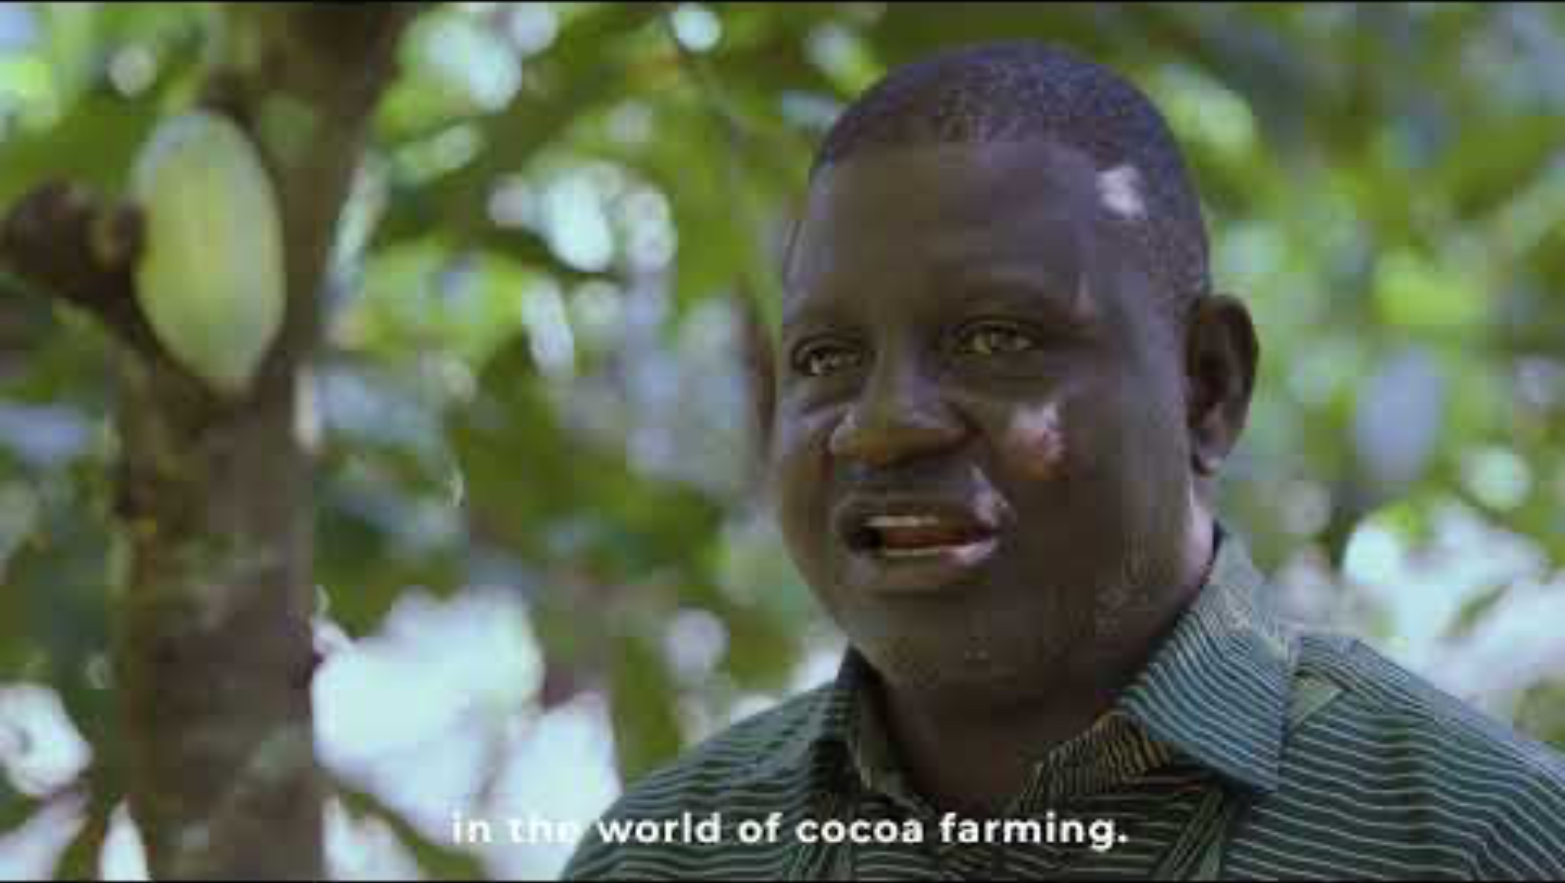
Key Skill: The Story of Tony's Chocolonely
Tony's Chocolonely was founded after a Dutch journalist discovered child labour and forced labour were widespread in cocoa farming in Africa. Its goal: chocolate made 100% slave-free. It pays cocoa farmers a higher price than the standard market rate, works directly with farming cooperatives, and uses recycled packaging. A Tony's bar may cost €4.50 compared to €3 for a cheaper bar that is not Fairtrade.
1. Give two reasons why someone might choose Tony's Chocolonely over another chocolate bar.
2. Identify two reasons that someone might not buy a Fairtrade brand like Tony's Chocolonely every time they buy a chocolate bar.
3. Is it fair to expect all consumers to buy ethical products like Tony's Chocolonely every time they shop?

Slide 9

Workbook Q1 -> Q6

Slide 10
Being a Sustainable Consumer
A sustainable consumer tries to limit the use of scarce resources in a way that does not damage the ability of future generations to meet their own needs.
Sustainability: using resources carefully today so that future generations can still meet their own needs.
Circular economy: a system where products are kept in use for as long as possible through reuse, repair and recycling, rather than being thrown away.

Slide 11

Sustainable Consumer Choices
More Sustainable
Less Sustainable
Reduce consumption: avoid fast fashion so less waste ends up in landfill.
Buy second-hand: keeps products in use for longer, saving resources.
Choose reusable or recyclable products: reduces demand for single-use plastic.
Buy local: Irish goods travel shorter distances, so less carbon is used.
Buying fast fashion to wear once or twice, then throwing it away.
Throwing items in the bin instead of repairing them.

Slide 12
Challenges of Being a More Sustainable Consumer
Even consumers who want to be sustainable can face challenges.
Buying local costs more: local businesses cannot buy in bulk like large retailers, so their prices are often higher.
Buying second-hand takes more time: finding the right item on Vinted takes more effort than buying new online.

Slide 13
Reasons a Consumer May Choose To Not Shop Locally
Even consumers who want to be sustainable can face challenges.
Buying local costs more: local businesses cannot buy in bulk like large retailers, so their prices are often higher.
Less choice: Shopping locally may mean the consumer has less choice of products and shops, so they may not find the exact item they want at the best price.

Slide 14
Fast Fashion
Fast fashion is the rapid production of large amounts of cheap clothing designed to be worn a few times, then thrown away and replaced.
Problems with fast fashion:
Large amounts of clothing end up in landfill each year.
Workers are often paid very low wages in poor conditions (sweatshops).
Alternative: buy second-hand and repair rather than replace, keeping clothes in use for longer.

Slide 15
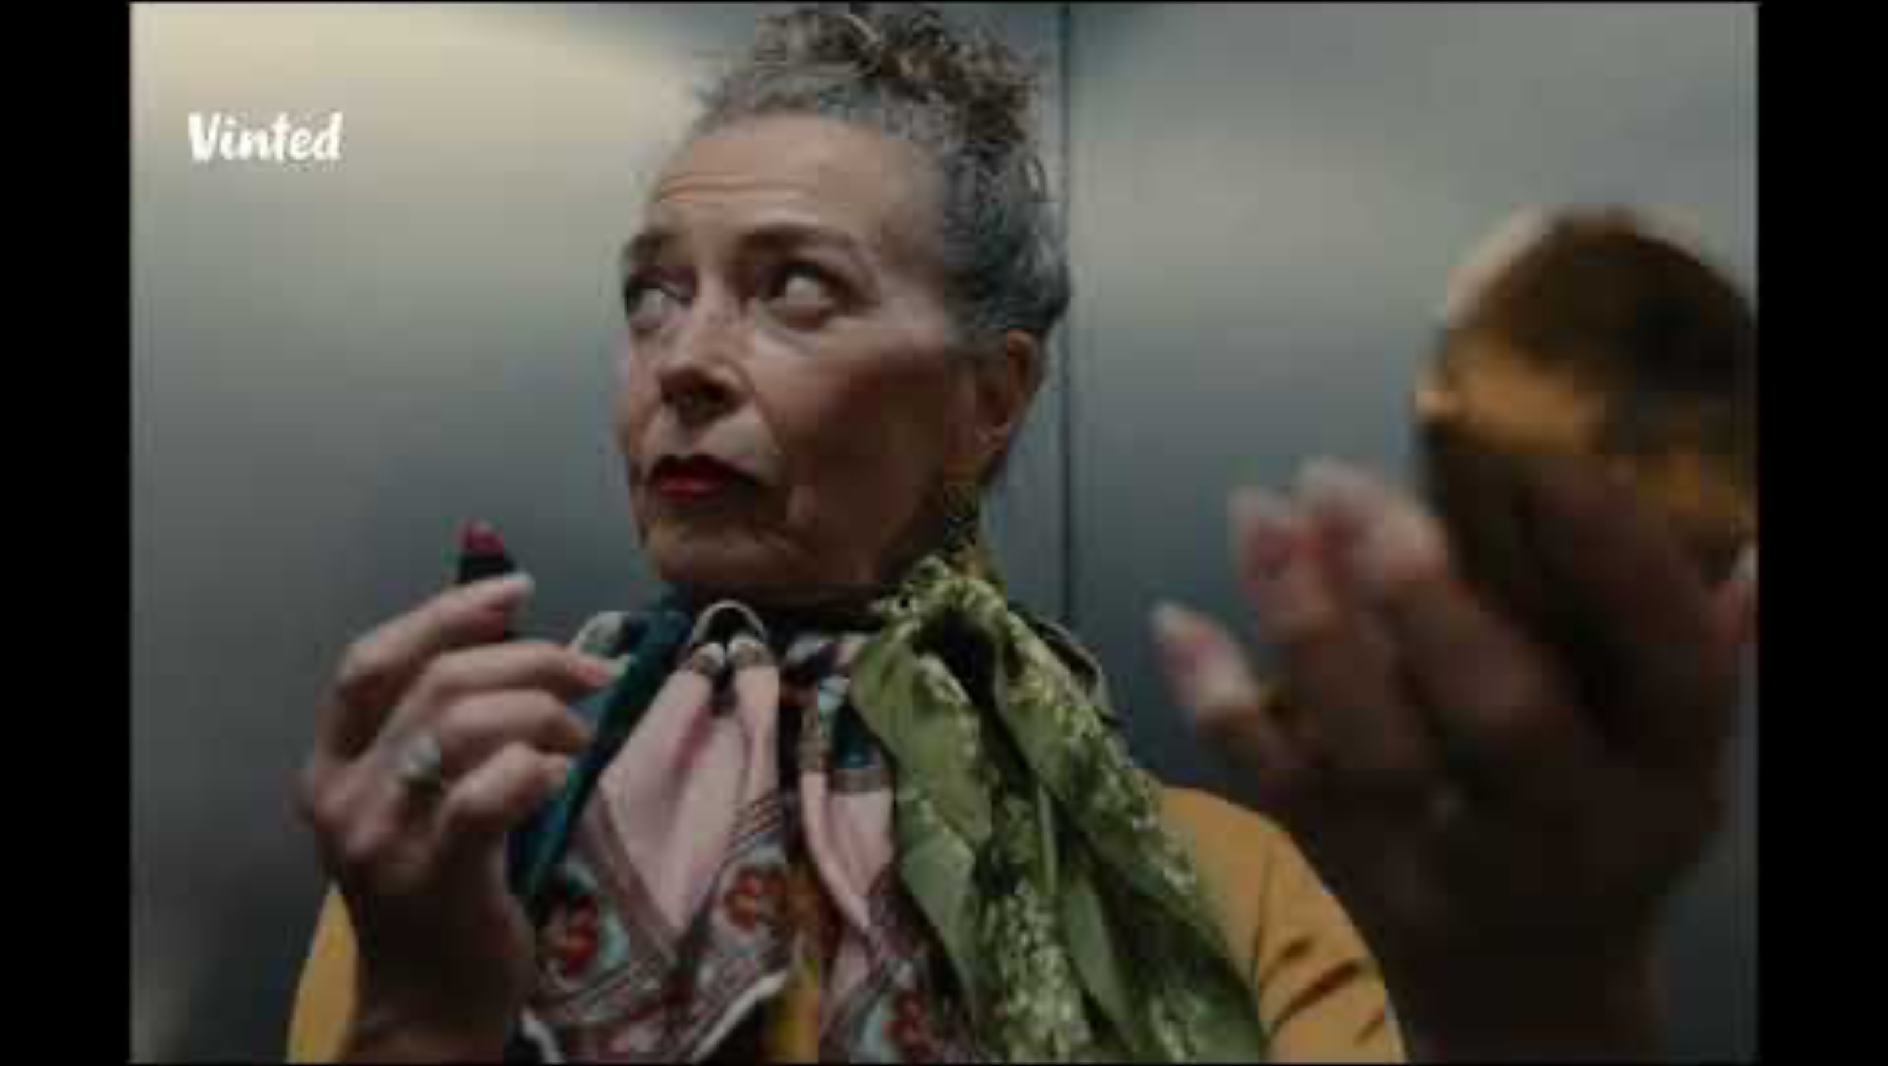
Key Skill: Evaluate the problems consumers face when trying to be more
ethical or sustainable
Roisin is 17 and loves fashion. She buys most of her clothes from cheap non-EU websites because they are affordable on her part-time wage of €120 a week. Her friend Amara buys most of her clothes second-hand on Vinted and spends about the same amount but gets more items. Amara recently told Roisin that she has concerns about the possible conditions in some of the factories that supply some fast fashion businesses.
1. Identify one ethical issue with Roisin’s current shopping habits.
2. Suggest one change Roisin could make that would be more sustainable and would not cost her more money.
3. Is it fair to criticise Roisin for buying from low priced sites given her income? Explain your answer.
4. Identify one benefit and one drawback of Amara buying from Vinted instead of buying new.

Slide 16
Workbook Q7 -> Q10

