Slide 1
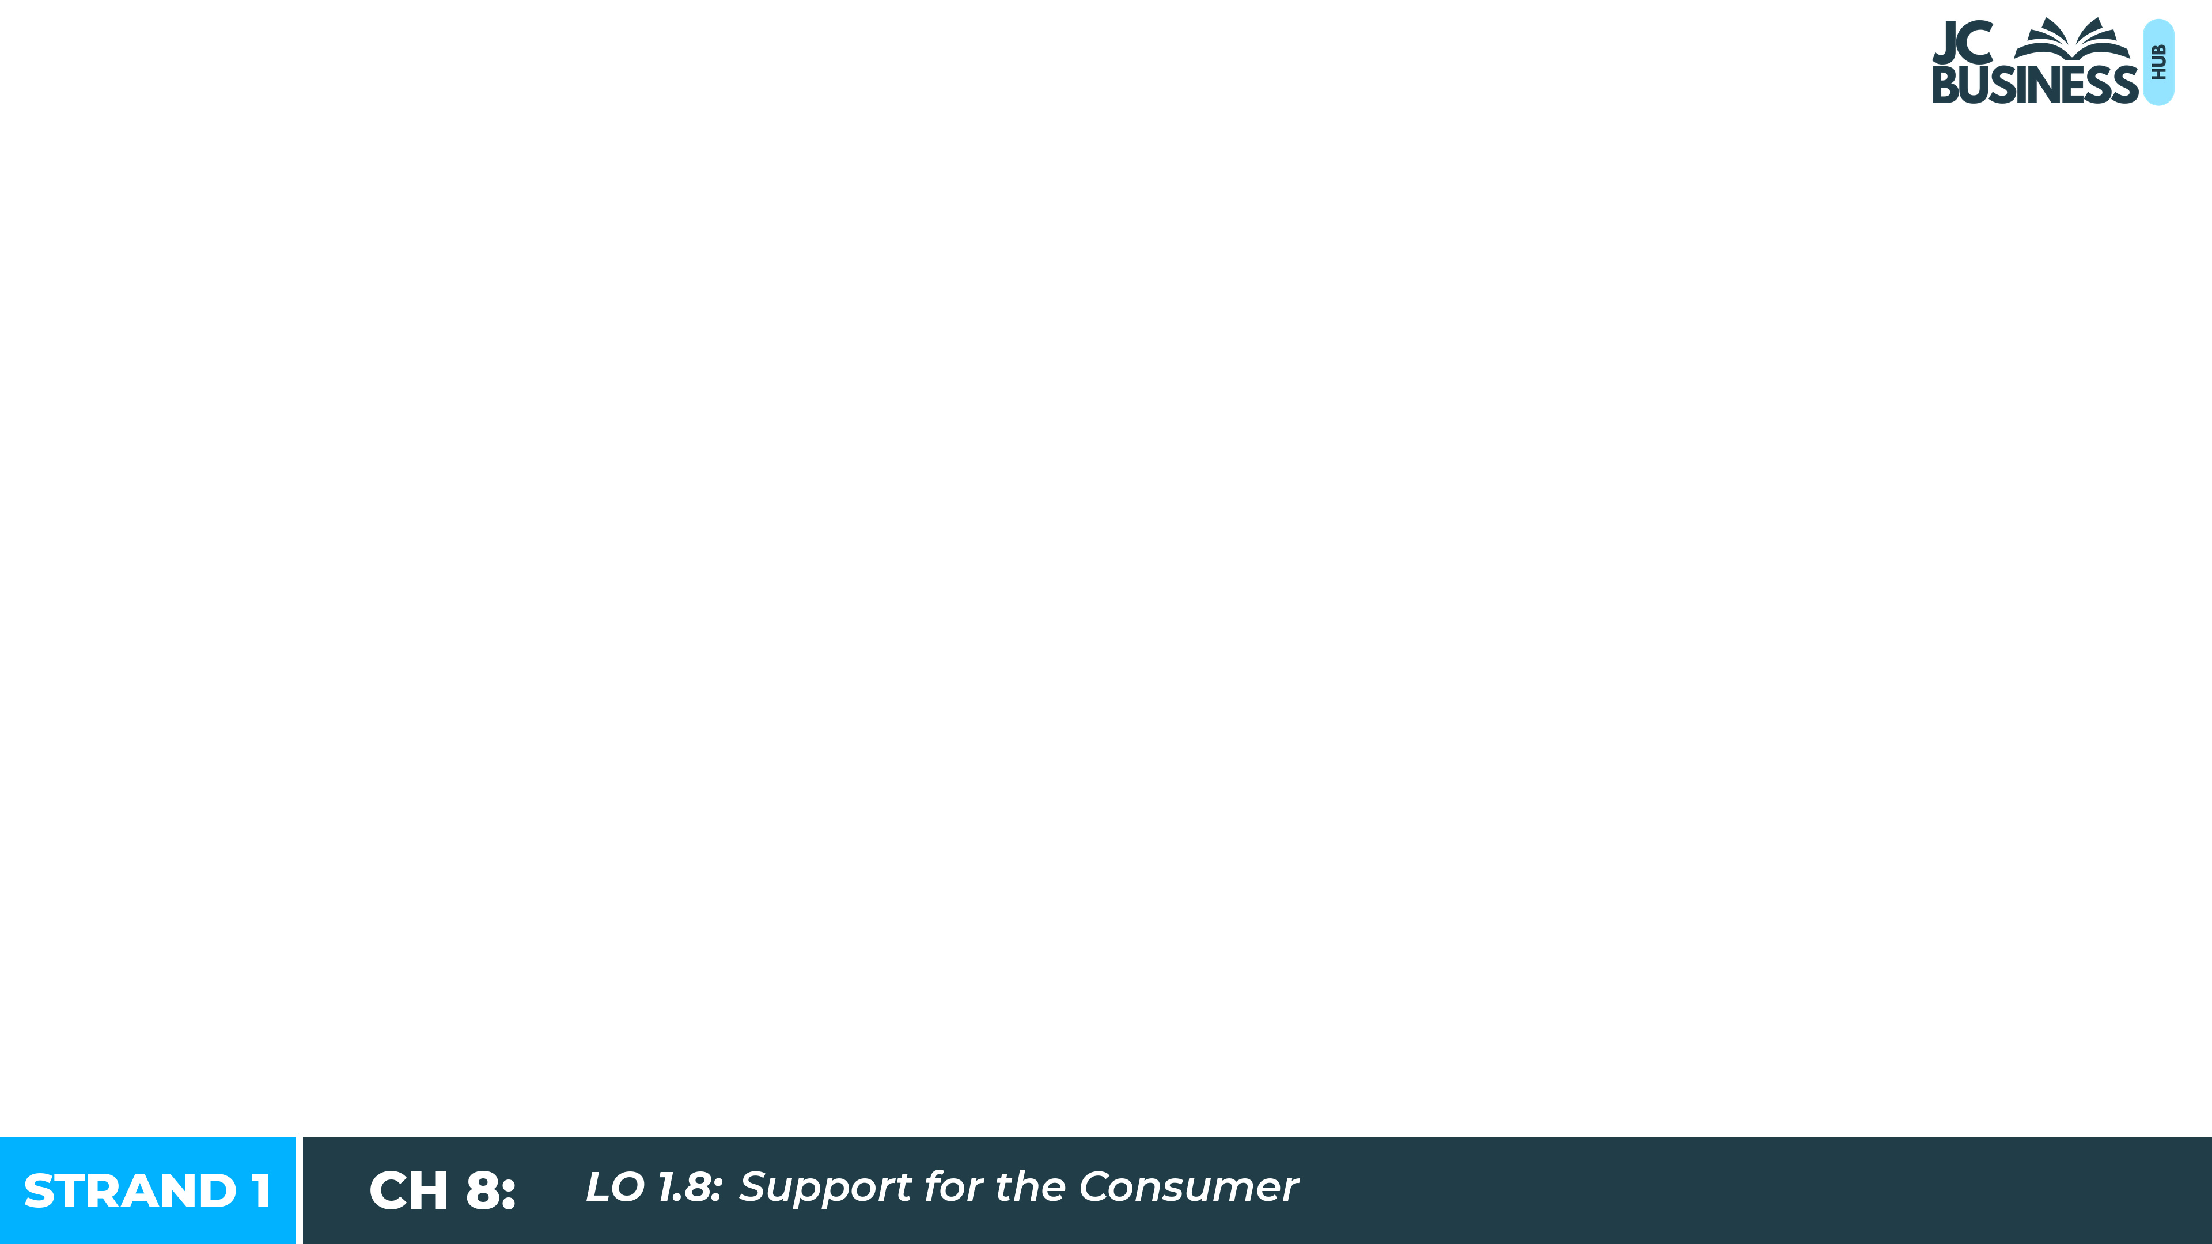
Support for the Consumer
Learning Outcome 1.8

Slide 2
Introduction
Aoife bought a new pair of headphones online for €120. They stopped working after three weeks. She emailed the company twice but received no reply.
A friend told her that there are organisations in Ireland that exist to help consumers in exactly this situation. Aoife had never heard of any of them.
This chapter looks at who can help you as a consumer, when to contact each organisation, and how to make a complaint.

Slide 3

Introduction Activity: Read each statement and decide whether it is True or False.
1. If a company ignores your complaint, there is nothing more you can do.
2. If you want to seek extra help dealing with a business you need to hire a solicitor.
3. Some consumer agencies provide their services for free.
4. There is an organisation that helps Irish consumers who have problems with businesses in other EU countries.

Slide 4
The CCPC
Competition and Consumer Protection Commission
Protects consumers and promotes fair competition in Ireland. Gives advice on consumer rights and helps you compare financial products. Investigates businesses that break consumer protection law.
Example:
Aoife wants to compare the interest rates on three personal loans before she borrows. She uses the CCPC to compare the products and get independent advice.

Slide 5

The ECCI
European Consumer Centre Ireland
Helps Irish consumers with complaints about businesses based in other EU countries.
Example:
Conor in Galway buys a coat from a website based in France. It never arrives and the company will not reply to him. He contacts the ECCI because the business is in another EU country.

Slide 6

Small Claims Procedure
Small Claims Procedure
A low-cost legal option (€25 fee) for disputes with traders involving amounts up to €2,000. No solicitor is needed. It only covers purchases from traders - not private sales such as Vinted or DoneDeal.
Example:
Sorcha paid a trader €700 to tile her kitchen. The work was done poorly and he refuses to return any of her payment. She does not want to pay for a solicitor, so she makes a claim through the Small Claims Procedure.

Slide 7
The ASA
Advertising Standards Authority
Independent body that handles complaints for free about ads that are misleading, harmful or offensive.
Example:
An influencer promotes an energy drink and claims it 'gives you energy that lasts all day’. The influencer does not mark their post as an ad. Meabh thinks it is an ad and that it is misleading so reports it to the ASA.

Slide 8

The CAI
Consumers' Association of Ireland
Represents the interests of consumers in Ireland. Campaigns for changes in consumer law and business practice.
Example:
A group of consumers are unhappy that hidden fees are added to concert tickets at the checkout. The CAI campaigns for clearer pricing rules to protect consumers.

Slide 9
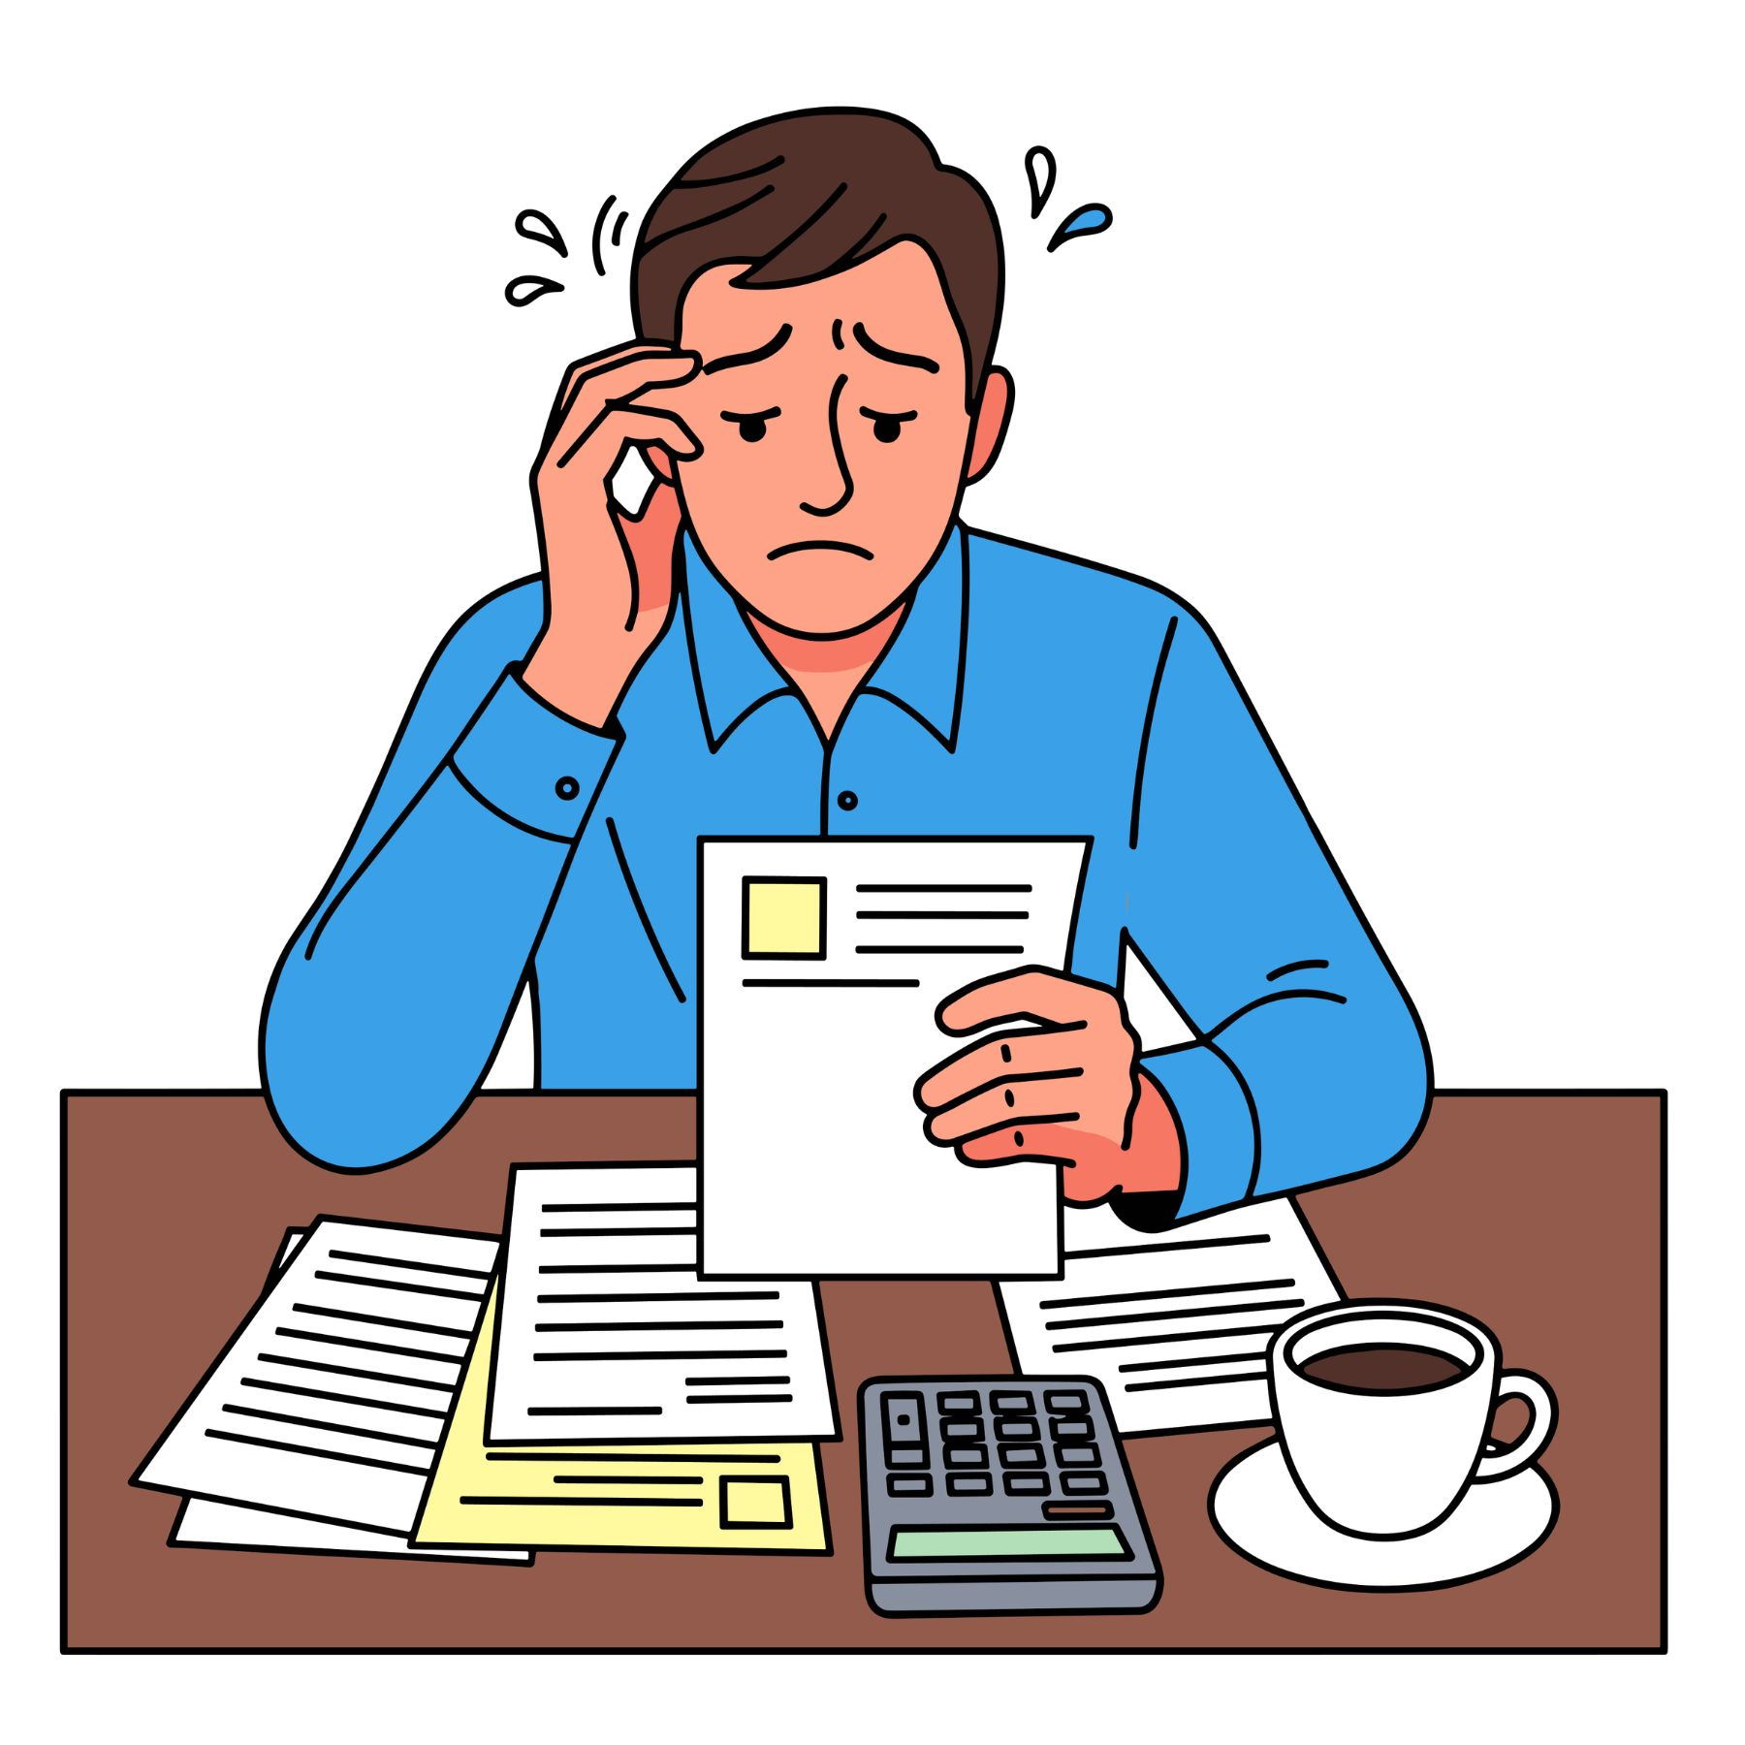
MABS
Money Advice and Budgeting Service
A free, confidential government service that helps people struggling with debt or managing their income and expenditure.
Example:
The Murphy family are struggling to keep up with their bills and loan repayments. They contact MABS for free, confidential advice on managing their income and expenditure.

Slide 10

Central Bank of Ireland
Central Bank of Ireland
Regulates banks, insurance companies and other financial service providers. Contact for information about financial products.
Example:
Before taking out a mortgage, Liam wants reliable information about how financial products like mortgages are regulated. He checks the Central Bank of Ireland.

Slide 11
The FSPO
Financial Services and Pensions Ombudsman
Investigates unresolved complaints about banks, insurance companies and pension providers when they treat you unfairly and will not resolve it.
Example:
Niamh's bank applied charges to her account that it refuses to explain or refund. After the bank will not resolve the issue, she brings her complaint to the FSPO.

Slide 12
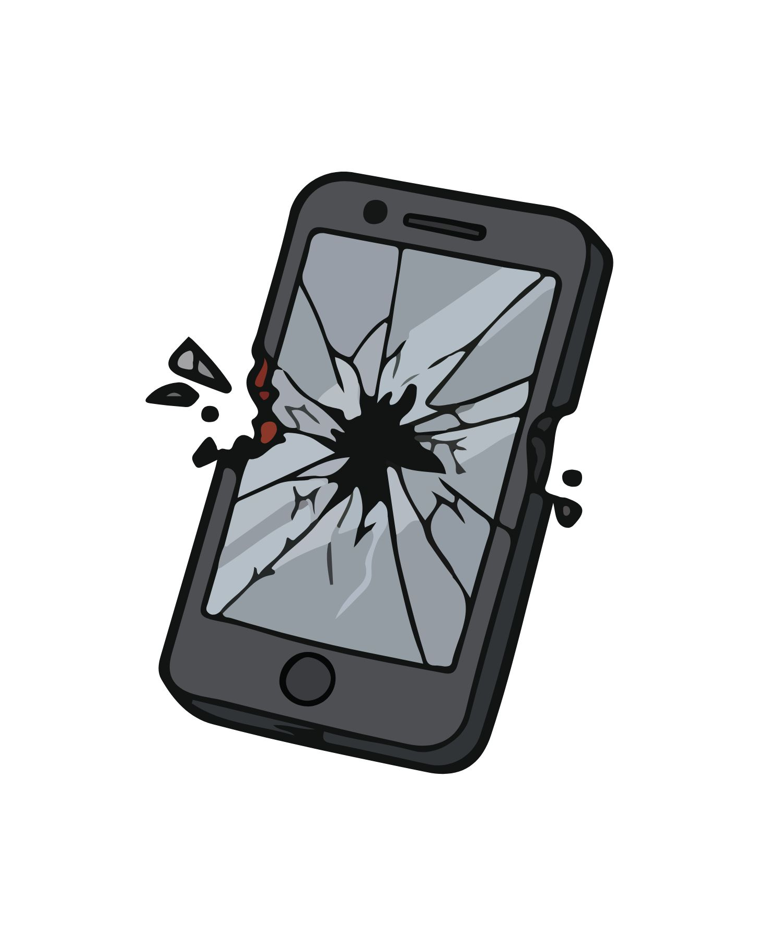
ComReg
Commission for Communications Regulation
Regulates mobile phone companies and broadband providers. Contact for complaints about phone or broadband services.
Example:
David's mobile phone company keeps charging him extra each month for data he did not use. When they will not fix it, he complains to ComReg.

Slide 13
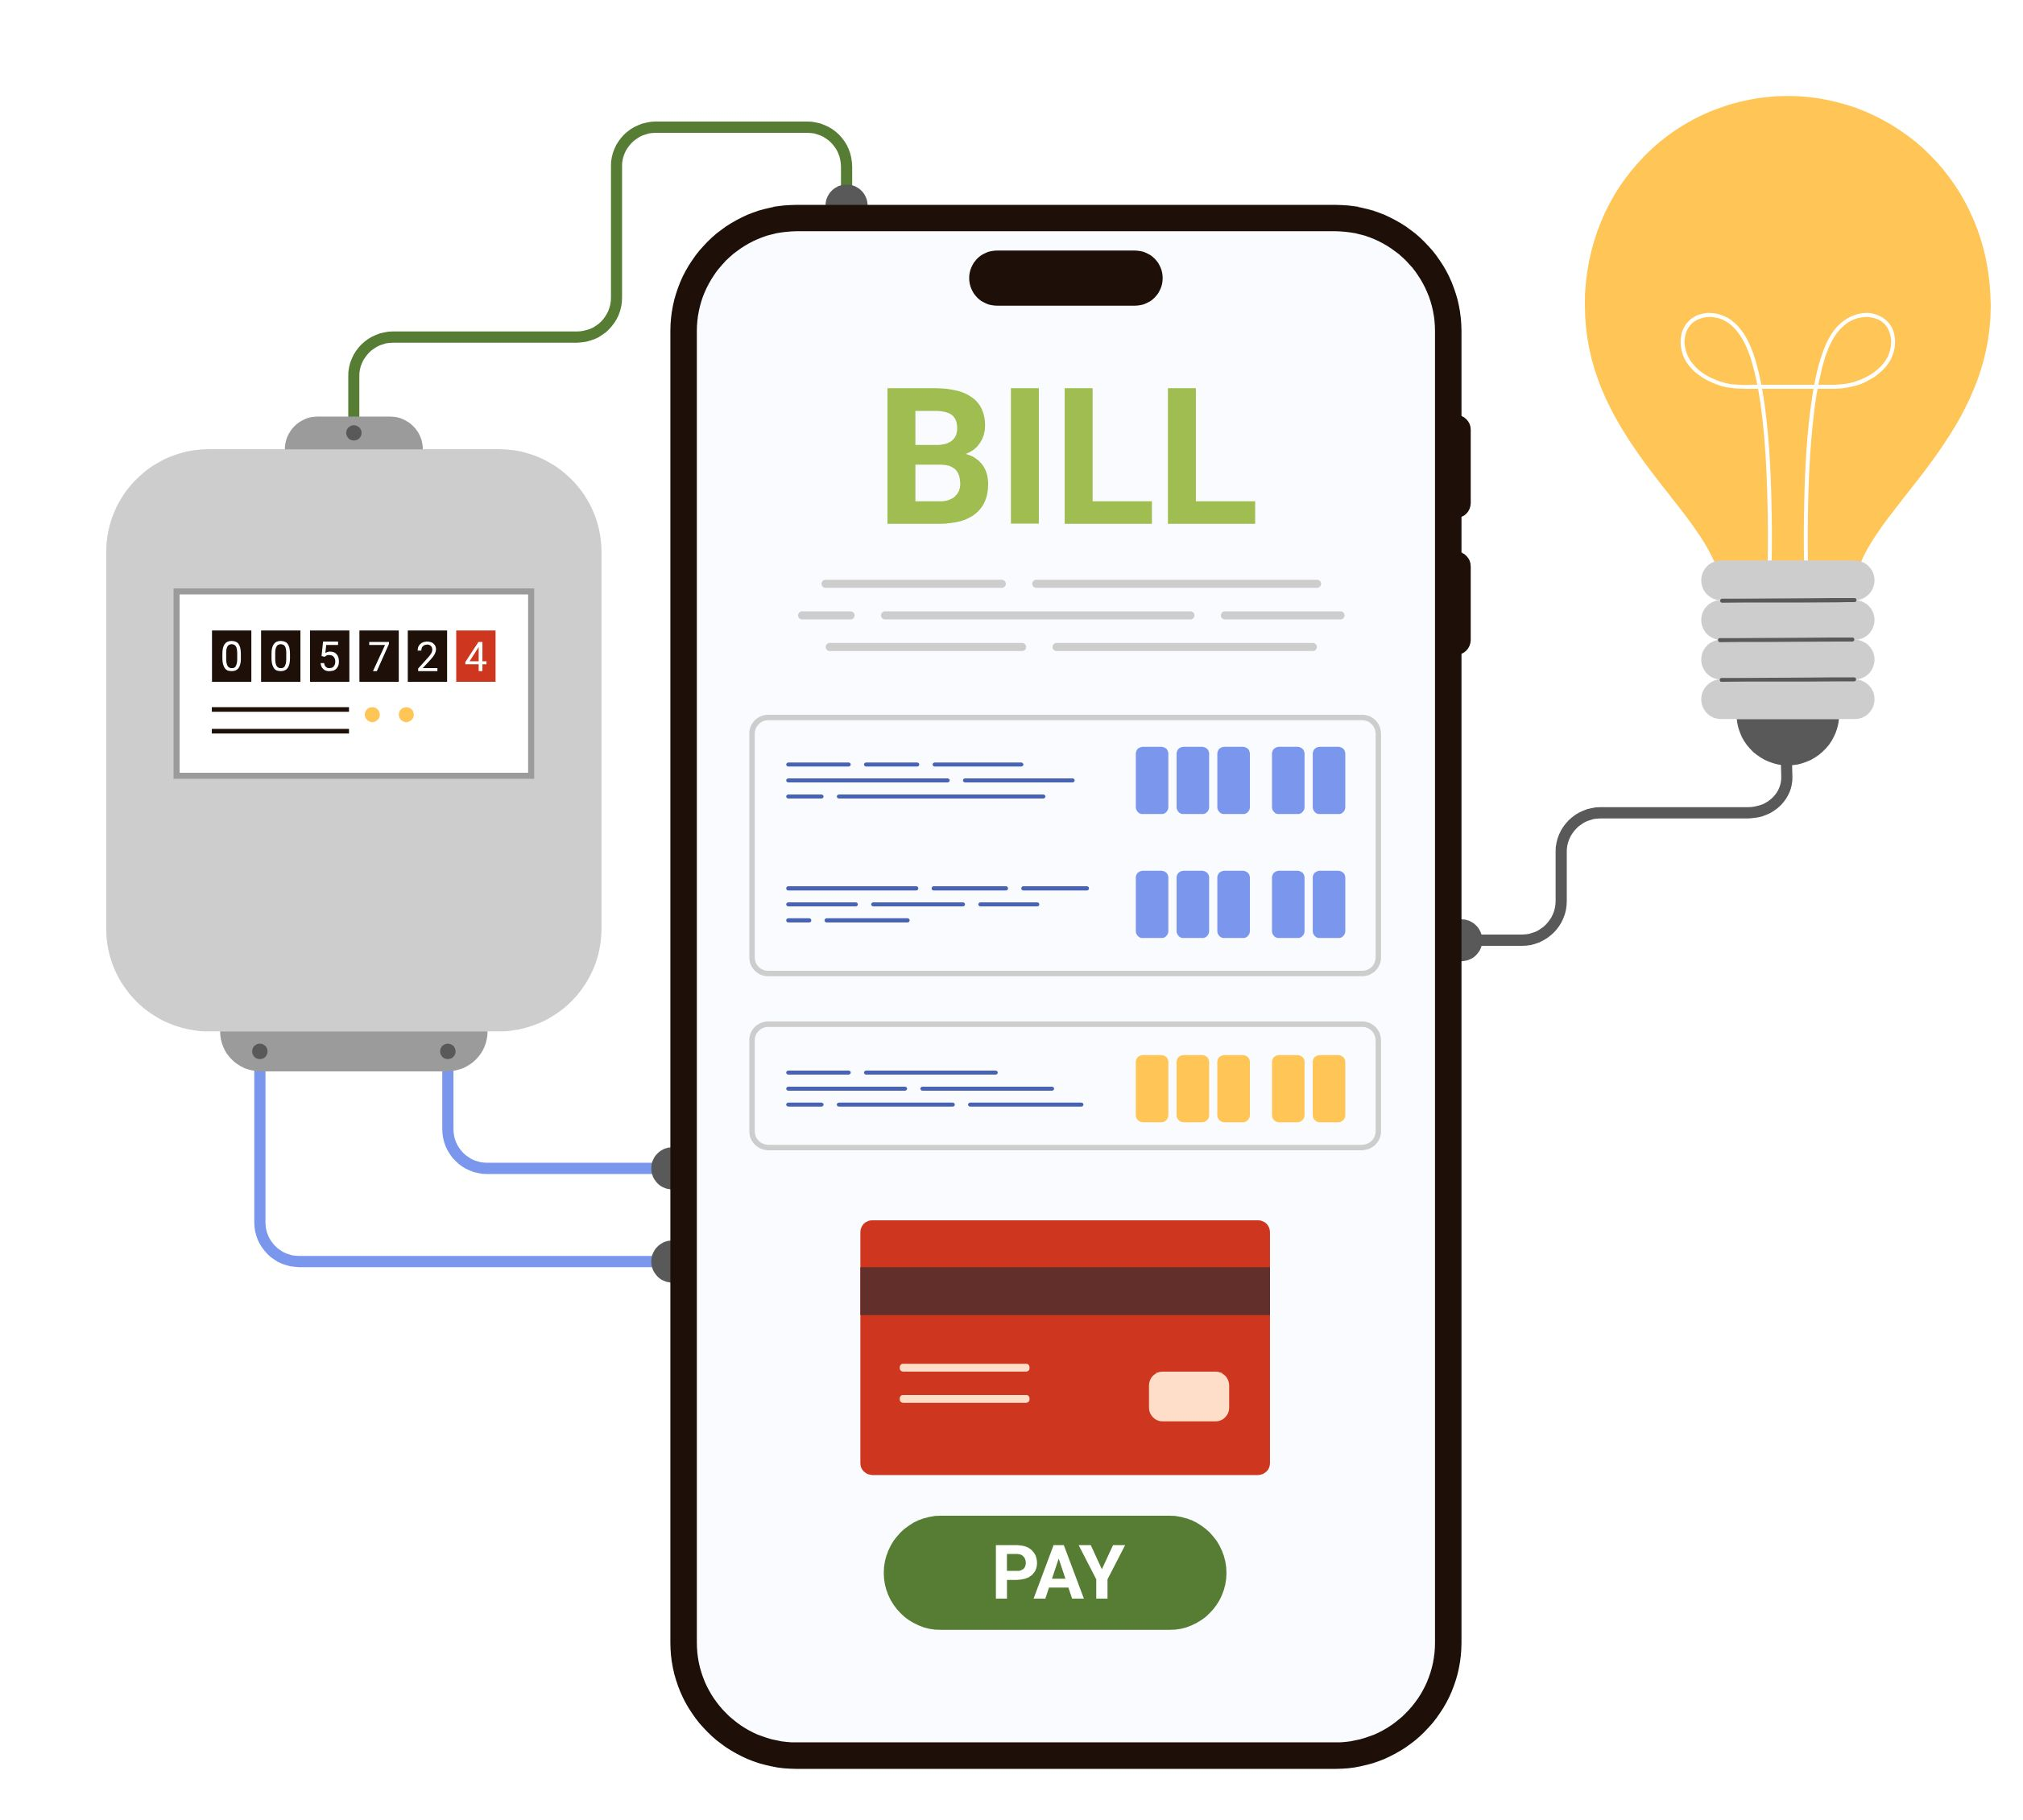
The CRU
Commission for Regulation of Utilities
Regulates electricity and gas suppliers. Contact for complaints about energy companies.
Example:
The Byrne family have been waiting four weeks for their electricity supplier to connect their new home. They contact the CRU to complain about the energy company.

Slide 14

2022 Q10
Match each complaint to the correct agency.
A: My bank has not reduced its loan rates in line with EU regulations.
B: I have been waiting four weeks for the electricity company to connect my house.
C: My mobile phone company keeps charging me extra every month.
Financial Services Ombudsman | Commission for Communication Regulation | Commission for Energy Regulation
A | C | B

Slide 15
Key Skill: Identify the correct agency to contact for any consumer complaint.
A. MABS B. Small Claims Procedure C. CCPC D. ECCI
1. Layla Singh ordered a jacket from a French website. It arrived in the wrong size and the company will not reply.
2. A household cannot keep up with bills and loan repayments and does not know where to turn.
3. Sorcha paid a trader €750 to paint her bedroom. The work was done poorly and the service provider is refusing to return any payment to Sorcha.
4. Ciarán wants to check his consumer rights before contacting a company about a faulty product.

Slide 16

Workbook Q1 -> Q5

Slide 17

How to Write a Complaint Email
A complaint email to a business must include:
From and To - both must be email addresses (with @).
Date - in DD/MM/YY format.
Subject line - begin with 'Re:' and describe the issue.
Salutation - begin 'Dear' and name the recipient if possible.
Content - order reference, the problem, the details and your desired outcome.
Sign-off - 'Yours sincerely' and your full name.

Slide 18
2019 Sample Paper Q16 (a) (i)
You bought runners online and they arrived damaged. Write an email to the company. Include the email address, subject, the complaint and your rights.
From: kateogrady@gdmail.ie To: customerservice@runrun.ie
Date: 12 June 2026 Subject: Re: Complaint - Damaged Goods Received
Dear Customer Service Team,
I am writing to make a formal complaint about an order I received from your website. I purchased a pair of runners online but they were damaged when they arrived. Under the Consumer Rights Act 2022, goods must be in conformity with the contract. These runners arrived damaged and did not meet this standard, so I am entitled to a replacement or refund. I would ask you to resolve this matter within 10 working days.
Yours sincerely, Kate O'Grady
TOP TIP: Always name the Consumer Rights Act 2022, state the right that was breached, and clearly request the outcome you want.

Slide 19
Key Skill: Write a complaint email.
Niamh paid €12.99 online for a study app advertised as covering the Irish JC Business course. When she logged in, all of the material was for a different country's course - it was not as described. She has her order confirmation.
Write an email from Niamh to the company asking for a refund. Include:
From and To (with @)
Date
Subject (Re:)
Salutation (Dear)
Order reference and the problem
The consumer right breached
Your desired outcome
Sign-off (Yours sincerely + name)

Slide 20
Workbook Q6 -> Q7

