Slide 1
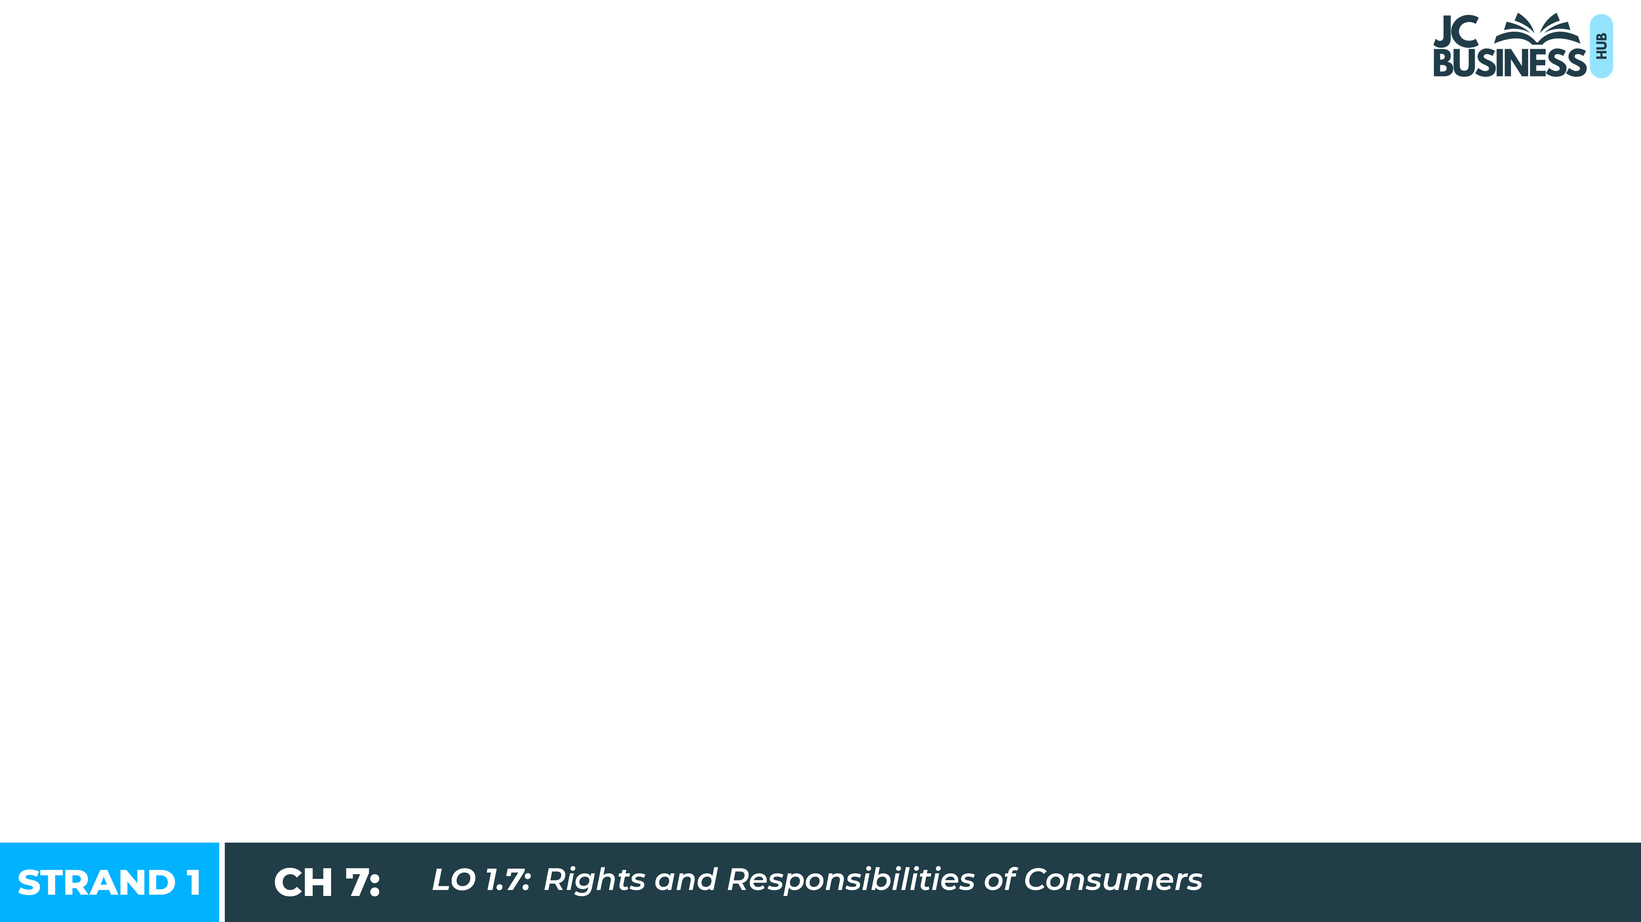
Rights and Responsibilities of Consumers
Learning Outcome 1.7

Slide 2
Introduction
Every time you buy something from a business, the law is on your side. The main law protecting consumers in Ireland is the Consumer Rights Act 2022.
It gives you rights when you buy goods, services, digital content and digital services from a trader. A second law, the Consumer Protection Act 2007, protects you from false or misleading advertising.
This chapter looks at your consumer rights, how to get redress when something goes wrong, and your responsibilities as a consumer.

Slide 3

Introduction Activity: Read each statement and decide whether it is True or False.
Ciaran bought Nike Air Max trainers in a sale. He wore them at home and noticed the sole coming away. The shop said he had no rights as he had worn them and bought them on sale. His sister Maya bought runners online and a week later returned them because she did not like the colour.
TRUE or FALSE:
1. The shop is correct - Ciaran has no rights because he already wore the runners.
2. Maya can get a refund because she bought her runners online.
3. Buying in a sale means you have fewer rights if something is faulty.
4. Buying from a seller on Vinted gives you the same rights as buying from a shop.
5. If a good does not come with a guarantee, you cannot get a refund if it becomes faulty.

Slide 4
The Consumer Rights Act 2022
The main law protecting consumers in Ireland is the Consumer Rights Act 2022.
It applies when you buy goods, services, digital content or digital services from a trader - a business or person that sells goods or services as part of their work.
It does not apply to private sales between individuals, eg buying a phone from a classmate.
When you agree to buy and a seller agrees to sell, you have made a contract of sale.

Slide 5
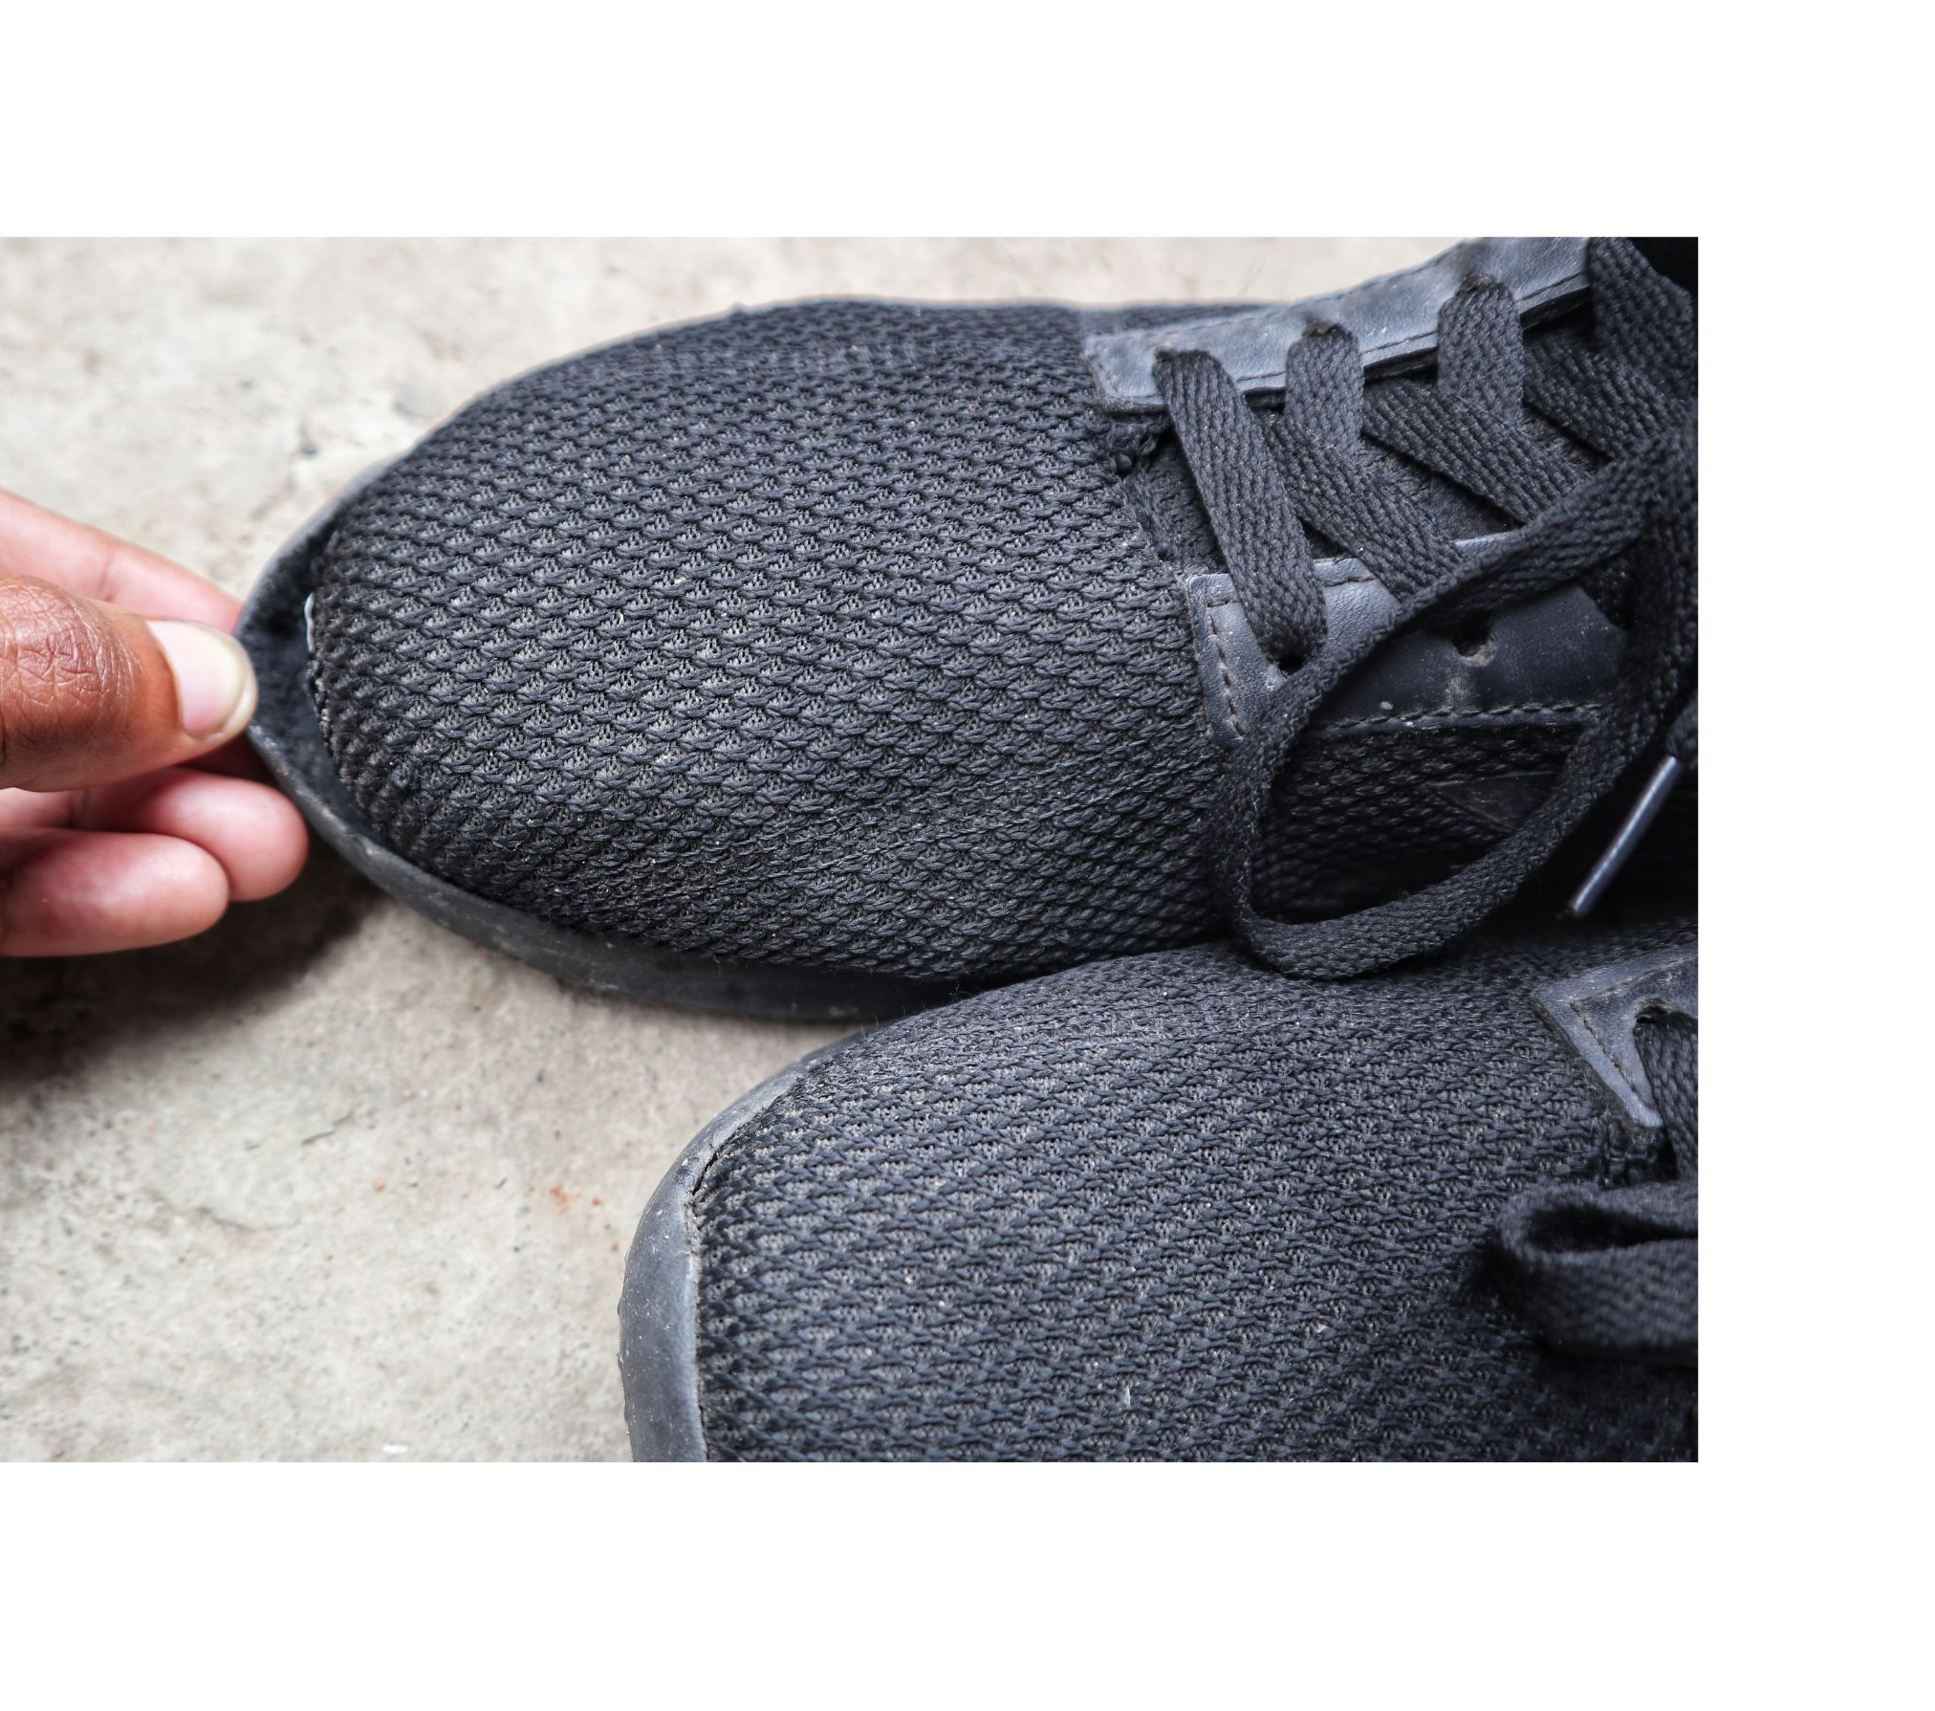
Rights When Buying Goods in a Shop
Goods must be in conformity with the contract. This means they must be:
As described - matches the description the seller gave.
Fit for purpose - does what it is supposed to do.
Of expected quality - safe, durable and the standard you would expect relative to how much you paid for it.
These rights apply whether a good was purchased at full price, in a sale, new or second-hand - once it was bought from a trader.

Slide 6
Buying Goods: Covered vs Not Covered
Covered
Not Covered
A phone charger stops working after two days. It was not of expected quality, so the seller must offer a solution.
A blender described as 'dishwasher safe' is damaged in the dishwasher after using it. It was not as described.
You buy a dress, get home and decide you do not like the colour. The dress is not faulty, so the shop has no obligation to change it.
You buy a second-hand bike from a neighbour and the brakes fail the next day. The Act does not cover private sales.

Slide 7

2025 Q18 (a) (iii)
Mary bought a dress in Breda's Boutique for €150. When she brought it home, she realised it did not match her jacket. The next day Mary went back looking for a refund.
Is Mary legally entitled to a refund? Yes / No
No. Mary changed her mind about the dress - there was nothing wrong with it.
There is no legal right to a refund for a change of mind on goods bought in a shop, so the shop is not responsible.
TOP TIP: A change of mind gives no legal right to a refund in a shop. A return right only applies online (14-day cooling off) or for distance contracts.

Slide 8

Workbook Q1 -> Q3

Slide 9
Rights When Paying for a Service
A service is work carried out for you by a trader, eg a haircut or a car repair.
A service must be carried out with:
Proper skill and care.
Completed in a reasonable time.
Charged at a reasonable price if none was agreed in advance.
If these standards are not met, you may be entitled to a refund, price reduction or to have the work redone.

Slide 10
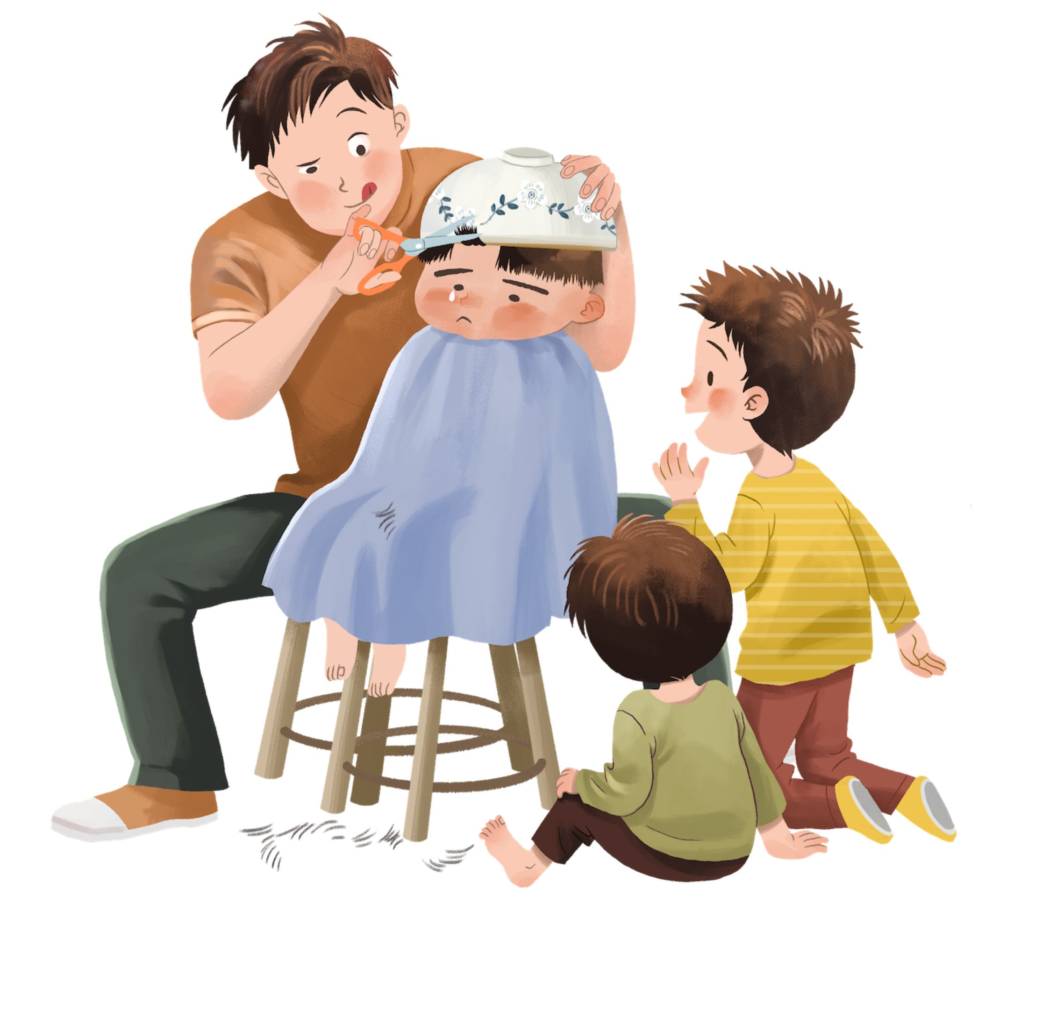
Paying for a Service: Covered vs Not Covered
Covered
Not Covered
A hairdresser cuts off far more hair than you asked for and leaves it uneven. The service was not carried out with proper skill and care.
A plumber is paid to fix a leaking tap but leaves it leaking worse. The service was not done with proper skill and care.
A hairdresser cuts your hair exactly as you asked but you do not like how it looks. The service was carried out properly.

Slide 11
Rights When Shopping Online
When buying goods online you have extra rights, as you cannot see or try them before you buy.
14-day cooling off period – a consumer can cancel and return goods within 2 weeks with no reason needed even if they are not faulty. They can change their mind.
Right to information – They should know the full price, delivery costs and seller details before they buy.
Right to data security - personal data must be stored securely by the seller.
Right to delivery - within 30 days of an order or they should receive a refund for non-delivery.

Slide 12

Rights When Buying Digital Content and Services
Digital content: downloaded music, films, games, apps or e-books.
Digital services: streaming subscriptions, social media, online gaming.
Digital content and services must be:
As described - an app described as a video editor must be able to edit videos.
Fit for purpose - an online JC maths course should teach JC maths content.
Kept up to date - the trader must provide updates needed to keep software working for users.
Not covered example: If you rent and download a film and watch it straight away. By choosing to watch it immediately, a cooling off period would not apply and no refund should be available.

Slide 13
Workbook Q4 -> Q6

Slide 14
Your Right to Redress
Redress means the solution you are entitled to when something goes wrong.
Faulty good within 30 days: full refund, so you would receive your money back.
Faulty good after 30 days: a repair or replacement may be offered first; if that fails, a refund or price reduction (you may get some money back or a reduced price).
No refund for a change of mind - unless bought online or not in person (catalogue, doorstep).

Slide 15
Guarantees and Warranties
Some businesses offer extra protection on top of your legal consumer rights.
Guarantee: a free promise to repair or replace a faulty product within a set period.
Warranty: the same protection, but sold as an add-on for extended cover.
Both sit on top of your legal rights - they never replace them.

Slide 16
Workbook Q7 -> Q11

Slide 17
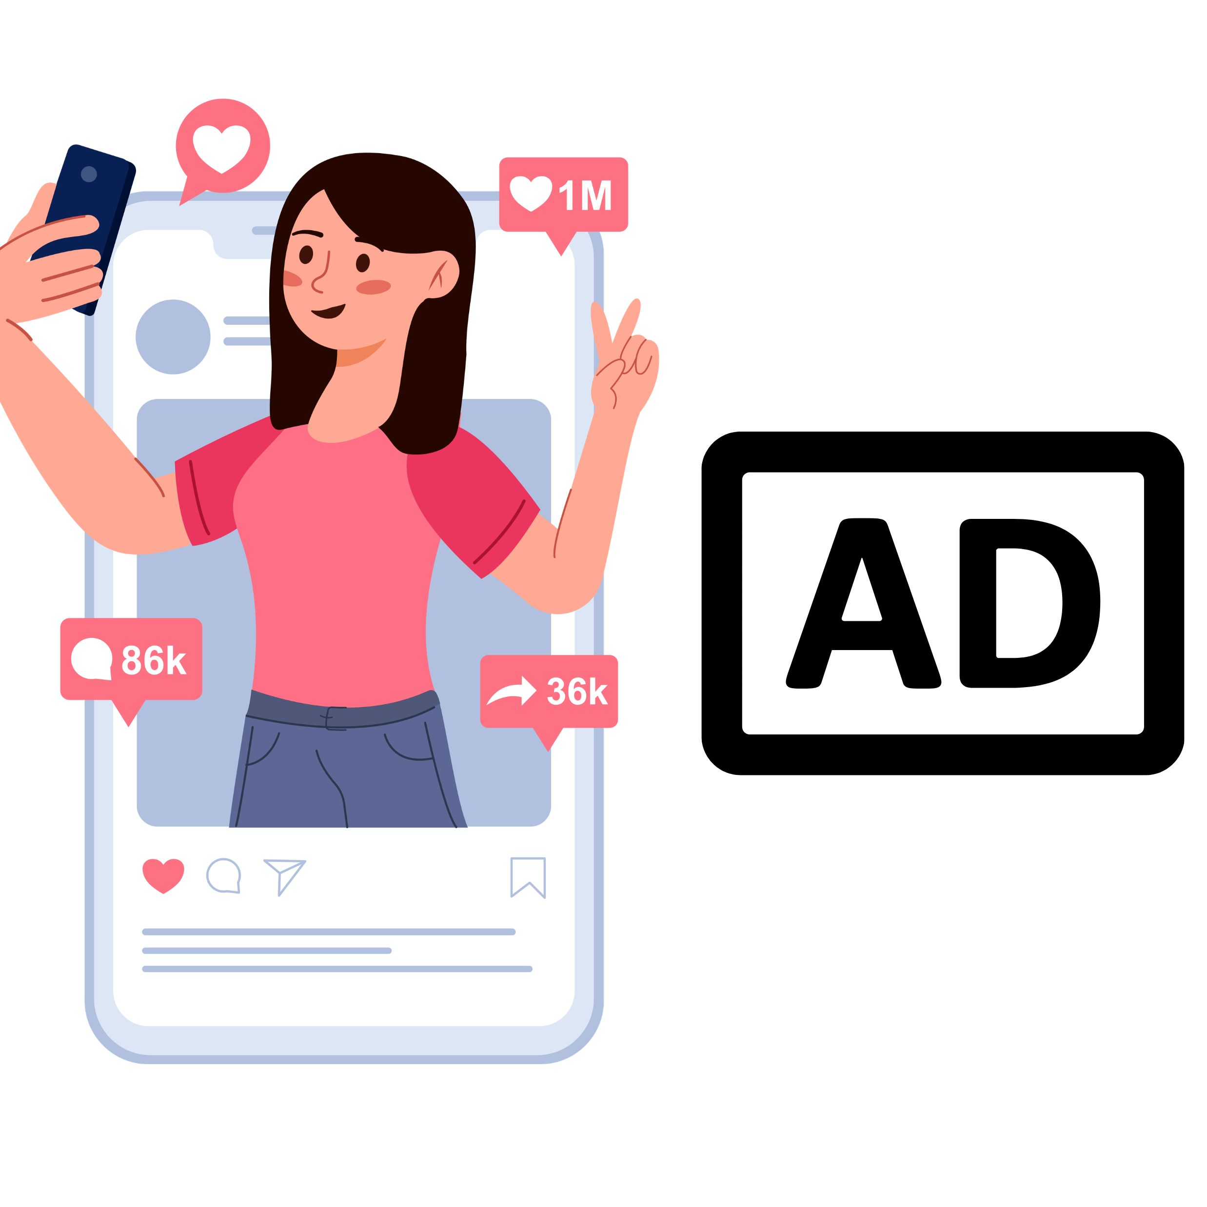
The Consumer Protection Act 2007
Protects consumers from unfair and misleading advertising and aggressive selling.
Under this Act it is illegal for a business to:
Make false or misleading claims about a product or its price.
Use aggressive selling tactics to pressure a consumer into buying.
Show large savings on items never actually sold at the higher price.
Examples: an influencer promoting a product without saying they are paid; a Black Friday sale where prices are not really reduced.
Breaches can be reported to the CCPC, and the business can be fined.

Slide 18
Workbook Q12

Slide 19
Your Responsibilities as a Consumer
Being a good consumer means knowing your rights and being responsible.
Think before you buy: read the small print before agreeing (caveat emptor - let the buyer beware).
Shop around: compare prices and reviews for the best value.
Keep receipts: proof of purchase is needed if something goes wrong.
Be honest: making a false claim to get a refund is illegal.
Be an ethical consumer: eg Fairtrade supports farmers paid a fair price.

Slide 20
Extra Responsibilities When Shopping Online
Check the website is secure: padlock icon and https in the address bar indicate a website should be more secure.
Use secure payment methods: PayPal or a credit card have a better chance of being cancelled, compared to a direct transfer.
Check the full price: including delivery and extra fees before buying.
Read reviews: verify the product and seller before buying from a website that you have not used before.

Slide 21
2026 Q18 (c) (i)
Every week, Ian and Paula make purchases for their household.
Explain two legal rights Ian and Paula have as consumers.
Right 1: They have the right to a refund if a good is faulty, eg football boots should not fall apart after normal use.
Right 2: When they purchase goods online they have the right to a 14-day cooling off period. They can return goods within 14 days without a reason, even if they are not faulty.
TOP TIP: Name the right AND explain it in context. A one-word answer such as 'refund' will not get full marks.

Slide 22
Key Skill: Identify when a consumer is entitled to redress.
Decide whether each consumer is covered or not covered, and give a reason.
1. Cian buys a second-hand phone from a classmate. It stops working the next day.
2. Priya buys runners in a sale for half price. The sole splits after one week.
3. Aoife pays €4.99 to download a game. It says it works on Android but does not work on her phone.
4. James buys a jacket in a shop, brings it home and decides he does not like the colour.
5. John pays €9.99 for a site with cheat codes for a PlayStation game. The codes work but the game is still too hard for John to complete.

Slide 23
Workbook Q13 -> Q14

