Slide 1

Personal Insurance
Learning Outcome 1.6
Identify appropriate types of insurance for particular personal needs and consider costs, benefits and risks.

Slide 2
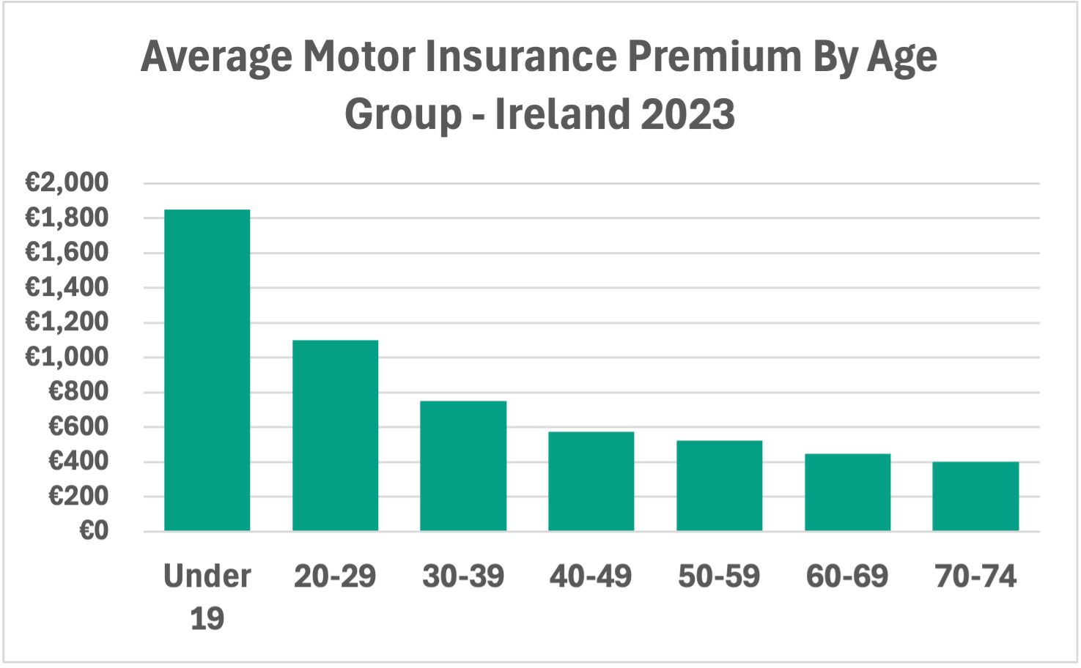
Introduction
Insurance cover against the financial cost of unexpected events, from a car accident to a broken phone.
Taking out insurance involves a trade-off: people pay for insurance cover that they may never use, but they benefit from being covered for a much larger financial risk if an accident does occur.
Not everyone pays the same for insurance. The amount a person pays depends on the level of risk the insurance company is being asked to cover.
What does this graph tell you about motor insurance?

Slide 3

Introduction Activity: Read each statement and decide whether it is True or False.
A teenager who just passed their driving test and an experienced adult driver pay the same for motor insurance.
A house with a burglar alarm costs the same to insure as a house with no alarm.
A more expensive car will cost more to insure.
When applying for insurance, a driver can decide not to tell the insurance company that they have penalty points in case it makes their insurance more expensive.

Slide 4
What Is Insurance?
Insurance helps people manage risk, the chance of something unexpected happening that has a financial cost. It is a way of protecting against the cost of these events.
Lots of people each pay a small regular fee, called a premium, to the insurance company. The company pools these payments together. If a person suffers a loss, the insurance company uses the pooled premiums to pay them compensation.

Slide 5
Why Do People Get Insurance?
Insurance helps people to manage risk in different ways including:
1. Providing Financial Protection so a person is not left with a large, unexpected bill that they can’t afford e.g. from a house fire or a serious car accident
2. It is a Legal Requirement. Every driver must have at least third party motor insurance to be allowed to drive on our roads. Driving without insurance is a criminal offence.
3. Reduces Financial Stress. Knowing that the financial cost of a risk is covered gives people peace of mind, so they do not have to worry as much about the consequences of something going wrong.

Slide 6

Workbook Q1 -> Q3

Slide 7
Types of Insurance
House and Contents Insurance: covers damage to the structure of a home and its contents from fire, theft or flooding.
Health Insurance: covers the cost of private medical treatment, including hospital stays and consultant fees.
Gadget Insurance: covers accidental damage, liquid damage and theft of devices such as mobile phones and tablets.
Travel Insurance: covers unexpected costs when travelling, including medical emergencies, lost luggage and trip cancellations.
Pet Insurance: covers the cost of vet bills if a pet is injured or becomes ill.

Slide 8
Motor Insurance
Motor Insurance covers a vehicle against accidents, theft and damage. It is a legal requirement to drive on a public road in Ireland.
Third party is the minimum required by law and covers injury or damage caused to other people in an accident.
Third party, fire and theft adds cover if the insured person's vehicle is stolen or damaged by fire.
Fully comprehensive is the most common type in Ireland. It covers damage to the insured person's own vehicle as well as everybody else involved in an accident, regardless of who is at fault.

Slide 9
Life Assurance
Life Assurance pays a lump sum to a person's family if the person covered dies. It helps the family pay the mortgage and cover everyday costs.
Top Tip: If a question asks for types of insurance, do not use Life Assurance as the answer. It covers an event that will happen, while other types cover events that may or may not happen.

Slide 10
Workbook Q4 -> Q7

Slide 11
Principles of Insurance
When a person takes out an insurance policy, both the insurance company and the insured person must follow certain rules. These are called the principles of insurance.
Utmost Good Faith: all material facts must be disclosed when applying for insurance, eg you need to tell an insurer you have penalty points or previous claims.
Insurable Interest: the insured must have a financial interest in the item being insured. For example, a person cannot insure a neighbour's car as they would not suffer a loss if it was robbed.

Slide 12
Principles of Insurance
Indemnity: a profit cannot be made from insurance. The insured is restored to the same financial position as before the loss.
Contribution: if the same risk is insured with more than one insurer, the companies share the cost of any claim between them.
Subrogation: after paying out on a claim, the insurance company can take legal action against the party responsible to recover its costs.

Slide 13

2022 Q18 (a) (i)
Kevin lives with his parents in Emo, Co. Laois. He recently passed his driving test and bought a car. He is now considering his motor insurance options.
Read the following definitions of some of the principles of insurance. Match the definitions with the correct principle.
A: A profit cannot be made from insurance.
B: When the same risk is insured with more than one insurer, they will divide the cost of any claim between them.
C: When applying for insurance, all material facts relating to the policy must be disclosed.
Utmost Good Faith = C, Indemnity = A, Contribution = B.

Slide 14
Key Skill: Identify the principles of insurance.
Read each example below and identify which principle of insurance it relates to.
Aoife applies for house insurance and does not mention that her house had a flood two years ago. Which principle has she broken?
A car worth €5,000 is damaged in an accident. The owner tries to claim €8,000. Which principle prevents this?
Seán insures his phone with two different companies and tries to claim the full amount from both when it is stolen. Which principle prevents this?
After paying out on a claim, an insurance company takes legal action against the person responsible for the damage. Which principle allows them to do this?
A person wants to take out insurance on their neighbour's car. Can they do this? Name the principle and explain your answer.

Slide 15
Workbook Q8 -> Q9

Slide 16
The Cost of Insurance
An insurance premium is the payment made to an insurance company, usually monthly or annually, to keep an insurance policy active.
An actuary is the person that creates a model that uses data to calculate how much of a premium to charge each person based on risk factors.
Higher risk = higher premium
Lower risk = lower premium

Slide 17
Factors That Affect The Cost Of A Premium
The factors that impact a motor insurance premium could include:
Age and experience: a younger or less experienced driver is a higher risk and pays a higher premium.
Value of the item: a higher value car or home costs more to repair or replace, so the premium is higher.
No claims bonus: drivers with no recent claims are seen as lower risk and pay a lower premium.
Location: living in a high-risk area, such as a busy city centre or a flood-prone area, increases the premium.
Level of cover: fully comprehensive costs more than third party because it covers more risks.
Security devices: a car alarm, GPS tracker or burglar alarm reduces the risk and lowers the premium.

Slide 18
Low Risk vs High Risk: Motor Insurance
Two drivers applying for motor insurance on the same day might pay different premiums based on their risk profiles.
Driver A is considered a much higher risk to insure because they are:
▸ Younger and less experienced.
▸ Driving a car with a higher value.
▸ Living in a higher-risk area.
▸ Without a no claims bonus.
Driver A: Age 19, just passed their test, drives a car worth €35,000, lives in Dublin city centre, no claims bonus -> HIGH premium. | Driver B: Age 42, with 20 years' experience, drives a car worth €8,000, lives in rural Co. Clare, 5 years no claims bonus -> LOW premium.

Slide 19
2019 Q4
Gerard is 21 years of age and has recently passed his driving test. He has now purchased an old car and needs to insure it.
Outline two factors the insurance company will take into account when calculating the cost of Gerard's car insurance.
Worked answer 1: Gerard is young (21) and does not have much experience driving, increasing the risk of crashing, which would increase his premium.
Worked answer 2: Gerard has purchased an old car, which is generally lower in value, lowering the cost of insuring it.
TOP TIP: Use any information given in the question. The question mentions Gerard's age (21) and his old car, so include these details in the answer.

Slide 20
Workbook Q10 -> Q15

Slide 21
Calculating Premiums - Loadings
A loading is an extra charge added to a premium because the insurer considers the risk to be higher than normal. It is a percentage increase on a base premium.
Loadings increase the cost of the premium.
Examples of factors that can trigger a loading on a premium:
Motor Insurance:
▸ Young or inexperienced driver.
▸ High-value vehicle.
▸ Penalty points on the licence.
House Insurance:
▸ Located in an area prone to flooding or burglary.
▸ No burglar alarm or security features.

Slide 22
Worked Example: Loading on a Motor Premium
Ciarán is applying for comprehensive car insurance. His base premium is €800. Because he has 6 penalty points on his driving licence for speeding offences, the insurance company decides to apply a 50% loading to Ciarán's premium.
Workings:
Base premium: no workings = €800
Loading (50% of €800): €800 x 50% = €400
Premium after loading: €800 + €400 = €1,200

Slide 23
Key Skill: Calculate an insurance premium using loadings and reductions.
Name two factors that would result in a loading being applied to a motor insurance premium. Explain why they increase the risk of cover for the insurer.
2. A driver’s base premium is €600. The insurance company applies a 30% loading because they live in a high-risk urban area. Calculate the cost of the premium after the loading is applied.
3. Would you expect the owner of a house that has a lot of expensive jewellery in it to pay more for house and contents insurance than someone who doesn’t have any jewellery? Give a reason for your answer.

Slide 24
Reductions
A reduction is a discount applied to a premium. Reductions can be given for a factor that reduces the risk for the insurer, or as an incentive to attract or retain customers.
Reductions lower the cost of the premium.
Risk-based reductions:
▸ No claims bonus, earned for each year of claim-free driving.
▸ Car alarm or immobiliser fitted.
▸ Burglar alarm or smoke alarm installed.
Other reductions offered:
▸ Paying the full premium upfront rather than in monthly instalments.
▸ Purchasing the policy online.
▸ Loyalty discount for renewing with the same insurer.

Slide 25
Worked Example: Reduction on a House Premium
The Murphy family's house is valued at €400,000. The insurance company charges €2.50 per €1,000. They have a burglar alarm installed which gives them an 8% discount.
Workings:
Base premium (€400,000 / €1,000 x €2.50): 400 x €2.50 = €1,000
Reduction (8% of €1,000): €1,000 x 8% = €80
Premium after reduction: €1,000 - €80 = €920

Slide 26
2024 Q3
Look at the following advertisement for an insurance company in Macroom, Co. Cork.
A1 Insurance Ltd, West Square, Macroom, Co. Cork. Buildings €2.50 per €1,000. Burglar alarm installed - 9% discount.
Lucas and Katrina want to insure their house for €320,000. They have no burglar alarm.
Worked answer (i) - Cost of insurance: €320,000 / €1,000 x €2.50 = €800.
Worked answer (ii) - Saving with alarm: €800 x 9% = €72.
TOP TIP: Read the question carefully. Part (ii) asks for the saving (€72), not the new premium (€728).

Slide 27
Key Skill: Calculate the impact of a reduction or loading on a premium.
A. Read each statement and decide whether you think it is True or False.
A loading increases the cost of an insurance premium.
A no claims bonus is an example of a loading.
A young inexperienced driver would expect to pay a lower premium than an experienced driver.
Installing a burglar alarm can reduce the cost of a house insurance premium.
The higher the value of a house, the higher the insurance premium.

Slide 28
Key Skill: Calculate the impact of a reduction or loading on a premium.
B. Answer the questions below.
1. Identify two factors that would result in a reduction being applied to an insurance premium. For each factor, explain why the insurer would offer a reduction.
2. A house is valued at €240,000. The insurance rate is €2.50 per €1,000.
(i) Calculate the annual premium.
(ii) The homeowner installs a burglar alarm and receives a 10% discount. Calculate how much they will save on their premium for installing the alarm.
3. A driver has not made a claim in five years. Explain how this affects the cost of their motor insurance premium.

Slide 29
Workbook Q16 -> Q19

Slide 30
Policy Excess
A policy excess is the amount of any claim an insured person must pay first, before receiving any compensation from the insurance company.
For example, if a policy has an excess of €250 and a claim is made for €1,000, the insured person pays the first €250 and the insurance company pays the remaining €750 in compensation.
Compensation due = Cost of damage - Policy excess
A higher excess usually means a lower premium, as the insured person is agreeing to cover more of the cost themselves if something goes wrong.

Slide 31
2022 Q18 (a) (v) & (vi)
Kevin purchased comprehensive insurance with a policy excess of €500. Unfortunately, Kevin had an accident which led to damage of €2,500 to his car.
(v) Calculate how much compensation Kevin will receive from his insurance company. Show your workings.
Worked answer: €2,500 - €500 = €2,000.
(vi) Describe the impact this claim will have on Kevin's insurance premium next year.
Worked answer: Kevin will have to pay a higher premium next year as a result of making a claim. He will also lose his no claims bonus.

Slide 32
Key Skill: Understand the role of a policy excess
Two motor insurance policies are available to Ciarán:
Policy A - premium €900, excess €250.
Policy B - premium €700, excess €750.
1. Ciarán chooses Policy B and has an accident causing €900 of damage. Calculate the payout.
2. Give one reason why Policy A might be the better choice.
3. Give one reason why Ciarán might choose Policy B.

Slide 33
Workbook Q20 -> Q21

Slide 34
Reducing The Cost Of Your Insurance
There are a number of ways to reduce the cost of an insurance premium.
Install security devices: fitting a burglar alarm, car alarm or immobiliser reduces the risk of theft, lowering the premium.
Build up a no claims bonus: avoiding claims over several years earns a discount on the premium each year.
Pay annually: paying the full premium upfront is usually cheaper than paying monthly.
Increase the level of excess: agreeing to pay a higher amount towards any claim makes a premium cheaper.
Buy online: many insurers offer a discount when a policy is purchased online rather than over the phone.
Lower the level of cover: eg removing a bicycle from a house and contents policy to reduce the premium.
Shop around: use a price comparison website such as Bonkers.ie, or an insurance broker, to get quotes from multiple companies.

Slide 35
Underinsurance and the Average Clause
Lowering the level of cover may mean an item becomes underinsured. This means an item is not fully covered by the policy.
In this case, the insurance company will only pay out compensation based on the percentage of the item that is covered. This is called the average clause.
Average clause formula:
(Amount insured / Actual value) x Loss = Compensation paid out

Slide 36
Underinsurance and the Average Clause
Average clause formula:
(Amount insured / Actual value) x Loss = Compensation paid out
Worked Example
A bicycle is worth €2,000 but is only insured for €1,000. The owner damages it and makes a claim for €800 worth of repairs.
Workings: (€1,000 / €2,000) x €800 = €400 compensation paid out.

Slide 37
Opportunity Cost of Saving on a Premium
Choosing a lower level of cover to save money might seem like a good idea, but it is important for people to consider the opportunity cost of insurance cover.
The choice: decide not to add a €2,000 bicycle to a house insurance policy in order to save €100 on the annual premium.
The cost of that choice: if the bicycle is stolen, the owner cannot claim back €2,000.
The opportunity cost of saving €100 per year is not having the protection worth €2,000 you have if the bicycle gets stolen. For most people, this is not a worthwhile saving.

Slide 38
2022 Q18 (a) (ii)
Kevin is researching different car insurance policies.
Outline one method of research Kevin could use to find the best quote for his insurance policy.
Worked answer 1: Price comparison websites like Bonkers.ie compare the prices of different insurance companies offering policies, making it easy for Kevin to find the best deal online.
Worked answer 2: An insurance broker researches policies from a number of companies and offers Kevin advice on the best policy available for him.
TOP TIP: Outline needs development: name the research method, then explain how it helps someone to find the best quote.

Slide 39
Workbook Q22 -> Q28

