Slide 1

Personal Financial Lifecycle
Learning Outcome 1.3
Construct a Personal Financial Lifecycle to identify financial needs at different life stages.

Slide 2
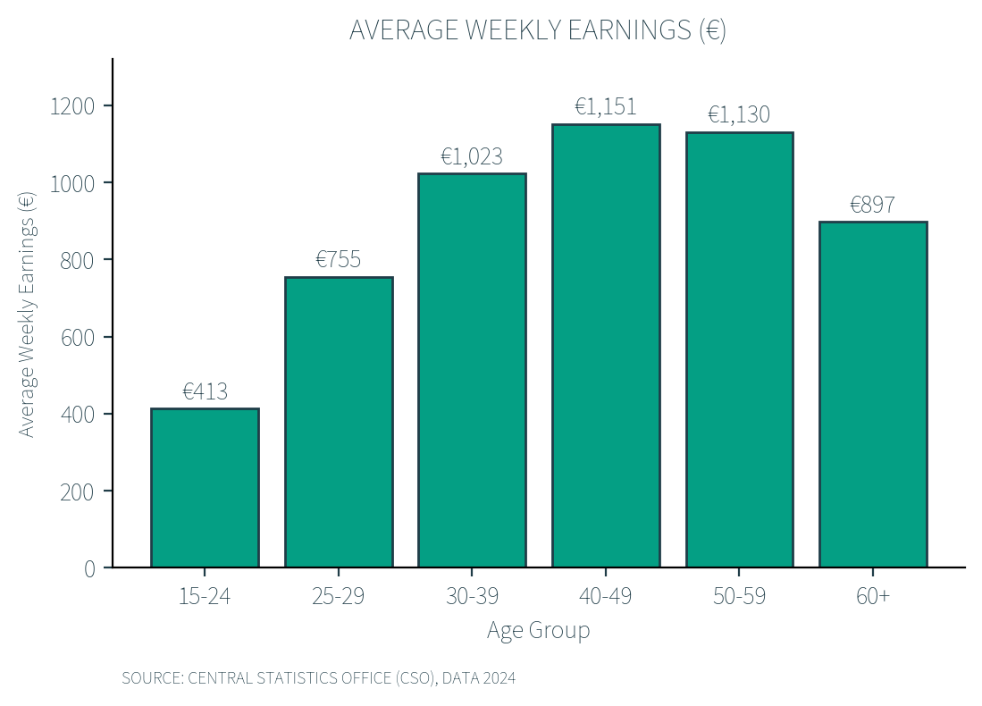
Introduction
A person's income will usually change as they move through different stages of life.
This graph shows the average weekly earnings for different age groups in Ireland in 2024.
It shows how the average income can rise and fall over the course of a person's life.

Slide 3
Introduction Activity
a) Which age group has the lowest weekly earnings?
b) Which age group has the highest weekly earnings?
c) How much does income change as people move from their 30s into their 40s?
d) Why might earnings be lower for younger people?
e) Why might income fall for those aged 60+?
f) Why might earnings increase with age?
g) Do you think everyone follows this pattern? Why or why not?
h) Do you think people's spending patterns follow a similar trend? Why or why not?

Slide 4
How Income and Expenditure Change
A Personal Financial Lifecycle shows how a person's income and expenditure are likely to change as they age.
It is based on an 'average' person's life and their varying needs and wants over a lifetime - the things you want now will not be the things you want at 40 or 60!
For example, a teenager usually doesn't need a mortgage, but an older person is much more likely to.

Slide 5
What Varies Over Your Lifetime
Level of income: usually increases with age, skills and experience. Sources of income change too: pocket money, then wages, then a pension.
Levels of expenditure: increase as you age. Buying a home and raising a family tend to be the most expensive times.
Decisions for the future: Lots of people go to college when they are younger to try to increase their future income with a course or degree. Mature students still go to college, but it is usually easier when younger, as people have fewer costs to pay.

Slide 6
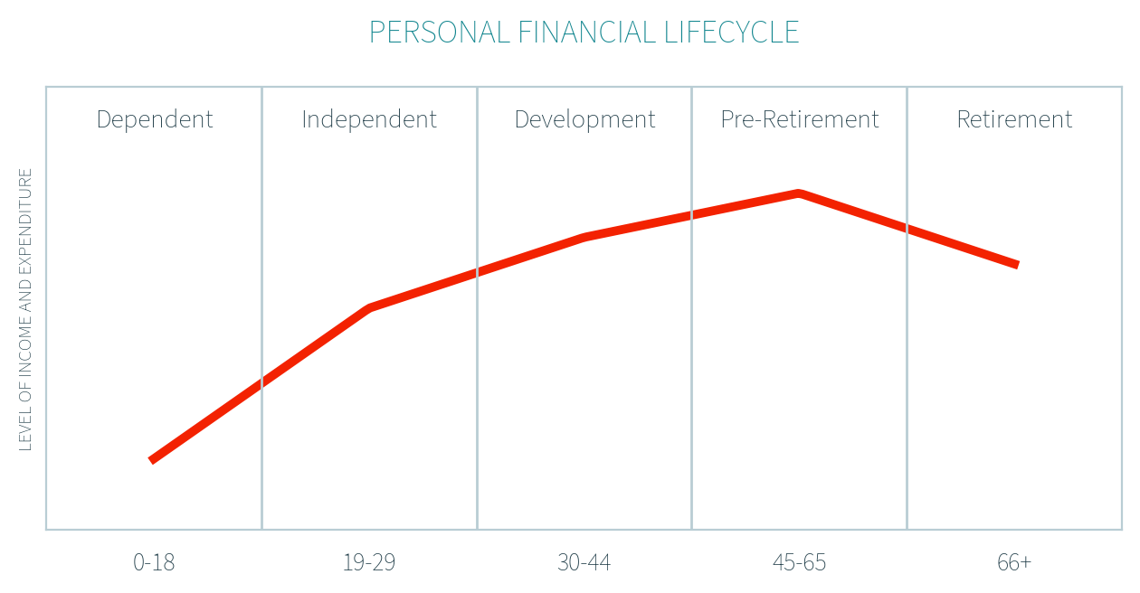
The 5 Stages of the Lifecycle
A person's needs and wants may vary depending on traditions, beliefs or cultures, so the age ranges below are just a guide.

Slide 7
1. Dependent Stage (up to age 18)
Reliant on family for financial support while in education.
Basic Needs
Potential Wants
Nutrition
Shelter
Basic clothing
Sweets, treats
Technology
Fashion (new clothing)
Entertainment (cinema, phone, TV, gaming)

Slide 8
2. Independent Stage (age 19-29)
You begin earning your own income and supporting yourself.
Basic Needs
Potential Wants
Mode of transport
Accommodation
Nutrition
Travel or holidays
Social life (meals, nights out)
Moving out (renting or buying a property/room)
Technology (laptop, devices)

Slide 9
3. Development Stage (age 30-44)
You take on major financial commitments such as housing and family costs.
Basic Needs
Potential Wants
A home
Support in raising children/childcare
Transport to work
Buying a house
Luxury items (new car, fashion)
Extracurricular activities for children
Family holidays

Slide 10
4. Pre-Retirement Stage (age 45-65)
You focus on saving and planning for retirement.
Basic Needs
Potential Wants
Transport to work
Maintaining a home
Nutrition
Travel or holidays
Home improvements
Comfort upgrades (car, furniture)
Leisure activities or hobbies

Slide 11
5. Retirement Stage (typically 66+)
You rely mainly on pension income after finishing full-time work.
Basic Needs
Potential Wants
Healthcare
A safe place to live (housing)
Nutrition (basic food)
Travel
Recreation and hobbies
Dining out

Slide 12
Stages and Ages Vary - Ireland is Changing
In 2004 the average age of a first-time mother was 28.5, compared to 31.7 in 2024.
In 2003 the median age of a first-time house buyer was 29 years old, compared to 35 in 2024 (+6 years).
In 2000, the average age of a male getting married was 30, now it is 37. A female was 28, now it is 36 (2024).
In 2002, 38.9% of young adults aged 25-34 had gone through third level education, which increased to 63.5% in 2024.

Slide 13

Workbook Q1 -> Q3

Slide 14
Sources of Income Over the Lifecycle
Dependent (under 18): income is usually limited and comes mainly from family support or small earnings while in school.
  Sources: Pocket money from parents or guardians, wages from part-time work.
Independent (19-29): income mainly comes from working, with some supports possible while studying or between jobs
  Sources: Wages or salary, SUSI Student Grant, Jobseeker's Allowance, allowance from family
Development (30-44): income is usually more stable as careers progress and households may have more than one income
  Sources: Wages or salary, bonuses, Child Benefit.

Slide 15
Sources of Income Over the Lifecycle
Pre-Retirement (45-65): Income is often at its highest, with continued earnings and possible income from savings or investments
  Sources: wages or salary, interest from savings, dividends from investments (eg owning shares in a company), rental income (eg renting out a room in their home).
Retirement (66+): Income usually comes from pensions and savings rather than employment
  Sources: State pension (government retirement payment), private pension (personal retirement fund), interest from savings, dividends from investments, rental income.

Slide 16

2025 Q16 (a) (ii)
There are a number of stages in a personal financial lifecycle. Each stage has different wants which are funded by different sources of income. Give an example for each of the following statements.
Statement | Example
A want for a dependent/reliant person: | Sweets, toys, holidays
Source of income for a retired person: | Pension, interest on savings, rental income
TOP TIP: Be specific when giving a need or want. If you were asked for a want for a dependent person and you wrote 'clothes' it would not score marks. You would need to write 'luxury clothing' or 'new clothes', as clothing is both a need and a want, so make sure to clearly show which type you are referring to.

Slide 17

Key Skill: Identify types of needs and wants at different stages in life
Stages: Dependent · Independent · Development · Pre-Retirement · Retirement
1) At what stage do you think people are most likely to have these needs/wants:
a. Buy a house b. Saving for retirement c. Higher healthcare costs d. Buy a first car
Key Skill: List different types of typical incomes earned across a person's lifetime
2) At what stage do you think people are most likely to have these sources of income:
a. Pension b. Part-time work c. Pocket money d. Child Benefit

Slide 18
3) Answer true or false for the following statements about the personal financial lifecycle, and then explain your answer:
a. You are most likely to have a mortgage in the dependent stage.
b. Childcare costs are likely to be the highest during the development stage.
c. Income is usually lower in the independent stage than in later stages.
d. A pension is the main source of income in the retirement stage.

Slide 19
Workbook Q4 -> Q6

