Slide 1
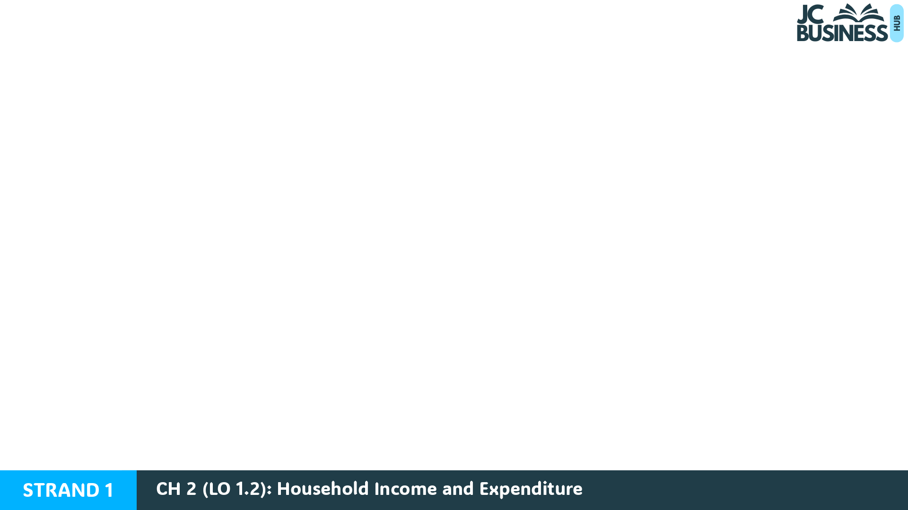
Household Income and Expenditure
Learning Outcome 1.2
Identify and classify sources of income and expenditure, compare options available to best manage financial resources, evaluating the risks associated with each option and making informed and responsible judgements.

Slide 2
Introduction Activity
The Murphy family live in Cork. John works as a mechanic and earns a monthly salary, while Sarah works part-time in a shop and is paid hourly wages. They have two children in school and a baby in a local crèche.
This month, the Murphy family spent money on groceries, petrol and their mortgage. They also spent €250 on a weekend away.
However, they have just realised they still need to pay their electricity bill and childcare costs, but they have run out of money.

Slide 3
Introduction Activity
After reading through the introduction, answer these questions:
Identify two expenses that are necessary for the Murphy family.
Identify one expense that is optional or non-essential.
List three expenses the Murphy family are likely to spend money on every month.
Why is it important for families like the Murphys to plan their future income and expenditure?
Suggest one action the Murphy family could take now to manage their situation.

Slide 4
Types of Household Income
Income is the money people and households receive that they can use to buy goods and services.
Individuals and households receive income in different ways, depending on their situation, whether they are working, studying, unemployed, or retired.
Income can also be grouped into regular and irregular income.

Slide 5
Regular and Irregular Income
Regular Income
Irregular Income
This is a fixed amount of money a person can expect to receive at regular times.
People can plan for this income.
This is money a person may or may not receive.
It can vary in amounts and in frequency of payments.
It is less predictable to plan for.

Slide 6
Income for a Student
Individuals that are studying in school or college on a full-time basis.
Their income may come from:
Part-time work (e.g. stacking shelves in a shop).
Pocket money from parents or guardians.
A grant to help with study, such as a SUSI grant.

Slide 7
Income for an Employed Person
Earns income by working for an employer (the self-employed pay themselves). Income may come from:
Wages: Income paid per hour. The more hours worked, the higher the wage.
Salary: A fixed yearly amount paid in equal instalments, eg paid monthly.
Commission: a percentage of the value of sales a salesperson earns.
Bonus: a one-off payment for reaching a target.
Wages and salary are regular income as they are a fixed amount due at regular times.
Commission and bonuses are irregular income as they can vary in amounts and when they are received.

Slide 8

Income for an Employed Person
The income received on the previous slide are monetary rewards, as they are all paid in cash to an employee.
An employee can also receive benefits-in-kind.
These are non-cash payments, eg free gym membership or use of a company car, given to them by their employer.

Slide 9
Income for An Unemployed Person
Someone who is not currently working and may receive income from the government to help support them:
Their income may come from:
Jobseeker's Allowance
Disability Allowance (if unemployment has arisen from this)
These payments may be used to help people who have little or no income.

Slide 10

Income for A Retired Person
Someone who has come to the end of their working life.
A pension would normally be their main source of income. In 2026, the State pension age in Ireland was 66.
Their income may come from:
A state (public) pension, paid by the government.
A private pension, that they have saved in to during their working life.

Slide 11
Other Sources of Income that anyone could have:
Regular Income:
Irregular Income:
Rental income received from owning a property or room that is rented out to someone.
Child Benefit is a state payment paid to parents for each child they have up to the age of 16 or their 19th birthday if in full-time education.
Interest received from a bank earned from a savings account.
Dividends from owning shares in a business.
Gifts or inheritance money gifted or inherited from family or friends.

Slide 12

2023 Q1 (ii)
List three typical sources of household income.
Wages/Salary/Overtime
Jobseeker's Allowance/Social Protection Payments
Child Benefit
Pension
TOP TIP: 'Wages/Salary/Overtime' are all ways to get paid as an employee, so only one of these would be accepted as a typical source of household income: don't write three different types of pay. The question also says 'typical', so a lotto win would not be allowed as it is not something a household would typically receive!

Slide 13
2025 Q6
Indicate with a tick (✔) in the table below which sources of income are regular and which are irregular.
Source of Income | Regular | Irregular
Basic Wage | ✔
Child Benefit | ✔
Bonus |  | ✔

Slide 14

Key Skill: Identify typical/non-typical or regular/irregular sources of income
Part A – Answer true or false for each statement below, and give a reason for your answer.
A person on a salary receives more income when they work longer hours one week.
A bonus is a regular source of income.
A person on a wage receives more income when they work longer hours one week.
A pension is a regular source of income.

Slide 15
Part B – (i) Match the typical source of income to the person from the options below.
(ii) Identify one more typical source of income for each person listed above.
Part C – Identify which sources of income are regular and which are irregular, from the list below:
(i) Commission (ii) Pension (iii) Salary (iv) Overtime
Person: | 1. Student | 2. Employed Person | 3. Unemployed Person | 4. Retired Person
Income: | A. Salary | B. State pension | C. SUSI grant | D. Jobseeker's Allowance

Slide 16

Workbook Q1 -> Q8

Slide 17
Types of Household Expenditure
A household should be aware of how much money it expects to earn and spend in the future. Planning helps prevent a household from running out of money and makes it easier to save.
When a household plans its future spending, it is helpful to group expenses into three categories: 1. fixed, 2. irregular and 3. discretionary.
Breaking spending into categories makes it easier to track where the money is going and to identify patterns in spending.

Slide 18

1. Fixed Expenditure
Spending that occurs at the same time for the same amount every week or month, that does not vary with use.
For example, a mortgage repayment is due on the same day each month for the same amount, regardless of if you use the house every day or if you are away on holidays.
Examples include:
House: Mortgage repayments, rent payments.
Loan repayments: Car loan repayments, home improvement loan.
Insurance: Insurance premiums for health, motor, or home cover.
Other: A TV licence, motor tax, property tax.

Slide 19

2. Irregular Expenditure
Spending that occurs at varied times and in varied amounts during a month depending on usage.
For example, the more you drive your car, the more you will need to spend on petrol.
Examples include:
Household costs: Groceries, bills (including light and heat, electricity or gas, mobile phones, etc.), essential clothing.
Car running costs: Petrol or diesel, car repairs or servicing, toll charges.
Education costs: School tours, school uniforms.

Slide 20

3. Discretionary Expenditure
Optional spending on non-essential items. A household can decide to spend on these things or not.
Examples include:
Entertainment: Cinema trips, movie channels, concerts, streaming services, eg Netflix.
Holidays: Hotels, flights, trips to the zoo or a theme park.
Gifts: Presents, celebratory meals.
Food: Restaurant bills, takeaway meals.
Luxury items: Upgrades such as a new car, phone or handbag.

Slide 21
Reducing Each Type of Expenditure
Fixed expenditure: Shop around for a better mortgage by switching to a different bank.
Irregular expenditure: Reduce usage: turn off lights when not using them, plan grocery shops to avoid waste, shop around for deals with service providers.
Discretionary expenditure: Cut spending on unnecessary luxury items like buying the latest iPhone, a new fashionable tracksuit or an extra holiday away.

Slide 22
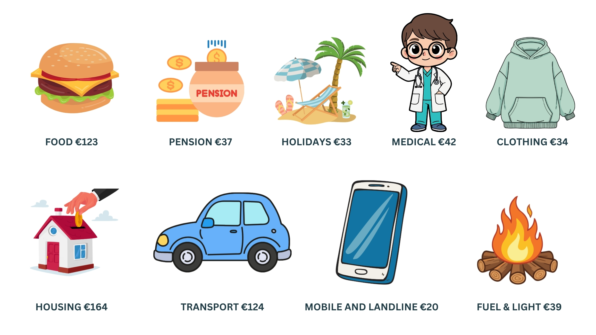
2019 Sample Paper Q1
Using the graphic above, identify one example each of fixed, irregular and discretionary expenditure.
Fixed: Housing, Pensions
Irregular: Food, Medical, Clothing/footwear, Transport, Fuel & light
Discretionary: Holidays

Slide 23
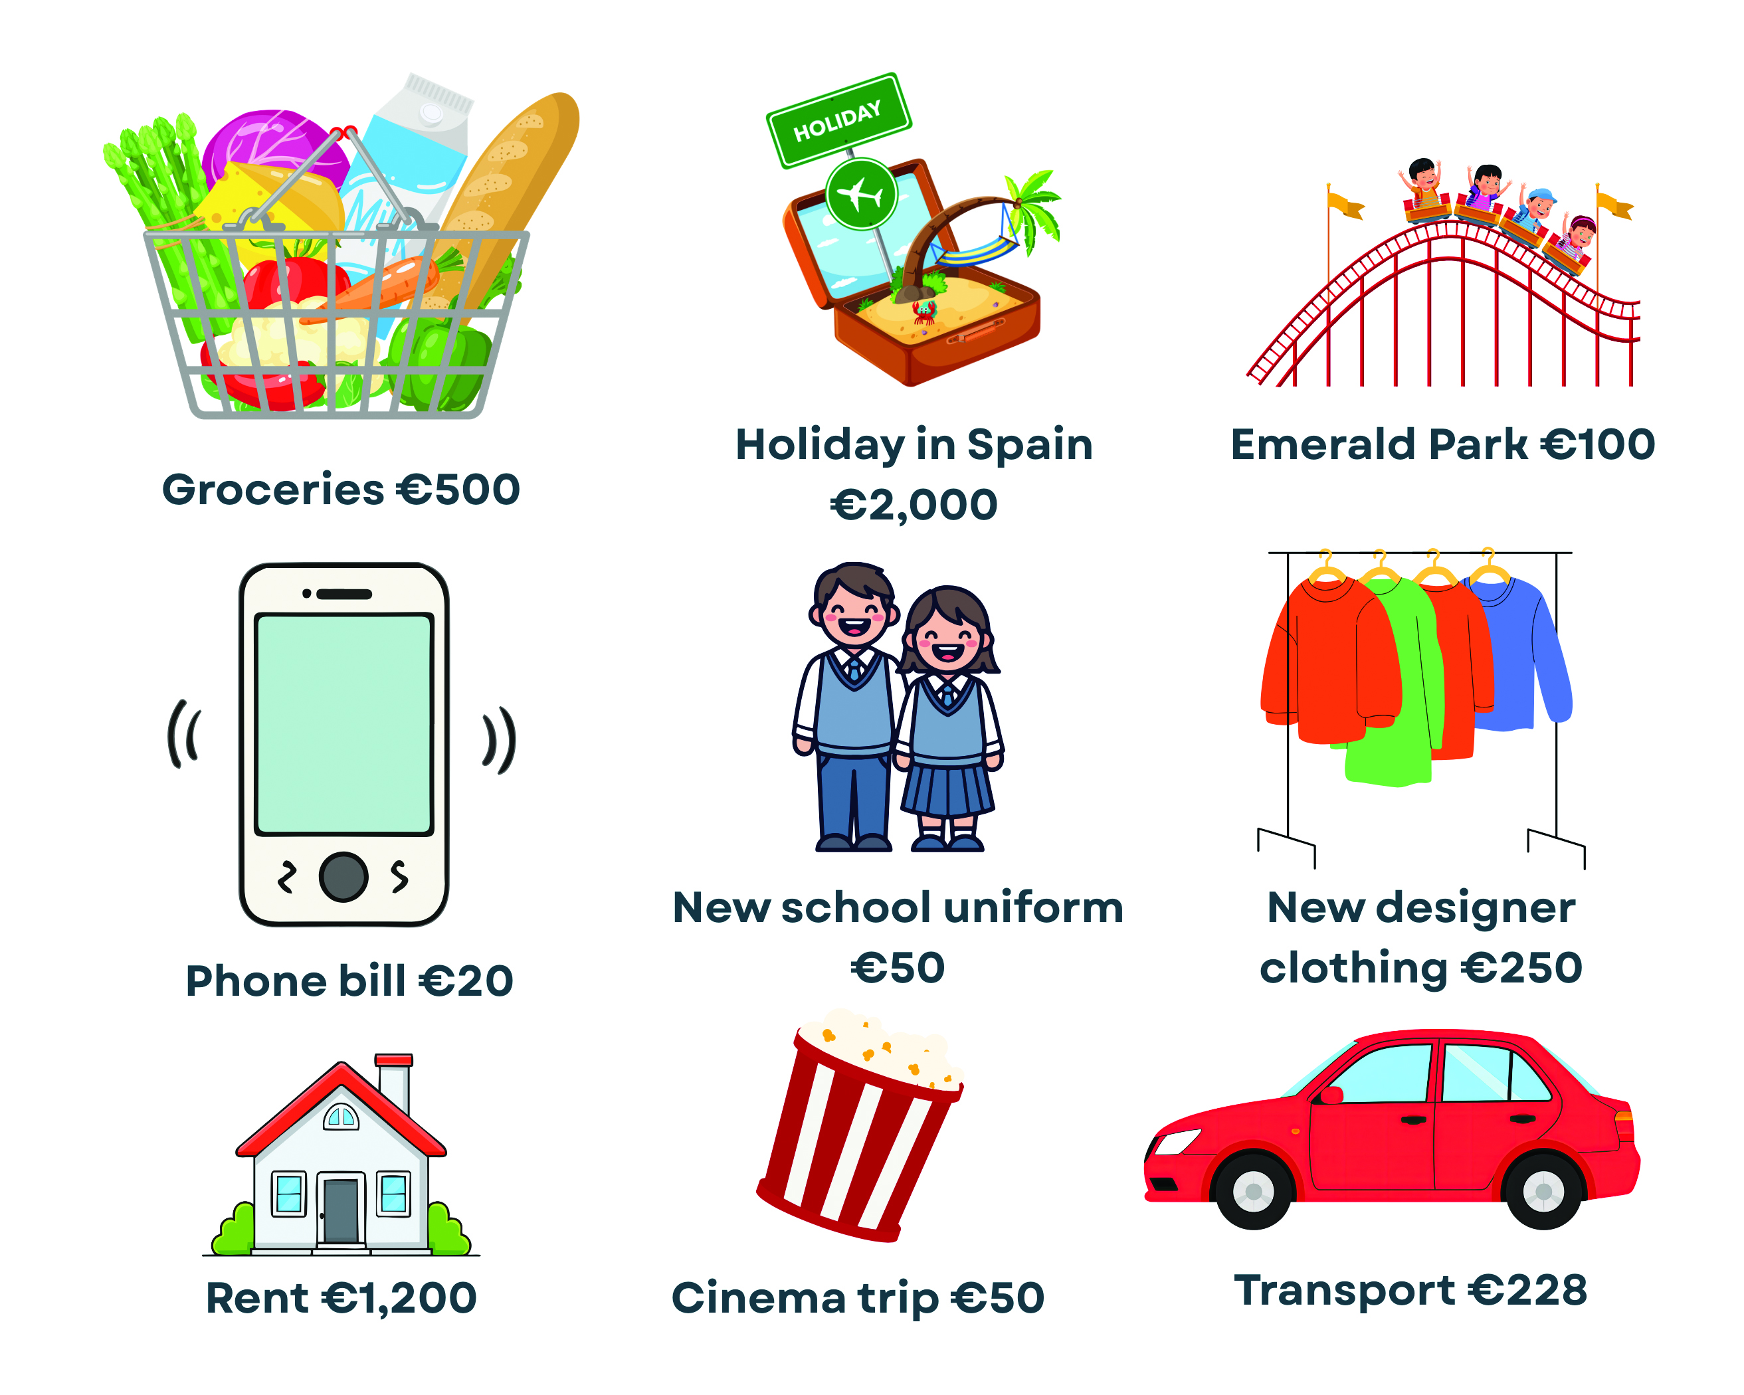
Key Skill: Identify examples of fixed, irregular and discretionary spending
The graphic shows the following spending for a household.
Identify two examples of fixed, irregular and discretionary expenditure from the graphic.
Identify one more example for each type of expenditure that a household might have that isn't in this graphic.

Slide 24
Workbook Q9 -> Q12

Slide 25
Risks Households Face
RISK: Overspending on day-to-day items. Small everyday purchases add up without a household realising it.
Reduce it: Create a simple financial plan, a budget, and stick to it. This cuts unplanned purchases such as impulse buying.
Impulse buying is when a consumer buys something they had not planned to buy, eg sweets while paying at the till.
RISK: Not enough for essential items. Too much spent on non-essentials leaves too little for food, electricity or transport.
Reduce it: Plan ahead and cut discretionary spending, like holidays or entertainment.

Slide 26
Risks Households Face
RISK: Falling into debt in the future. Uncontrolled spending may force a household to borrow later if income falls, creating financial stress and repayments that are hard to manage.
Reduce it: Avoid over-borrowing or taking out too many loans for upgraded items, eg a new car.
RISK: No savings for emergencies. Unexpected costs, eg car repairs or replacing appliances, put pressure on an unprepared household.
Reduce it: Set aside regular savings so funds are available for any emergencies.

Slide 27
Risk: Purchasing False Economies
A false economy occurs when a consumer buys a good or service because it appears cheaper, but it results in higher costs over time.
Option 1: Cheap schoolbag €20 – only lasts one school year before wear and tear means it must be replaced. Total cost over two years is €40.
Option 2: Standard schoolbag €30 – more durable, so lasts two years of use. The consumer pays €30 once, resulting in a lower overall spend.
How to reduce this risk: A household should consider the likely quality or durability of items and not just buy the cheapest option.

Slide 28
Key Skill: Identify risks a household faces with their income and expenditure
The Murphy household does not plan their spending. They often notice that they buy extra items while shopping that end up in the bin. They recently chose a cheap pair of football boots that had to be replaced after a few months. They have no savings, so when their washing machine broke down, they had to take out a loan to pay for repairs, so now have monthly repayments to make. They also booked a weekend away without checking their bank account and are now worried that they will not be able to pay their electricity bill when it is due.
a) Identify three financial risks the Murphy household is facing.
b) For each risk identified, outline one problem it could cause for the household.
c) For each risk, suggest one piece of advice that could help the household to manage its income and expenditure more effectively.

Slide 29
Workbook Q13 -> Q15

Slide 30
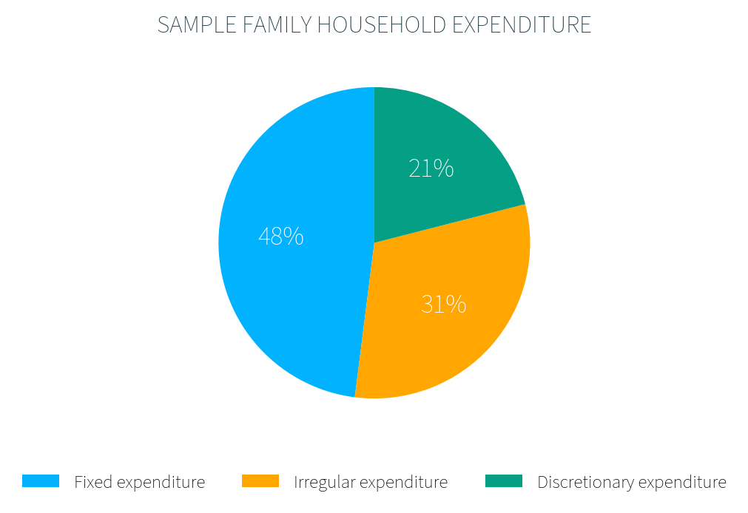
Tracking Expenditure: 1. Comparing Types
Banking apps make it much easier to see how and where money is being spent. Data shown as a pie chart or bar chart is easier to interpret.
In a pie chart, each slice represents the proportion of the total amount for each category.
Here, 48% of expenditure is fixed. If total expenditure is €3,000:
€3,000 × 48% = €1,440 spent on fixed expenditure.

Slide 31
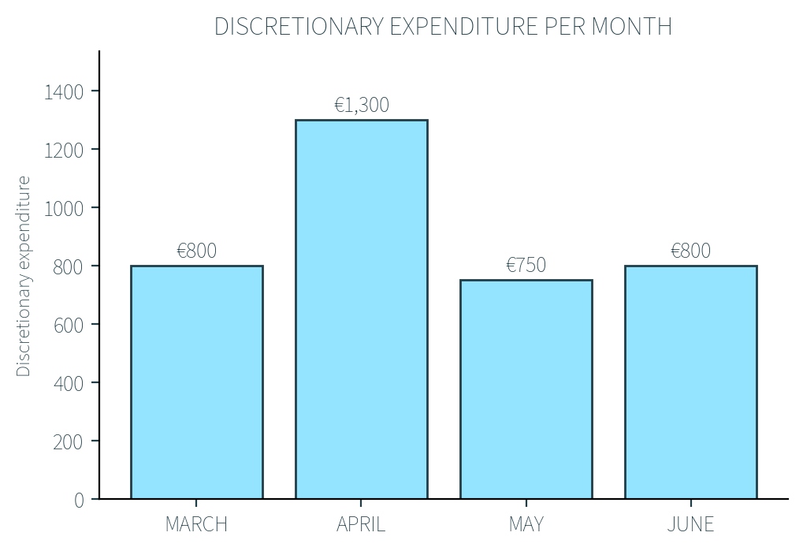
Tracking Expenditure: 2. Comparing Patterns
Comparing spending patterns over different time periods allows a household to spot where they may be overspending and adjust planned future spending when budgeting.
Here, discretionary expenditure in March, May, and June is very similar (€750–€800). Spending in April is €1,300, which is €500 higher than March.
If this was a one-off expense, such as a holiday, the household may try to spread the payments over a number of months rather than pay in one lump sum.

Slide 32
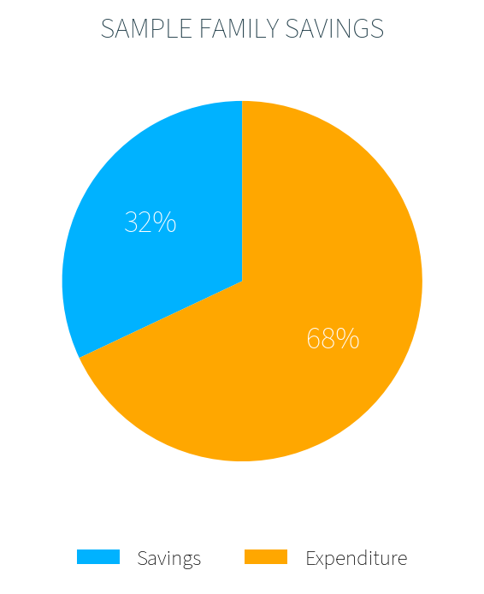
Tracking Expenditure: 3. Saving and Spending
A household can compare how much of its income it spends and how much it saves, to check it is setting aside enough for future or unexpected expenses.
Here, 32% of income is saved and 68% is spent. If total income is €3,000:
€3,000 × 32% = €960 saved.
€3,000 × 68% = €2,040 spent.
TOP TIP: When comparing patterns or trends in a graph, be sure to include the words 'increase' or 'decrease' in your answer, and reference how much difference there is between the two figures you are comparing, to get full marks.

Slide 33
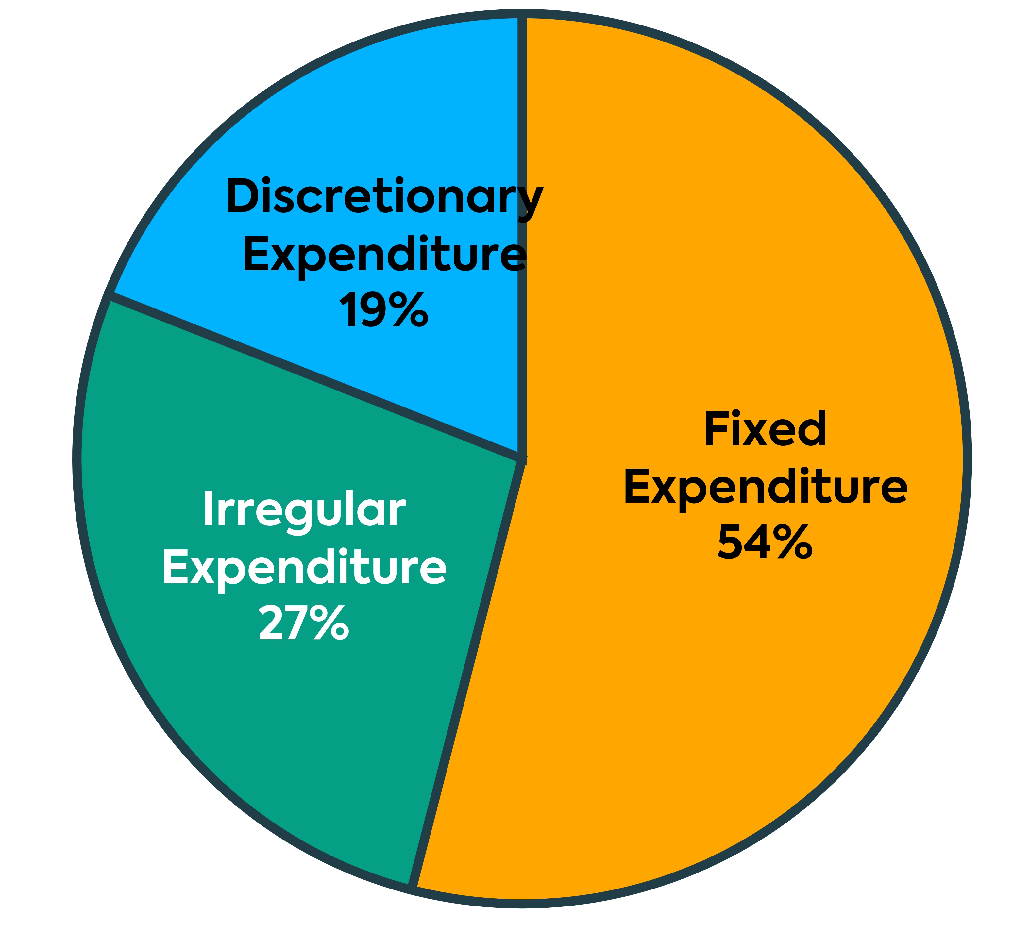
2022 Q1
The graph shows the Cotter family household expenditure.
(i) Which type of expenditure had the highest percentage of total expenditure in the Cotter household?
Fixed Expenditure
(ii) Give an example of each type of expenditure below.
Fixed: Mortgage/loan repayments, rent, property tax, car tax, TV licence, insurance premiums.
Irregular: Groceries, clothing, petrol, light and heat/electricity bill, telephone bill, car repairs, education costs.
Discretionary: Entertainment, holidays, gifts, TV subscriptions, restaurant bills, upgrades to expensive household electronics, takeaway meals, sports/movie channels.

Slide 34
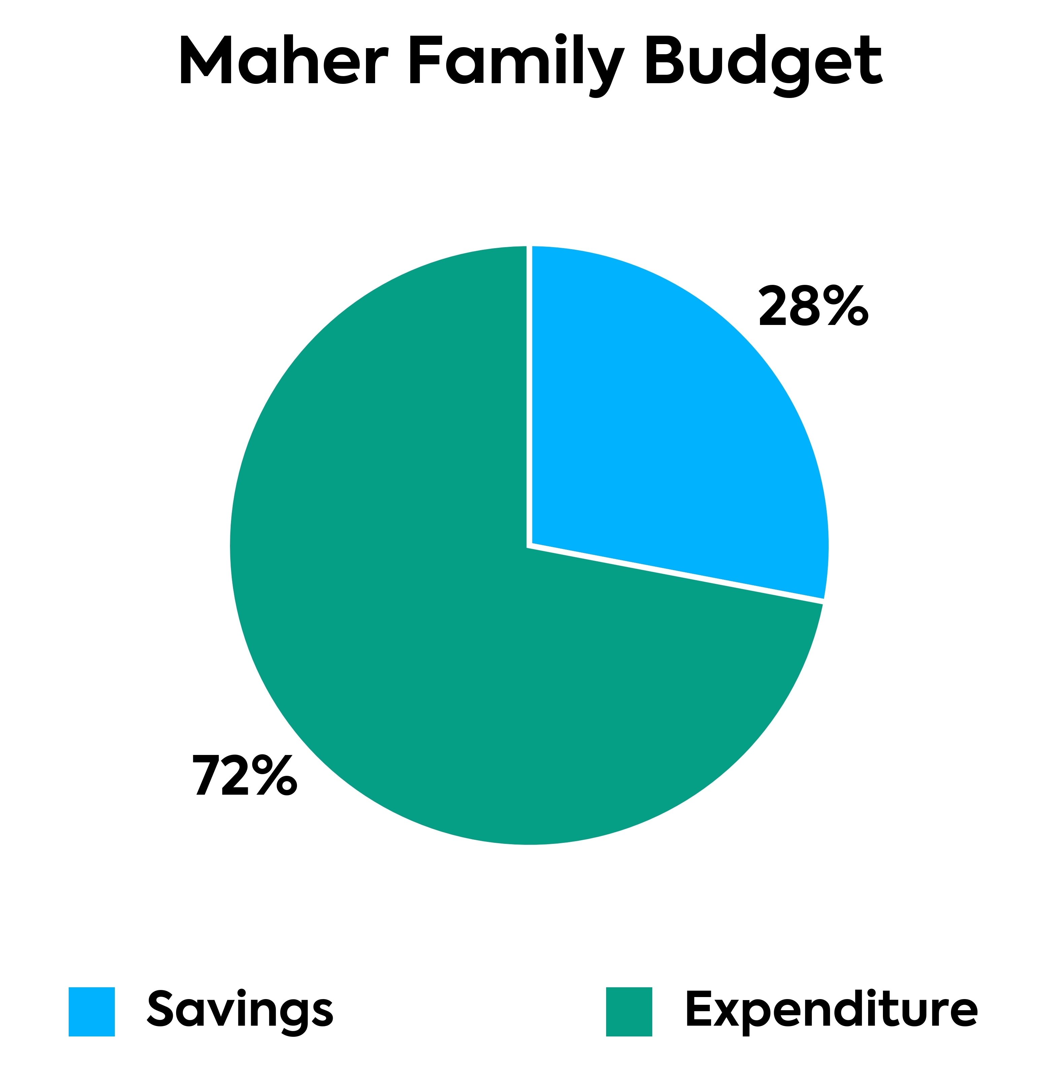
2023 Q1 (i)
The pie chart shows the expenditure and savings for the Maher family for the month of September.
If total income for the month of September is €5,400, calculate how much money the Maher family save.
Workings: 5,400 × .28 = €1,512
Answer: €1,512
TOP TIP: Income is either saved or spent. The pie represents the total income.
If total income is €5,400 then you multiply that figure by the percentage of savings or expenditure to calculate how much each percentage is in Euro.

Slide 35
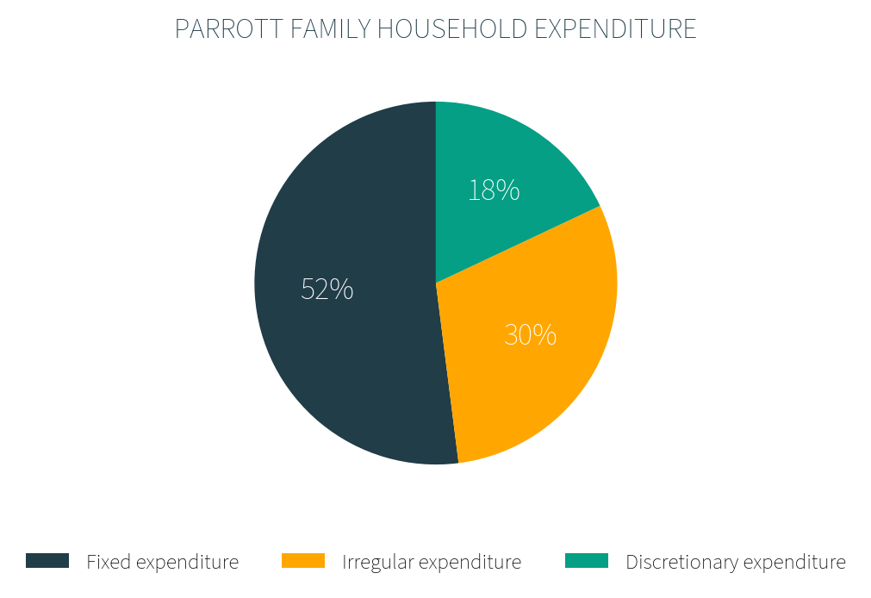
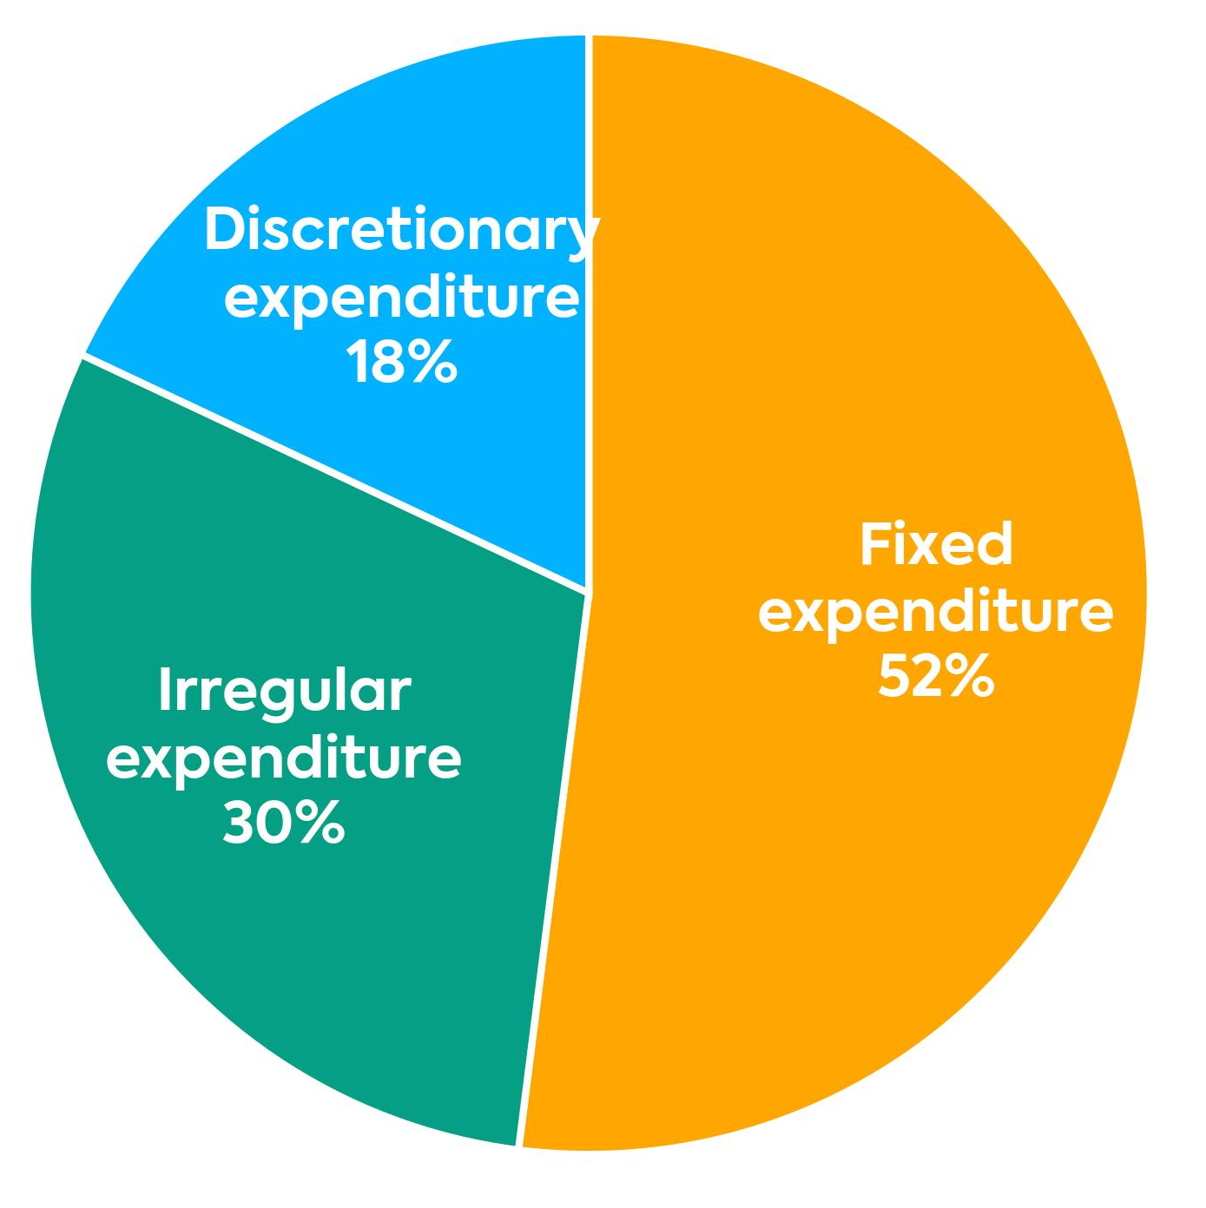
Key Skill: Interpret income and expenditure data from graphs
Part A – Use the Parrott Family chart to answer:
a) Which type of expenditure had the lowest percentage of total expenditure?
b) Give two examples of what the family might spend money on for each type of expenditure.
c) If total household expenditure is €2,000, calculate how much is spent on irregular expenditure.

Slide 36
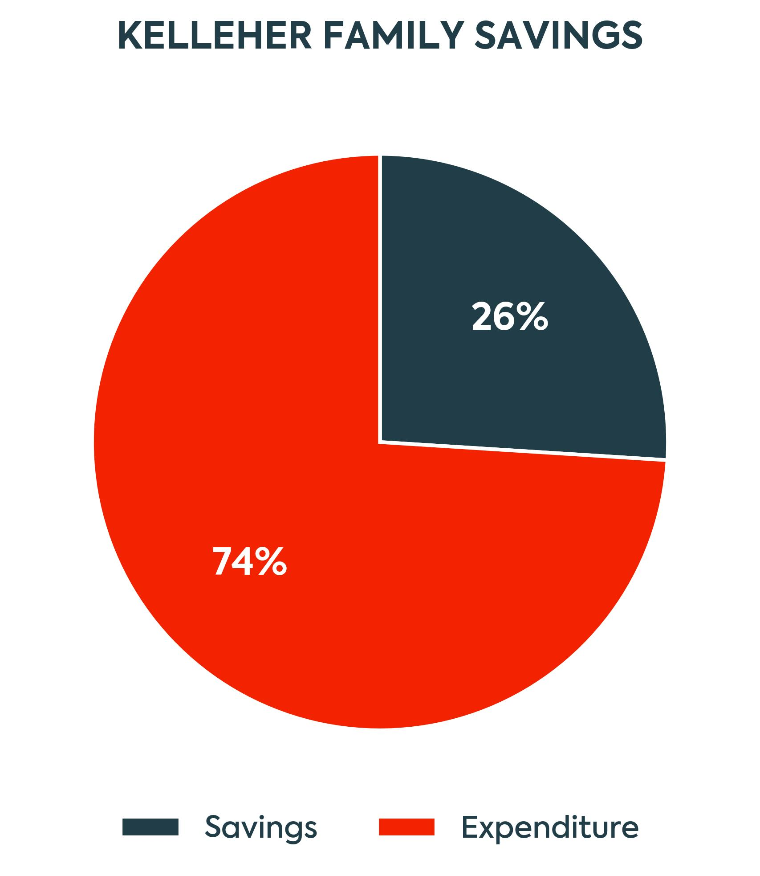
Part B – Use the Kelleher Family Savings chart to answer:
a) Identify which is larger, savings or expenditure.
b) State the percentage of income that is saved.
c) If total household income is €2,500, calculate how much is saved. Show your workings.
d) Suggest one reason why a household might want to increase the percentage it saves.

Slide 37
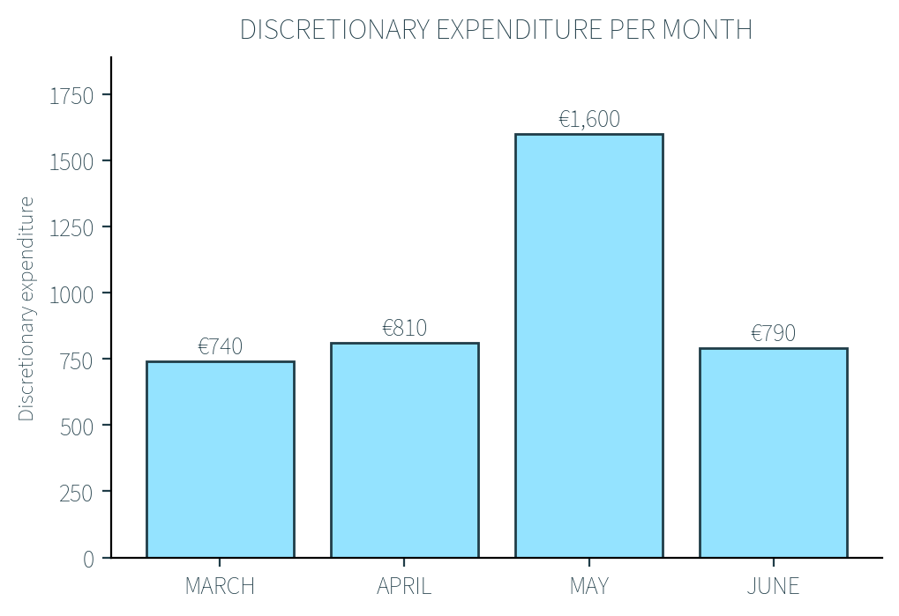
Part C – Use the Discretionary Expenditure per Month chart to answer:
a) State how much was spent on discretionary expenditure in June.
b) Identify the month with the highest discretionary expenditure.
c) Is the change in spending from March to April a positive or negative trend?
d) Suggest one possible reason why spending might have increased in May compared to other months.

Slide 38
Workbook Q16 -> Q20

