Slide 1

Reviewing Your Personal Resources
Learning Outcome 1.1
Review the personal resources available to them to realise their needs and wants and analyse the extent to which realising their needs and wants may impact on individuals and society.

Slide 2
Introduction Activity
Jamie is 13 and wants to start a small online business selling phone accessories.
Jamie doesn't have everything he needs, but he does have some useful resources:
Jamie's older brother is doing a computer course in college and helped build a simple website.
Jamie saved money from the last three birthdays to buy some stock.
Jamie has a phone and internet access to take photos and answer messages.
Jamie's parents agreed to help with posting orders.
Jamie can only work on the business in the evenings and at weekends.
Jamie would like to spend more money on advertising, but that would mean not buying extra stock. Jamie has to make a choice about how to spend his money.

Slide 3
Introduction Activity
Part 1 – Using your resources – a resource is something that can help you achieve a goal.
Identify three different types of resources Jamie has.
What do you think Jamie is most limited by if he wanted to grow the business?
What resources is someone your age most limited by if they wanted to:
  (a) Start their own online business
  (b) Study something they are interested in
  (c) Become a professional sportsperson

Slide 4
Introduction Activity
Part 2 – Facing a choice
Think about a decision you make sometimes, such as ordering a takeaway.
What factors influence your choice when deciding which decisions to do and which to avoid doing?
Why wouldn't everyone make the same decision as you?

Slide 5
Your Personal Resources
A resource is something a person can use to achieve a goal.
Everyone has access to different resources. These resources affect what we can do and what choices we can make.

Slide 6
Types of Resources
Resource | Explanation | Example
Financial resources | Money you have earned (income), saved, or received. | Pocket money, wages from a part-time job, gifts.
Personal resources | Skills and abilities you have. | Being good at technology, music, sport, or art.
Physical resources | Items you own that help you do things. | A bicycle, a phone, a laptop with internet access.
Human resources | People who can help or support you. | Parents, teachers, friends, coaches, people in your community.
Time | The amount of free time you have. | The amount of time you have available will limit what you are able to do.

Slide 7
Our Resources Are Scarce
Scarcity means our resources are limited – there are not enough resources available for everyone to have, or do, everything they want.
For example:
You may want to go on holidays to Spain and America, but not have enough financial resources.
You may want to learn basketball, but not have the human resources available, such as a coach in your area.
Because resources are scarce, choices must be made.

Slide 8
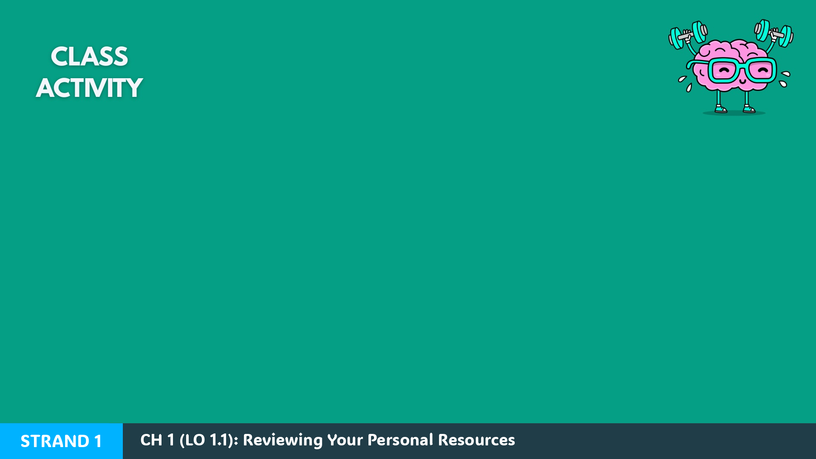
Key Skill: Review Your Own Resources
Identify and list your own personal resources under the headings below:
  Financial resources, skills and abilities, physical resources, human resources, time.
Identify how you could use one or two of your resources to:
  (a) earn money now, or (b) earn money in the future.

Slide 9

Workbook Q1 -> Q4

Slide 10
A Need Versus A Want
People use their resources to meet their needs and wants. Understanding the difference helps us make better choices.
A need is something we require for survival.
A want is something we would like to have, but do not need to survive.
Our needs and wants change at different stages of life, but everyone has both.

Slide 11
A Need Versus A Want – Examples
Needs
Wants
FOOD
We need food to grow and have energy.
HOUSING
We need shelter and a safe place to live.
EDUCATION
We need to learn basic skills and knowledge.
CLOTHING
We need basic clothing to stay warm and protected.
FOOD
We want tasty food like a burger and chips.
HOUSING
We might want to live in a mansion.
EDUCATION
We might want to study a specific career, such as medicine.
CLOTHING
We might want the latest fashion or expensive brands.

Slide 12

2019 Q15
The following items were identified as the main areas of expenditure for Irish consumers in 2018. Classify each item of expenditure as a need or a want.
Item of Expenditure | Need / Want
Food | Need
Holidays | Want
Clothing and Footwear | Need / Want
Answer Explainer:
We need food to survive/function.
We don't need to travel or take holidays.
We need basic clothing, but want branded/fashionable clothing.
TOP TIP: Expect a future question like this to reference a type of clothing e.g. designer/luxury clothing – so that you will have to identify it as a want and not a need.

Slide 13
Key Skill: Identify needs and wants
Work through the list below and try to identify if they are a want or a need:
  A chocolate bar
  A jacket in winter
  A trip to New York
  Medicine
  A car
In groups, choose five goods or services that you think are either needs or wants for you and your classmates. Create a list and test another group to see if they can guess the answers correctly.

Slide 14
Workbook Q5 -> Q7

Slide 15
Making Decisions: Needs and Wants
Scarcity means there are not enough resources for everyone to have or do everything they want.
Because of this, choices must be made by:
individuals
businesses
governments
These choices are about how best to use the limited time, money, and resources available.

Slide 16
Financial Cost and Opportunity Cost
When a consumer has a choice to make, there is usually both a financial cost and an opportunity cost of making their decision.
The financial cost of a decision is how much you spend to make the decision.
The opportunity cost is the item you miss out on by choosing something else.

Slide 17
Mary's Choice – Two Options
Mary is planning how to spend her pocket money with her friends this Friday:
OPTION 1
Go to the cinema for €10
OPTION 2
Buy a meal in a restaurant for €10
If they choose the cinema:
The financial cost is €10.
The opportunity cost is the meal they did not buy.
If they choose the meal:
The financial cost is €10.
The opportunity cost is going to the cinema.

Slide 18
Opportunity Cost
The opportunity cost of any decision is the item or choice you go without because you choose something else.
A household: If a person chooses to study full-time to become a teacher, they cannot study to become a nurse at the same time.
A business: If a business chooses to advertise online, it cannot use the same money to advertise on TV or in newspapers.
The government: If the government chooses to build more social housing, it cannot use the same money to build more schools.
TOP TIP: Always include an example to help explain the term opportunity cost.

Slide 19
2023 Q16 (a) (ii)
Martin would like to go on holiday with his friends at the end of the summer. He is also interested in buying a laptop which would be useful when he goes to college in September. His two options are shown below:
Option 1 | Option 2
Holiday in Spain €450 | Laptop €450
Martin has decided to go ahead and purchase the laptop.
Identify the financial cost and the opportunity cost of Martin's choice:
Financial Cost: €450 3m
Opportunity Cost: The holiday in Spain they miss out on 3m
TOP TIP: Leaving out the € sign from the financial cost would lose marks in the exam.

Slide 20
Key Skill: Distinguish between the financial cost and the opportunity cost of making a decision
Thomas would like to reduce his environmental impact as a consumer. He was considering buying a used electric vehicle and he is also interested in getting solar panels installed on his house. He has €20,000 to spend. His two options are shown below:
Option 1: Electric Vehicle (EV) €20,000 Option 2: Solar Panels €20,000
Thomas has decided to install solar panels on his house.
Identify the financial cost and the opportunity cost of Thomas’ choice, and explain your reasons for both.

Slide 21
Workbook Q8 -> Q12

Slide 22
Positive Impacts of Your Consumer Choices
Every time a consumer buys a good or service, they are influencing what is produced. Our choices can have positive or negative impacts on others and on society.
Fairtrade: Buying Fairtrade products helps ensure workers and farmers are paid fairly and are not exploited.
Shopping locally: Buying Irish goods and services helps support local businesses and jobs in Ireland.
Paying tax: When we buy goods and services, tax (such as VAT) is included in the price. This tax helps pay for services like schools, hospitals, and roads.
Second-hand and re-using goods: Buying second-hand items or re-using goods instead of buying new helps conserve resources and reduces environmental damage.

Slide 23
Negative Impacts of Your Consumer Choices
Pollution and waste: Buying cheap or disposable goods can increase waste and pollution.
Fast fashion: Buying cheap clothes that do not last and are quickly thrown away adds to environmental damage.
Worker exploitation: Some goods are produced using child labour or poor working conditions. Cheaper prices can sometimes mean workers are treated unfairly.
Transport and the environment: Imported goods often travel long distances. Transporting goods across the world increases fuel use and pollution.
Buying counterfeit goods: Buying fake or illegal goods (such as counterfeit jerseys or dodgy boxes) avoids tax payments and harms legitimate businesses.

Slide 24
Key Skill: Understand how realising your needs will impact on individuals and society
In your groups, identify three goods you or your family buy that have positive impacts, and three goods that may have negative impacts on others or society.

Slide 25
Workbook Q13 -> Q16

