Slide 1
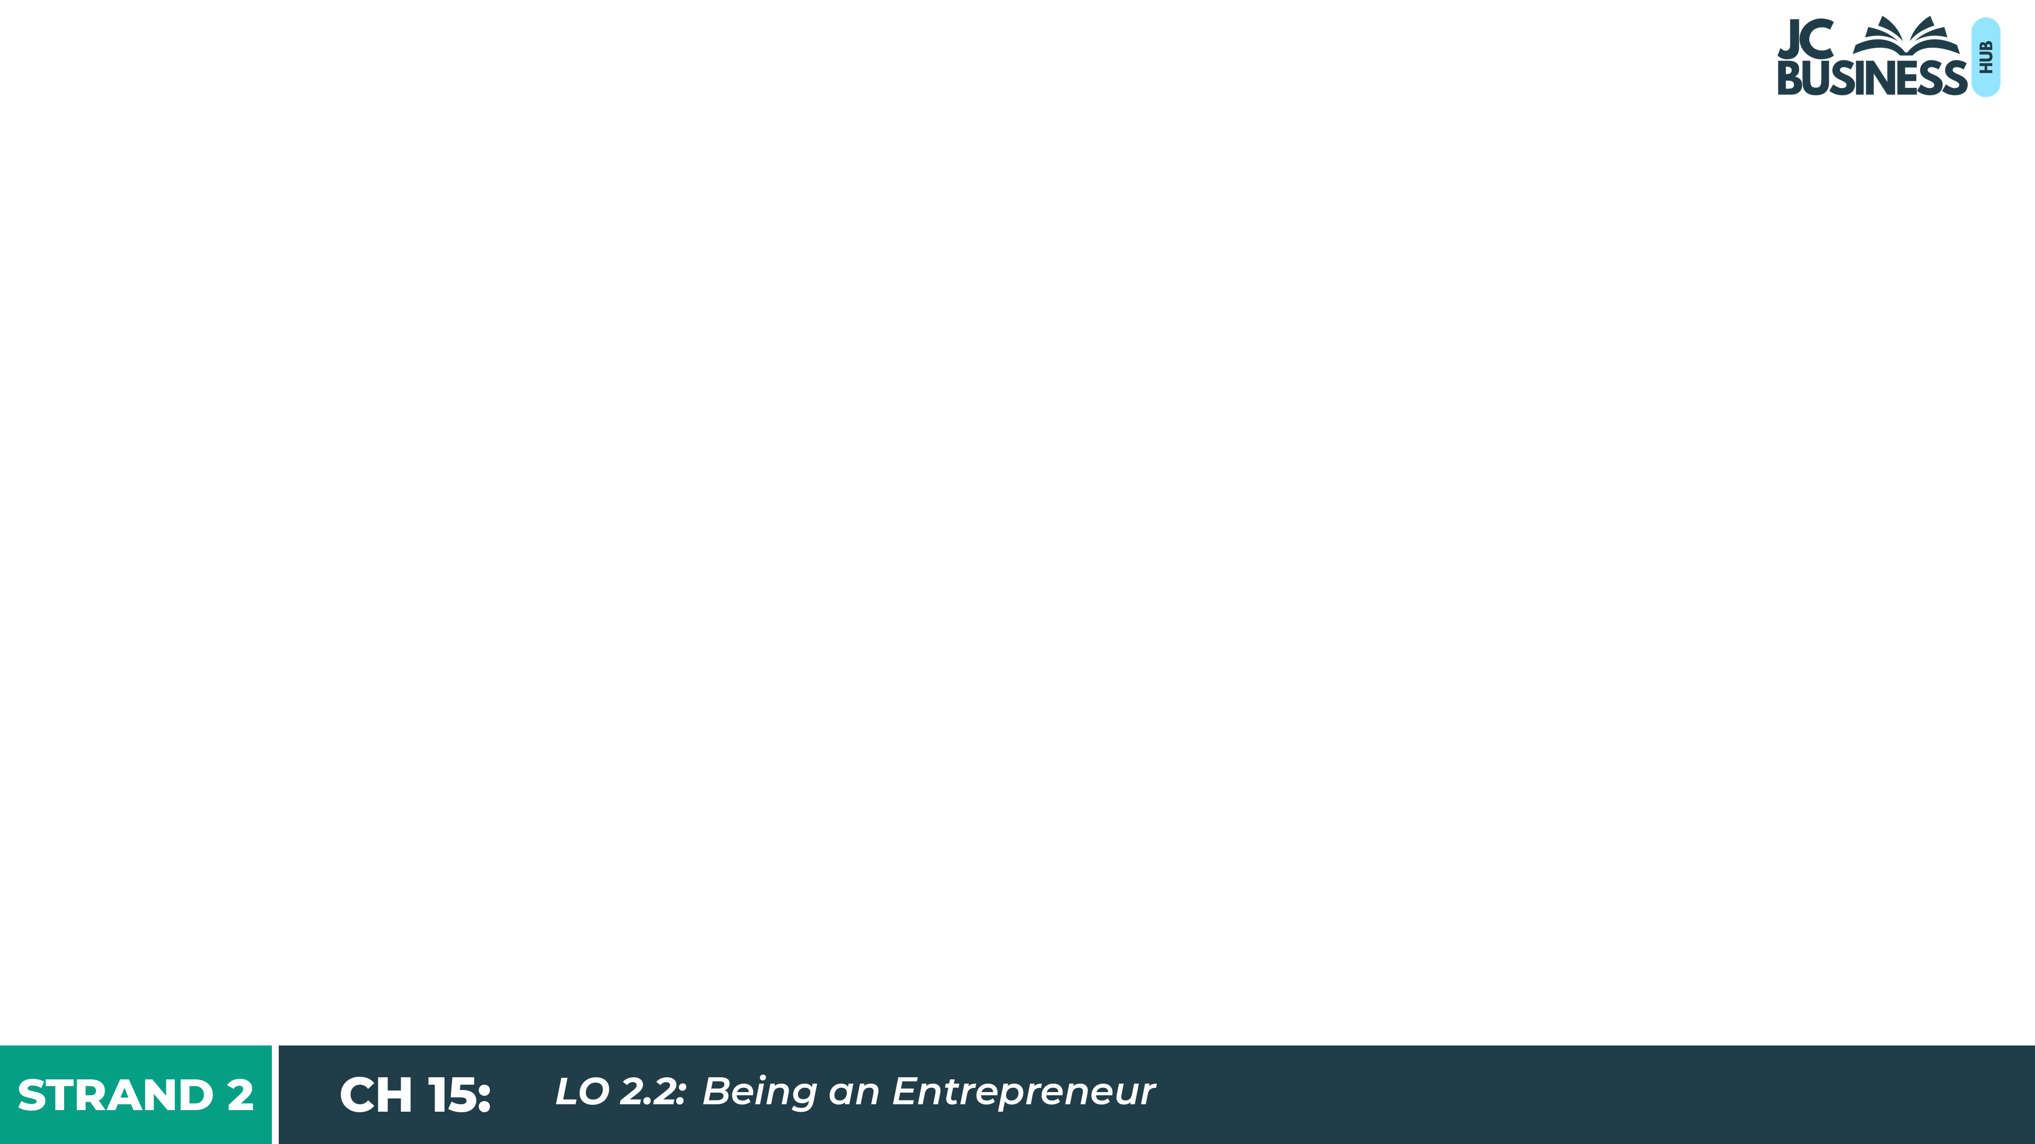
Being an Entrepreneur
Learning Outcome 2.2
Describe the skills and characteristics of being enterprising and appreciate the role of an entrepreneur in an organisation, in society and to the economy.

Slide 2
Introduction
Around 50,000 new businesses start up in Ireland every year. Most begin with one person, an idea and a decision to take a risk.
Around one in five do not survive their first year. For many, the risk is still worth taking.
Steve Crosbie: spotted a gap for outdoor saunas and built Fad Saoil Saunas.
Aimee Connolly: saved €10,000 and launched Sculpted by Aimee with no outside investment.
Why take the leap? Freedom to build something of their own, jobs created, an idea made real.

Slide 3

Introduction Activity: Answer true or false for the following statements.
You need a business degree to start a successful business.
Most entrepreneurs are motivated mainly by profit.
The most successful entrepreneurs never fail.
An entrepreneur and a manager are the same thing in a business.
You always need to raise investment to fund a new business.

Slide 4
What Is an Entrepreneur?
An entrepreneur is a person who uses their initiative to set up a business after spotting a gap in the market, taking on personal and financial risk in the hope of making a profit.

Slide 5
Skills and Characteristics of an Entrepreneur
Use Their Initiative: proactive. They see an opportunity and move on it, without waiting for someone else to act.
Eg Hannah Joyce built the Flexera website before the first Pilates machine was even made.
Innovative/Creative: they spot a gap in the market others have missed, and come up with something new or a better way of doing something.
Eg Eoin Cluskey spotted a gap for an artisan bakery and built Bread 41 from scratch.
Risk Takers: they put their own money, time and reputation on the line with no guarantee of success.
Eg Rosie Connolly and Paul Quinn invested their own money in 4th ARQ with no certainty it would work.

Slide 6
Skills and Characteristics of an Entrepreneur
Networking: good people skills, building strong relationships with staff, customers and investors.
Adaptable: flexible to change as the environment they work in changes.
Decisive: makes clear decisions quickly, especially under pressure.
Resilient: overcomes setbacks and keeps going when things get difficult.
Ambitious: a drive to succeed, willing to aim high and put in the work.

Slide 7

2023 Q4
Ed O’Donnell is an entrepreneur from Tipperary. Since 2007 he makes crisps from potatoes grown on his farm.
Explain the term entrepreneur.
A person who takes the initiative (2m), spots a gap in the market (2m) and takes on the personal and financial risk (2m) of setting up a business, in the hope of making a profit.
For example, Eoin Cluskey spotted a gap and took the risk to set up Bread 41 in Dublin.
TOP TIP: Three main parts should be included: use initiative, spot a gap in the market, take on personal and financial risk. Add a named example to help.

Slide 8
Key Skill: Identify the skills/characteristics of an entrepreneur.
Niall Harty and Ross McDowell built All Real Nutrition from a home kitchen in Kerry. Which skill does each of the following best demonstrate? Give a reason for each answer.
Niall left a secure engineering career to make protein bars with no experience in food production.
Niall went through between 500 and 600 recipe attempts before getting the bar right.
On his first day Niall had no roadmap or support available, but figured out a plan of action and got to work.
Niall and Ross built relationships with retailers like SuperValu and Centra and grew a loyal customer base of online customers.
From a kitchen in Kerry, Niall and Ross set a goal of becoming the number one natural protein bar brand in Europe and made every decision with that target in mind.

Slide 9

Workbook Q1 → Q3

Slide 10
Being Enterprising In Everyday Life
Being enterprising is a way of thinking anyone can use: spot an opportunity, use your initiative, take a risk and turn an idea into action.
Personal Life (Aoife): gets fit with free online workouts and a weekly plan. Initiative + Resilient.
In School (Daniel): proposes a better recycling system and organises a team to run it. Innovative + Networking.
In The Community (Anna): organises friends to do the shopping for older neighbours each Saturday. Creative + Decisive.
The same skills entrepreneurs use to build a business.

Slide 11
Key Skill: Identify enterprising skills in everyday life.
A) Sadhbh wants to improve her grades before the Junior Cycle. She made a study plan, booked the library three days a week and asked her older brother to test her each week. After a poor result in her first maths test, she changed her plan and gave more time to her weakest topics. Which skill/characteristic does each of the following show? Give a reason for each answer.
Sadhbh made a study plan and booked the library three days a week.
Sadhbh asked her older brother to test her each week.
After a poor result, Sadhbh kept going and changed her plan.
Sadhbh gave more time to her weakest topics.
B) Identify one other area in your life where you have been, or could be enterprising, and come up with three enterprising skills/characteristics that would be useful for it.

Slide 12
Workbook Q4

Slide 13
Benefits of Being an Entrepreneur
Personal
Being your own boss: follow a dream, no manager to answer to, control over your own time and decisions.
Financial
Earning profits: income comes from the profits of the business rather than a fixed wage, allowing for expansion.
Societal
Making a difference: do good locally, offer something more ethical or sustainable, to solve a problem nobody else is addressing, improving their sense of achievement/well being.

Slide 14
2026 Q17 (a) (i) & (ii)
Tony Donnelly, an entrepreneur, spotted a gap in his local area for a hardware outlet to provide premium quality supplies to local building contractors and members of the public. In 2023 he set up his own company called Donnelly Ltd.
(i) State two skills/characteristics of an entrepreneur.
(ii) Outline two benefits of being an entrepreneur.
(i) Risk taker: an entrepreneur takes on the personal and financial risk that the business might fail.
Uses initiative: an entrepreneur is proactive and acts on an opportunity instead of waiting.
(ii) You get to be your own boss... so you have control over your own time and decisions.
The chance to earn higher profits... as the entrepreneur’s income can increase allowing them to invest and expand their business.
TOP TIP: State needs less development than outline. For the outline parts, give two prongs: the benefit, then what it lets the entrepreneur do.

Slide 15
Risks and Challenges of Starting a Business
Financial Loss
An entrepreneur may invest their own savings and if the business fails, that money is gone.
Long Working Hours
In the early stages, an entrepreneur often works far longer hours than an employee would and it can be harder to switch off from work.
Uncertain Income
Unlike a wage, income from a business is not guaranteed. A bad month can mean little or no pay, making it harder to pay bills or get a mortgage.
Difficulty Accessing Funding
Banks and investors can be cautious lending to new businesses, so securing a loan or investment may prevent an entrepreneur from growing.

Slide 16
Workbook Q5 → Q6

Slide 17
Entrepreneur vs Manager in a Business
ENTREPRENEUR
MANAGER
Role in the business
Sets up the business and drives it forward with a clear vision for where it is going.
Organises the people and resources needed to keep the business running day to day.
Idea Generation
Always looking for new ways to do things and open to change.
Focuses on making the current plan work and keeping things stable.
Risk taking
Willing to try new things even if they might not work out.
Aims to minimise uncertainty and keep the business running consistently.
Impact on employees
Shares their vision and passion for the business to inspire staff.
Gives staff clear roles and checks that the work is getting done.

Slide 18
The Impact Of Entrepreneurs
In an organisation
Sets the vision, makes the big decisions and drives the business forward, especially in the early days.
On society
Creates products and services that improve people’s lives; supports communities through jobs, sponsorship and initiatives.
On the economy
Pays tax such as Corporation Tax and VAT (employees pay PAYE), funding public services. Drives innovation and inspires others to start up.

Slide 19
Workbook Q7 → Q10

