Slide 1

Financial, Cultural and Social Enterprise
Learning Outcome 2.1
Identify different types of financial, cultural and social enterprise and appreciate the role each plays in society.

Slide 2
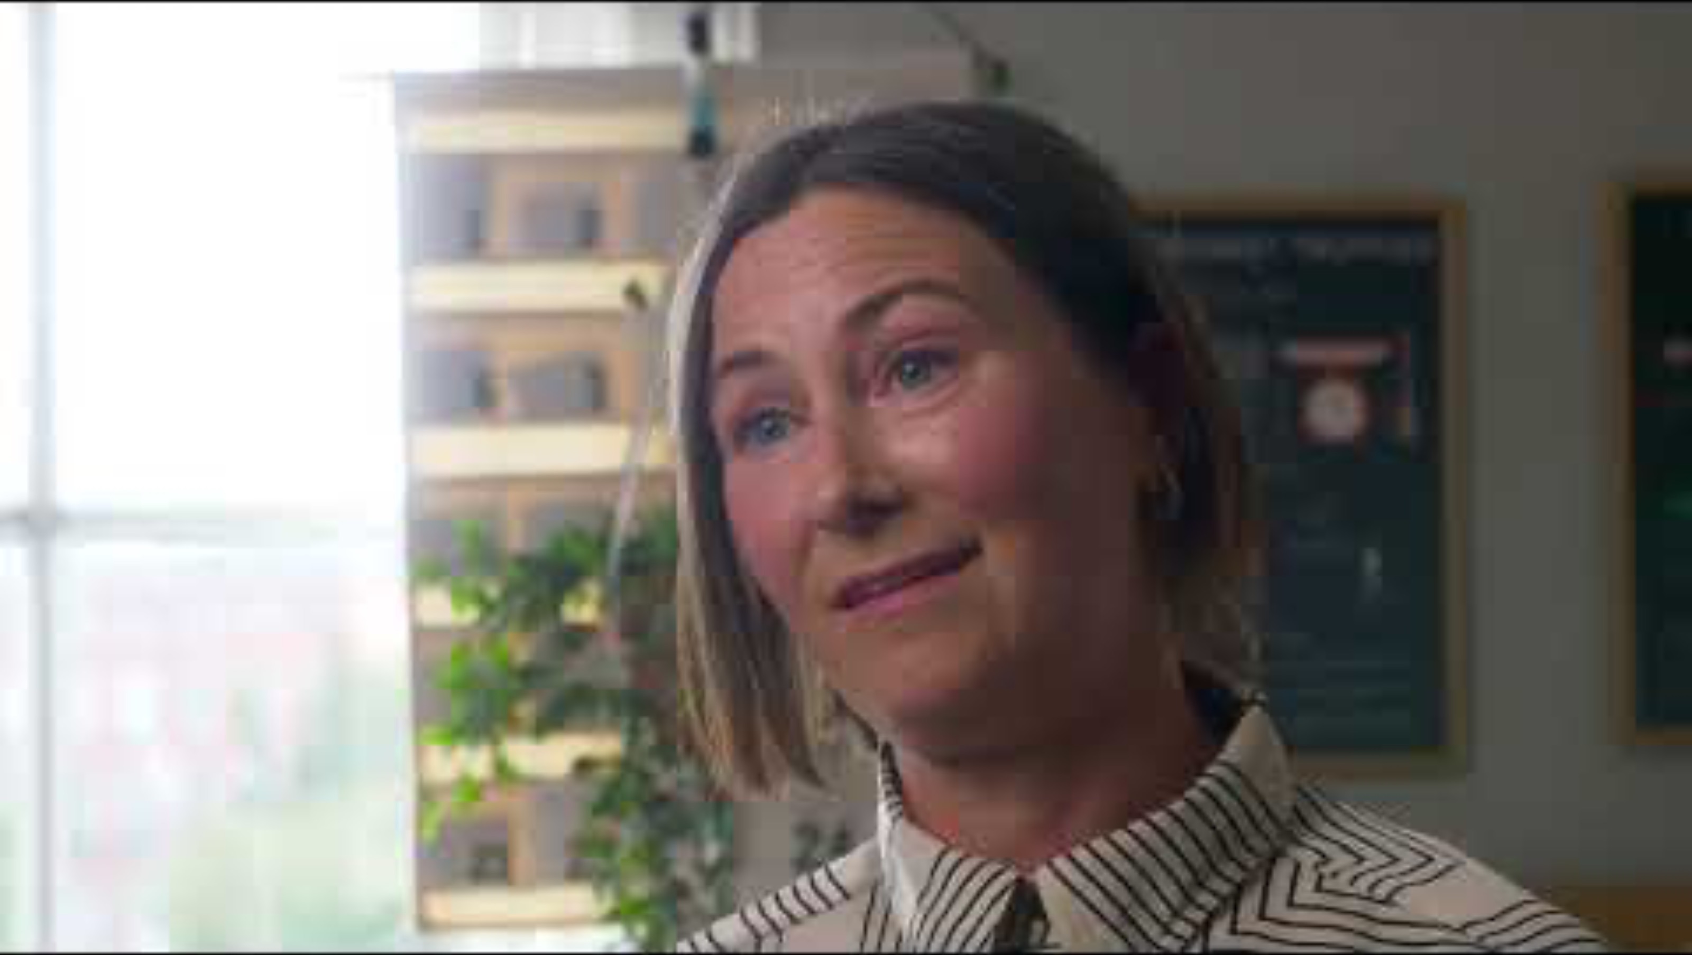
Introduction
We Make Good is a Dublin business that makes and sells homeware products such as cushions, bags and printed goods. Since 2018 it has trained and employed people from disadvantaged backgrounds, including refugees, people who have been in prison, struggled with addiction or people living with a disability.
Their products are sold online and in shops, and the money made goes back into the business to create more jobs. We Make Good has won awards and its products are stocked in some of Ireland’s best-known retailers.
A business where making profits is not the main purpose is called a social enterprise.

Slide 3

Introduction Activity: Discuss the following questions.
We Make Good sells products and makes money. Does that make it the same as any other business? Why or why not?
Can you think of somewhere in your local area that exists to help people rather than to make a profit (like a club, a service or an organisation)?
Who do you think pays for services like meals for older people or support for people who are homeless: businesses, the government or someone else?
If a business is doing something good for society, does it matter whether it earns high revenue or not?

Slide 4
What Is An Enterprise?
An enterprise is any organisation that provides goods or services.
Enterprises come in many different forms. Some exist to make a profit. Others exist to serve a community. Some do both.
In this chapter we look at three types of enterprise: financial, cultural and social.

Slide 5
Types of Enterprise
Financial Enterprise
Cultural Enterprise
Social Enterprise
Enterprises that provide goods and services to consumers with the aim of making a profit.
Enterprises that promote arts, sport, heritage or traditions in our communities.
Enterprises with a goal other than to make a profit. They are set up to address a social, economic or environmental issue that we face.
They drive innovation by creating and improving goods and services, increasing people’s standard of living.
They bring people together and contribute to local identity.
They operate like a business, but reinvest any surplus into a social mission to help put people and community first.
Examples: Shops, restaurants, apps, service providers.
Examples: GAA clubs, Electric Picnic, Galway Arts Festival, Fleadh Cheoil.
Examples: Rise at the Cove, FoodCloud, Meals on Wheels.

Slide 6
For-profit or Not-for-Profit?
Every enterprise can be one of two things: for-profit or not-for-profit.
A for-profit enterprise is one whose main aim is to make a profit for its owners.
A not-for-profit enterprise operates like a business, but its main aim is something other than making a profit.
A not-for-profit enterprise still has to pay bills, employ people, run marketing campaigns and sell goods or services, but any surplus it makes is reinvested into the cause it supports, rather than kept by the owners as profit.
Most businesses operate to make a profit.
Electric Picnic is held to earn a profit, while a local GAA club is a not-for-profit.
Social enterprises trade like a business, but they are not-for-profits. Any surplus is reinvested into their social mission.

Slide 7

2026 Q7
Match each logo with the most suitable type of enterprise by placing a tick in the relevant box.
FoodCloud Electric Picnic Centra
Columns: Financial Enterprise | Social Enterprise | Cultural Enterprise
FoodCloud = Social Enterprise (it redistributes surplus food, putting community first).
Electric Picnic = Cultural Enterprise (a music and arts festival).
Centra = Financial Enterprise (a retailer set up to earn a profit for its owners).
TOP TIP: Learn one named example of each enterprise type. A tick question like this is a quick 6 marks if you can classify FoodCloud, Electric Picnic and Centra on sight.

Slide 8

Workbook Q1 → Q3

Slide 9
1. Financial Enterprise
A financial enterprise is a business that is set up with the main aim of earning a profit for its owners.
Examples include: Retailers such as Centra and Dunnes Stores, manufacturers such as Kerry Group, and banks such as Bank of Ireland.

Slide 10
The Role of Financial Enterprises In Society
Create employment
Financial enterprises employ local people, so they create jobs which increase disposable income for the local community. Centra employs more than 11,700 people across its stores in Ireland.
Provides goods and services
They supply goods and services that people need every day, so consumers can shop close to home rather than travelling long distances. Mace operates around 160 stores across Ireland, many of them in smaller towns and villages.
Supports the local economy
Profitable enterprises pay taxes on their profits and buy stock from Irish suppliers, so funds are kept circulating within the local economy. Musgrave, which owns Centra and SuperValu, supports over 41,000 jobs across more than 1,000 stores and sites in Ireland.
TOP TIP: When explaining a benefit for society from something like a financial enterprise, ensure you explain the benefit for individuals or the community the enterprise is in, rather than the government in general.

Slide 11
Challenges Facing Financial Enterprises
Rising costs
The cost of energy, wages and rent has increased, so enterprises must work harder to control their costs or their profits will fall.
Online competition
More people now shop online with retailers eg Amazon, so enterprises must invest in technology and delivery to keep their customers.
Competition from large retailers
Smaller financial enterprises compete with large supermarket chains eg Tesco, Aldi and Lidl, so they must offer strong service or local products to hold on to their customers.

Slide 12
Workbook Q4 → Q6

Slide 13
2. Cultural Enterprise
A cultural enterprise promotes arts, sport, heritage or traditions. It brings people together and contributes to a community’s identity.
Examples include: GAA clubs, Electric Picnic, Galway International Arts Festival, Fleadh Cheoil and local theatres.

Slide 14
The Role of Cultural Enterprise in Society
Creates employment
Cultural enterprises employ staff and create jobs locally, so more people earn an income in an area improving their standard of living. Electric Picnic creates hundreds of local jobs in Stradbally, Co. Laois every summer.
Promotes community pride
Cultural enterprises bring people together and celebrate local identity which helps to improve wellbeing in the community. A local GAA club brings parents, players and supporters together every weekend.
Attracts visitors which boost sales for local businesses
Festivals and events bring visitors from around Ireland and abroad, so local businesses such as hotels, cafes and shops will generate more sales and profits. Galway International Arts Festival attracts hundreds of thousands of visitors to Galway every July.
Keeps traditions alive
Cultural enterprises celebrate Irish music, sport and language, passing on our local heritage to future generations. Fleadh Cheoil na hEireann celebrates Irish traditional music and is hosted in different Irish towns around the country.

Slide 15
Challenges Facing Cultural Enterprises
Funding and sponsorship
Many cultural enterprises rely on grants and sponsors, so when funding is cut events may be smaller or cancelled.
Online competition
People can stream music, films and sport at home, which can result in a lower attendance at live events and festivals.

Slide 16
2024 Q10
Electric Picnic is an annual music and arts festival held in Ireland. It is an example of a cultural enterprise.
What role does a cultural enterprise play in society?
1. Cultural enterprises can create employment opportunities locally, so the standard of living rises in the local area.
2. Cultural enterprises promote local tourism by encouraging visitors to come to a local area on their holidays, so visitors spend money in local hotels, restaurants and shops increasing profits for local businesses.

Slide 17
2023 Q8
The Galway Arts Festival is an example of a cultural enterprise and is held in July. The festival programme includes Irish and international work of the highest quality, featuring theatre, music, comedy, visual arts, opera, street spectacle, dance, discussion and comedy.
Outline two reasons why cultural enterprise is important in society.
1. They can create employment... in the local area like people working in the theatres for the festival.
2. Provide entertainment and events... for locals to enjoy in their area and socialise at with neighbours.

Slide 18
Workbook Q7 → Q8

Slide 19
3. Social Enterprise
A social enterprise is a business set up to address a social, economic or environmental issue. It generates its own income but puts people and community ahead of private profit.
They differ from a charity as they have to generate revenue to cover their costs, instead of relying on donations to operate.
Examples include: Rise at the Cove, FoodCloud and Meals on Wheels.
TOP TIP: A social enterprise is not the same as a charity. A social enterprise generates its own income from selling goods or services. A charity relies mainly on donations.

Slide 20
The Role of Social Enterprises In Society
Provides services that are underprovided
Social enterprises offer services that the government or private sector does not always provide, so people who need help can access it. Meals on Wheels delivers hot meals to older and vulnerable people who cannot easily cook for themselves.
Raises awareness of social issues
Social enterprises tackle problems such as homelessness, addiction and food waste that private businesses have no incentive to solve, ensuring these issues get the attention they need. FoodCloud redistributes surplus food from supermarkets to charities and community groups across Ireland.
Offers a platform to volunteer
Social enterprises give people a chance to give back to society and learn new skills, so volunteers gain experience working in teams and taking on leadership roles. St Vincent de Paul is supported by over 11,000 volunteers across Ireland helping people in need.
Provides employment in local communities
Social enterprises often employ people who find it hard to get other work, so they provide a route to earning a living. Rise at the Cove employs and trains people in the Tiglin rehabilitation programme in Greystones, Co. Wicklow.

Slide 21
Challenges Facing Social Enterprises
Lack of volunteers
Social enterprises often rely on volunteers, so when fewer people give their time, services may have to be reduced or stopped.
Generating income to cover costs
A social enterprise must earn enough income to keep running while putting people and community first, so it can be hard to do both at the same time.

Slide 22
2025 Q15
It is estimated there are 4,300 social enterprises operating in Ireland. (Adapted from gov.ie, July 2024)
(i) Explain the term social enterprise.
(ii) Describe one challenge facing social enterprises.
(i) A social enterprise is a business set up to address a social, economic or environmental issue. It generates its own income but puts people and community ahead of private profit, eg Meals on Wheels.
(ii) A social enterprise must earn enough income to cover its costs while still putting people and community first, so it can be hard to do both at the same time when competing against for-profit businesses.

Slide 23
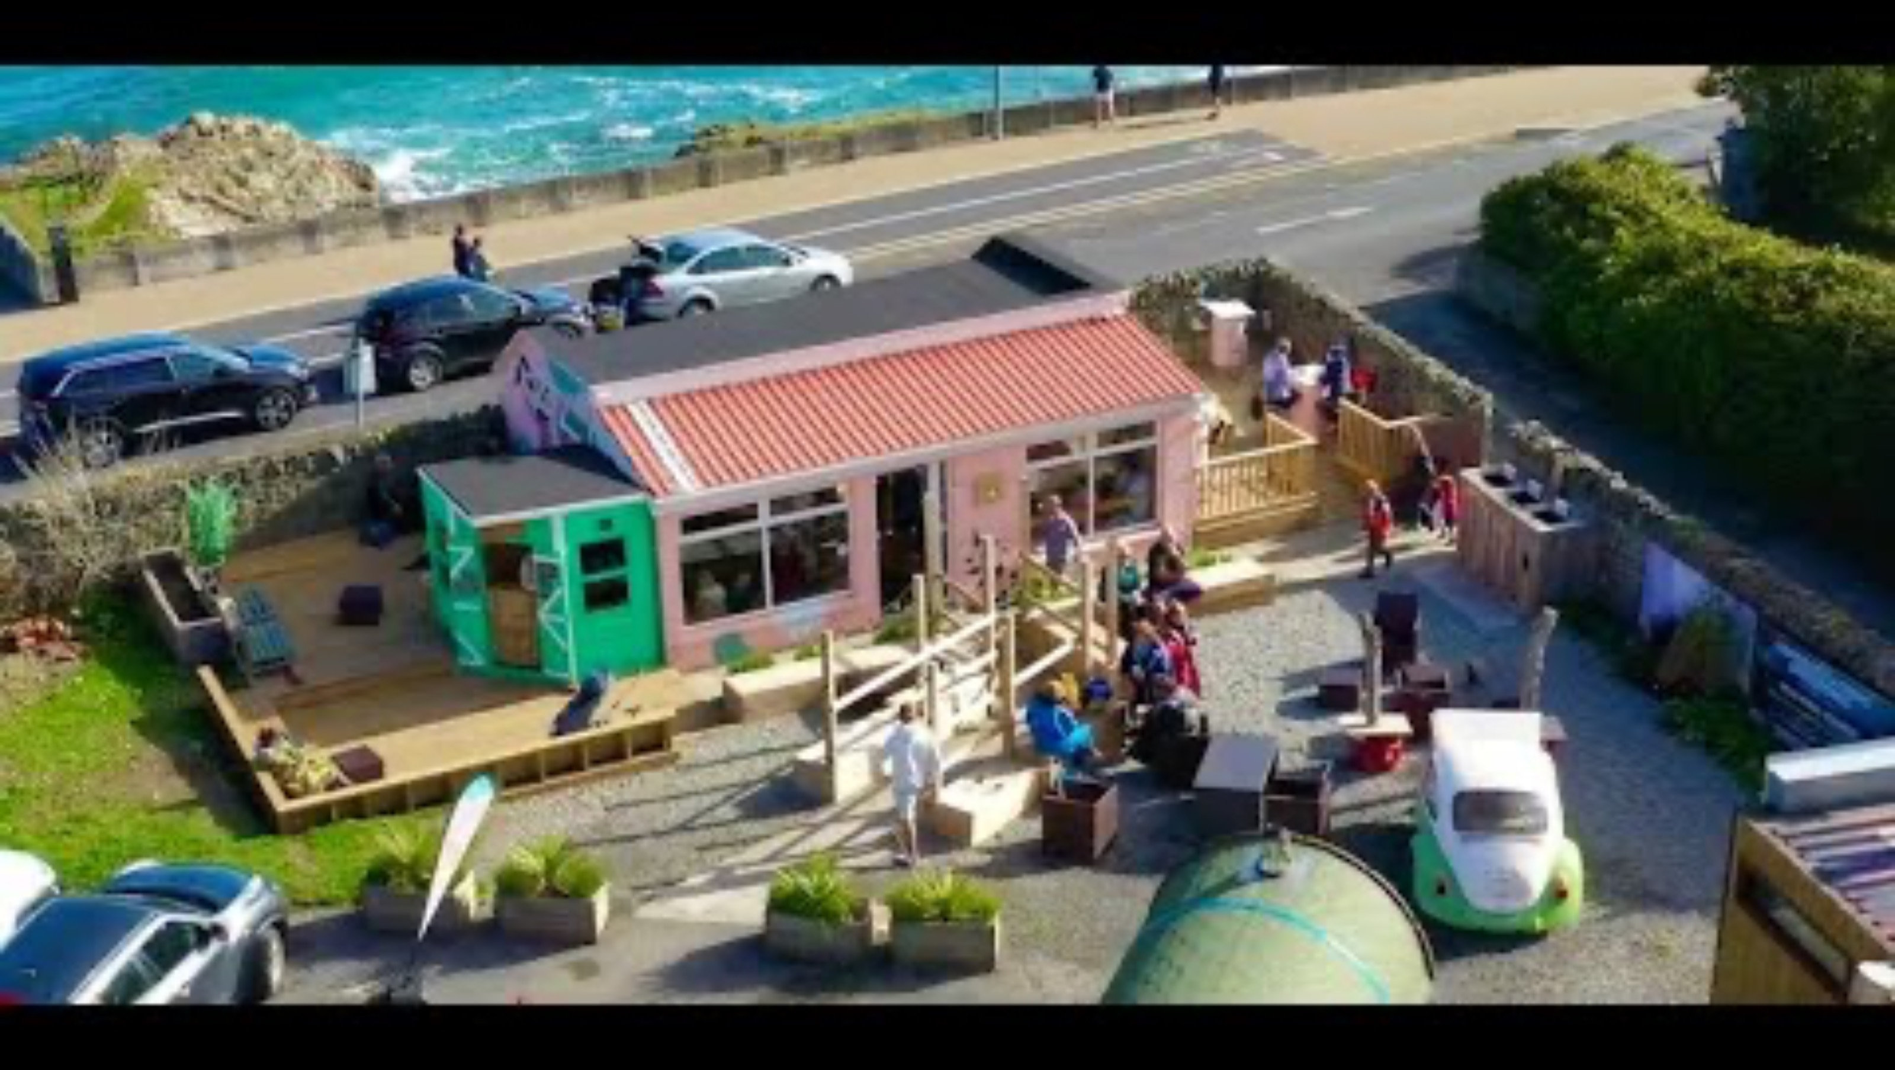

Slide 24
Business In Our World: Rise at the Cove
Rise at the Cove is a community cafe in Greystones operated by Tiglin, an organisation that supports people experiencing homelessness and addiction to rebuild their lives. The cafe was established as a social enterprise to create employment and training opportunities while providing a welcoming space for the whole community. Any surplus is reinvested into the business and Tiglin’s programmes.
What type of an enterprise is Rise at the Cove? What is its main purpose?
What role does an enterprise like Rise at the Cove play in society?
What are two benefits volunteers get from helping out in Rise at the Cove?
Identify one challenge Rise at the Cove is facing.
B. Research one other social or cultural enterprise operating in Ireland. Try to find out three interesting things about how and why they operate.

Slide 25
Workbook Q9 → Q10

