Slide 1
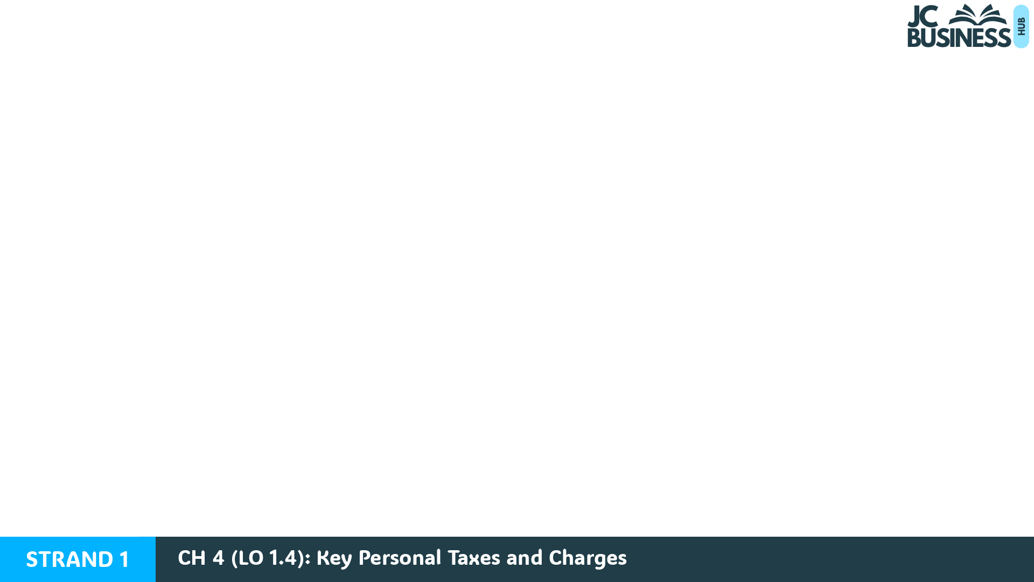
Key Personal Taxes and Charges
Learning Outcome 1.4
Explain key personal taxes and charges and suggest the occasions when and why they might arise.

Slide 2
Introduction
Taxes are compulsory payments made to the government through Ireland's tax authority, called Revenue. Everyone who earns an income or buys goods and services pays tax in some way.
There are different types of taxes. For example, Income Tax is paid on wages, VAT is added to the price of goods and services, and Motor Tax is paid by vehicle owners. Some taxes, such as Sugar Tax or Carbon Tax, are designed to influence behaviour.
The government uses tax revenue to provide public services such as healthcare, education and transport.

Slide 3
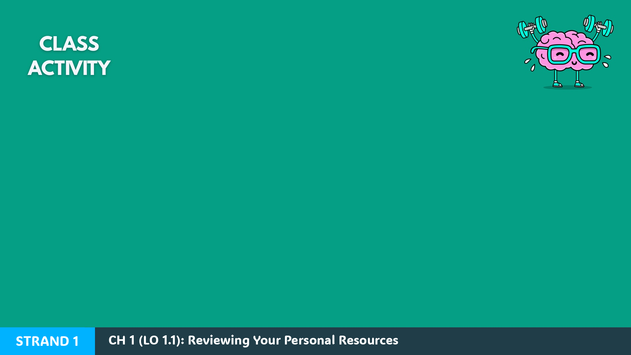
Introduction Activity: Read each statement and decide whether it is True or False.
A 14-year-old would never pay any type of tax in Ireland.
You don't pay tax if you own your own business.
When you buy goods in a shop, part of the price may go to the government.
Taxes can be used to encourage people to make healthier choices.
People pay more tax when buying cigarettes and alcohol than when buying bread and milk.

Slide 4
Direct vs Indirect Taxes
To make it easier to understand how we pay, most taxes are split into two categories:
1. Direct Taxes
2. Indirect Taxes
These are taxes paid on a person's income or wealth.
Examples: PAYE, USC, and Local Property Tax.
These are taxes included in the price of goods and services you buy.
The shop or business collects the tax and then passes it on to Revenue.
Examples: VAT, Excise Duty, and Sugar Tax.

Slide 5

Workbook Q1 -> Q2

Slide 6
Employment - Taxes When Earning an Income
There are two main ways income taxes are paid in Ireland:
Employees
Self-employed individuals
The taxes paid by an employee are deducted from their salary/wages by their employer before it is transferred to their bank account.
Self-employed individuals must calculate how much tax they owe for each year, and then make a payment directly to Revenue.
They often employ an accountant to help them with this.

Slide 7
The Three Main Deductions From Income
1. PAYE (Pay As You Earn): a tax on income earned from working.
Ireland's system is progressive: higher rates as income increases - in 2026 the standard rate is 20%, the higher rate 40%.
Every worker receives tax credits that reduce their PAYE.
2. USC (Universal Social Charge): also a tax charged on income earned, which is deducted from an employee's pay before they receive it.
3. PRSI (Pay Related Social Insurance): technically a social insurance contribution, but also deducted from income earned along with PAYE and USC.
PRSI helps fund social welfare benefits for the person paying it: support if they lose their job (Jobseeker's Benefit), get sick (Illness Benefit), or when they retire (State Pension).

Slide 8
Workbook Q3 -> Q4

Slide 9
Housing - Taxes When Owning a Property
Local Property Tax (LPT): a tax paid by homeowners, based on the value of their property. It helps fund local services such as roads, parks, libraries, and community facilities.
Stamp Duty: a tax paid by whoever purchases a property. It is charged as a percentage of the purchase price, so the higher the house price, the higher the level of Stamp Duty charged.
TV Licence: a payment required for every household that owns or uses a TV. This charge helps fund public broadcasting services like RTE.

Slide 10
Workbook Q5

Slide 11
Shopping - Taxes When Buying Goods
VAT (Value Added Tax): a tax included in the price of most goods and services. Essentials like milk, bread and books have a 0% rate; most items, like iPhones, a hoodie or a can of Monster, carry the standard 23% rate.
Excise Duties: an additional tax added to the price of certain goods such as fuel, alcohol and tobacco. These goods have additional taxes as they can negatively affect people's health or the environment.

Slide 12
Shopping - Taxes When Buying Goods
Sugar Tax: a tax included in the price of drinks with high sugar content. It makes sugary drinks more expensive to encourage healthier choices.
Customs Duties: a tax on goods that are imported from outside the EU, for example on clothes ordered from China. They increase the cost of goods coming into Ireland from outside the EU, which helps protect local businesses.
Plastic Bag Levy: a small environmental levy charged on plastic bags supplied in shops. It encourages consumers to bring reusable bags and reduce single-use plastic to help protect the environment.

Slide 13
Workbook Q6 -> Q8

Slide 14
Buying or Owning a Car - Taxes and Charges
Vehicle Registration Tax (VRT): a tax charged when a vehicle is first registered in Ireland, including new and imported vehicles, eg a second-hand car bought in Northern Ireland.
VAT: included in the price of buying a car, buying petrol, or paying a mechanic for a service or repair in a garage.
Motor Tax: a tax paid annually by the vehicle owner to keep a vehicle legally registered for use on public roads. The amount charged depends on the vehicle's emissions level. Electric vehicles pay a lower annual rate because they emit no CO₂. Motor Tax raised helps fund road infrastructure and transport services.

Slide 15
Buying or Owning a Car - Taxes and Charges
Carbon Tax: an additional tax included in the price of fossil fuels such as petrol and diesel. It makes fuels that produce carbon emissions more expensive, to encourage lower emissions.
Excise Duty: an additional tax charged on each litre of fuel such as petrol and diesel. It is one of the main taxes that make up the price of fuel.
Toll Charges: payments required when a driver uses certain toll roads or bridges. Tolls collected can help fund the cost of road infrastructure and toll road maintenance.

Slide 16
Workbook Q9 -> Q10

Slide 17
Banking and Other Situations
DIRT (Deposit Interest Retention Tax): a tax charged on interest earned on savings. DIRT is calculated based on the interest earned on savings in a bank account, before the interest is paid to the account holder.
Stamp Duty on Bank Cards: a tax charged each year on debit and credit cards issued by banks.
Capital Gains Tax (CGT): a tax paid on the profit someone makes when selling certain assets, eg selling shares in a business, cryptocurrency such as Bitcoin, or an investment property at a profit.
Capital Acquisitions Tax (CAT): a tax paid on gifts or inheritances received that are above a certain value.

Slide 18
Workbook Q11 -> Q12

Slide 19

How to Explain a Tax in the Exam
Naming the tax is usually only worth part of the marks. A good explanation shows you understand how the tax works.
TOP TIP: To help explain what a tax is you should include: who the tax is imposed on, why the tax is imposed, or what the money raised from it will be used to fund.

Slide 20
2025 Q16 (c) (i)
David and Linda Evans live in Tralee, Co. Kerry with their three children. David Evans is a teacher, while Linda is a paramedic. They want to save for their children's future education.
List three taxes that the Evans family may have to pay.
Income Tax/PAYE
USC
VAT
(also acceptable: Motor Tax, DIRT, Excise Duties, Customs Duties, LPT, Carbon Tax, Sugar Tax)
TOP TIP: Either Income Tax or PAYE is correct to use, but both would not be accepted as two separate answers – this would be an example of duplication. PAYE is the system used to collect Income Tax, not a separate tax.

Slide 21
Key Skill: Identify taxes and charges individuals need to pay in different scenarios
Match each scenario below to the correct tax or charge given in the table.
Scenarios
Taxes / Charges
A. Earning wages | B. Buying goods in a shop | C. Owning a house | D. Saving income in a bank
E. Registering a new vehicle | F. Buying fuel | G. Using a toll road | H. Owning a television
1. Carbon Tax | 2. Tolls | 3. TV License | 4. Local Property Tax
5. VRT - Vehicle Registration Tax | 6. Income Tax / PAYE | 7. VAT | 8. DIRT

Slide 22
Key Skill: Explain or list taxes and charges that individuals need to pay
Read through the scenarios below and answer the questions.
  a) An employee starts a job and receives their first payslip.
  b) A family buys a new phone in a shop.
  c) A family purchases a house.
  d) A teenager orders clothes from a Chinese website.
  e) Someone earns interest in their bank.
  f) A driver fills a car with petrol.
Explain one tax or charge that applies to the scenario.

Slide 23
Workbook Q13 -> Q14

