Slide 1
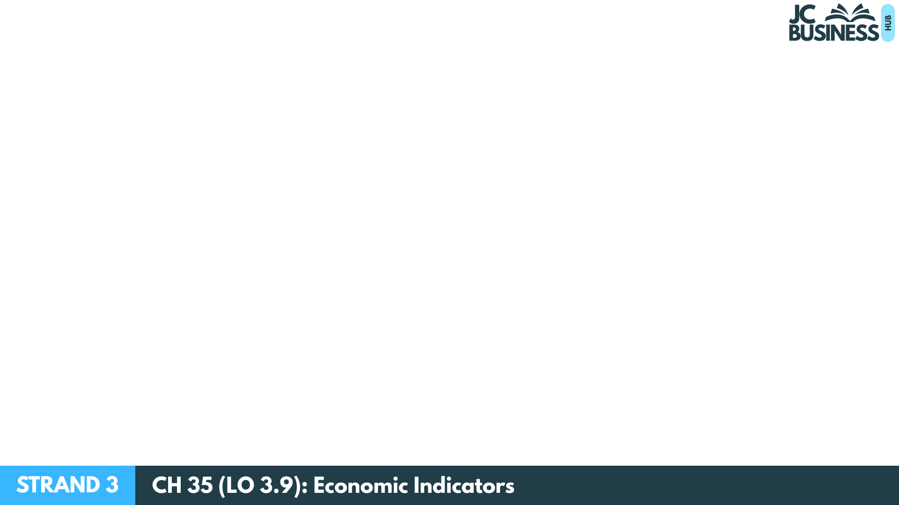
Economic Indicators
Learning Outcome 3.9
Explain the relevance of economic indicators such as inflation, employment rates, interest rates, economic growth, national income and national debt for individuals and the economy.

Slide 2
Introduction Activity
Part A – What do you already know about Economic Indicators?
Try to choose between True or False for these statements:
High inflation means prices are rising quickly
A rise in unemployment means more people are in paid work
Higher interest rates make borrowing more expensive.

Slide 3
Introduction Activity
Part A – What do you already know about Economic Indicators?
Try to choose between True or False for these statements:
4. Economic growth means the economy is getting bigger.
5. Ireland’s National Debt will rise when our government plans to spend more than it collects in a year.

Slide 4
Introduction Activity
Part B - Identify whether each trend is generally a ‘good’ or ‘bad’ trend for the economy:
Unemployment falls from 6% to 4%.
Inflation rises from 2% to 7%.
Interest rates fall from 5% to 3%.
Economic growth becomes negative.
National debt increases sharply.

Slide 5
What is inflation?
Inflation measures the rise in the prices of goods and services over time in an economy

Slide 6
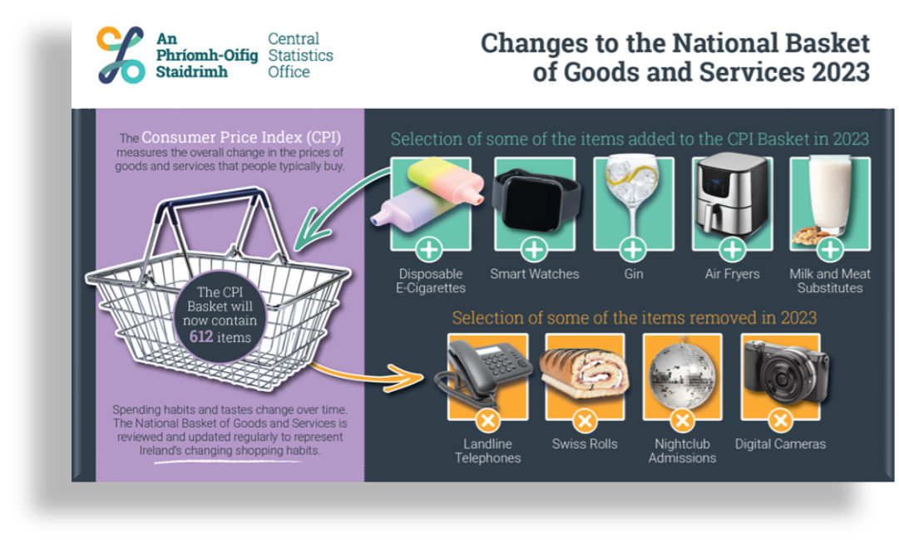
How is inflation measured?
The CSO check the prices of over 600 items that households are likely to buy, and compare them to a previous period.

Slide 7
Why Is Measuring Inflation Useful?
By comparing current prices to the prices of the previous month, the CSO can calculate if the cost-of-living is rising or falling for the average person.

Slide 8
What Is A Normal Level Of Inflation?
The ECB aims for EU inflation to be at 2% which is seen as a good inflation rate for an economy.
High inflation means that the cost-of-living is rising.
Low or negative inflation indicates that the economy is weak.

Slide 9
Causes Of Inflation
When demand exceeds supply, scarcity occurs causing prices to rise. (Demand-pull)
When production costs increase, firms raise prices to maintain profit levels. (Cost-push)
When taxes such as VAT increase, businesses pass the cost onto consumers, increasing prices. (Government induced)

Slide 10

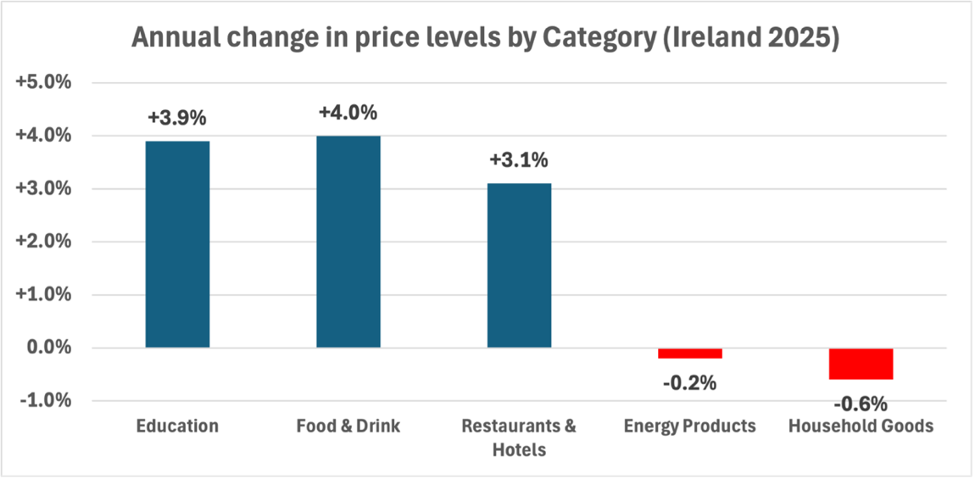
(a) Identify the category that had the highest percentage increase in price level in 2025
(b) Identify a category where their price level decreased in 2025
(c) If Education costs rose because of students having to pay more for third-level college places, would this be an example of demand-pull or cost-push inflation? Explain your answer

Slide 11
Impact Of Inflation on Individuals
Inflation Falling Towards 2%
(good trend)
Rising or High Inflation
(above 2% is a bad trend)
Stable prices mean the cost-of-living does not rise sharply. This allows households to maintain their standard of living.
When prices rise slowly and predictably, households know what things will cost. This makes it easier to plan spending and manage their budget.
Rising inflation reduces purchasing power, so individuals may struggle to pay their bills as the things they buy cost more.
Higher prices mean households have less disposable income after paying essential bills, lowering their standard of living.

Slide 12

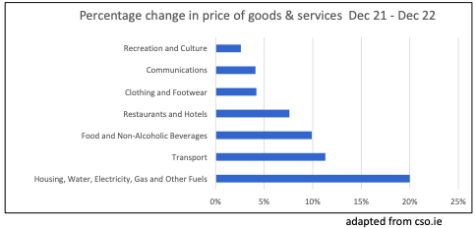
(i) Identify which category of goods and services shows the largest increase in price.
Housing, Water, Electricity, Gas and Other Fuels 5m
(ii) State the official measure of inflation in Ireland.
Consumer 1m Price 1m Index 1m
(ii) Explain one impact a rising level of inflation can have on an individual and a business in your local area.
An individual: It costs an individual more to buy what they normally buy so they will have less disposable income 1m and they may now struggle to pay for some of their bills. 1m
A business in your local area: It may lead to a business becoming less competitive as they may put their prices up 1m due to higher costs of production. 1m

Slide 13
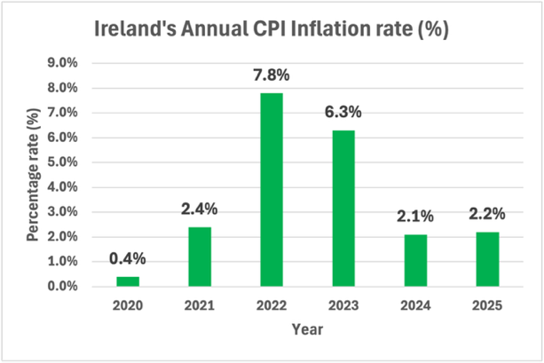
(a) Identify the year that inflation was at its highest rate
(b) Calculate the trend in inflation in 2024 from the previous year. State whether this represents a good or bad trend for Irish consumers and explain your answer.
(c) Outline one impact on each of the following from inflation falling from 5% to 2%:
(i) Individuals (ii) Businesses in Ireland (iii) Our economy
(e) Explain two causes of inflation that could have caused prices to rise over this period

Slide 14

Workbook Q1 -> Q5

Slide 15
Employment
Employment is measured in Ireland by the CSO in two ways:
1. The Employment Rate: The percentage of the working-age population (15–64) who are currently in paid employment.
2. The Unemployment Rate: The percentage of the labour force (aged 15–74) who are without a job but are available for and seeking work.

Slide 16
What Is A Good Level For An Economy?
An unemployment rate of around 4% is described as full employment for an economy. This means that most people who want to work can find a job.
A fall in unemployment or rise in employment is a good trend as more households are earning income so demand for goods and services will rise.
A rise in unemployment or fall in employment is a bad trend as more individuals need government support through jobseekers allowance payments.

Slide 17
Impact Of Employment On Individuals
Low Unemployment / High Employment
(good trend)
High Unemployment / Low Employment
(bad trend)
More households are earning income, meaning higher spending power and a better standard of living.
Higher employment means the government collects more tax revenue and spends less on social welfare, allowing more investment in public services.
Individuals who lose their jobs face reduced income and may struggle to pay bills, lowering their standard of living.
The government must spend more on Jobseeker’s Allowance payments, reducing funds available for other public services.

Slide 18
Impact Of Employment On Business
Low Unemployment / High Employment
(good trend)
High Unemployment / Low Employment
(bad trend)
More people in work means more consumer spending, increasing demand, sales and profits for businesses.
A fall in disposable income reduces consumer spending, reducing demand, sales and profits for businesses.

Slide 19
Impact Of Employment On The Economy
Low Unemployment / High Employment
(good trend)
High Unemployment / Low Employment
(bad trend)
More workers increase the PAYE, PRSI and USC collected, meaning the government can increase spending on public services, eg improving health services.
Government spending on Jobseeker’s Allowance falls, reducing government expenditure and improving a budget deficit.
Less income tax (PAYE, PRSI and USC) is collected, which may lead to a cut in public services.
Government spending on Jobseekers Allowance rises, which may mean cuts in spending in other public services/increased budget deficit.

Slide 20
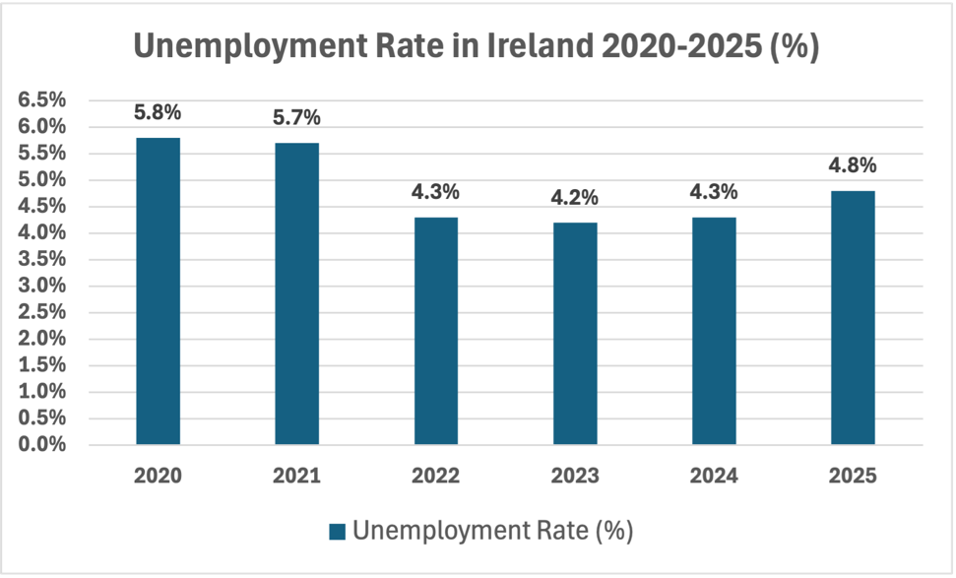
The title shows what is being measured (unemployment)
A decrease in the unemployment rate is a good (positive) trend for the economy.
In 2022, unemployment fell to 4.3% from 5.7% in 2021
The lowest figure on a graph like this would indicate the closest year to full employment (around 4%)
An increase in the unemployment rate is a bad (negative) trend for the economy.
In 2025, unemployment increased to 4.8% from 4.3% in 2024

Slide 21
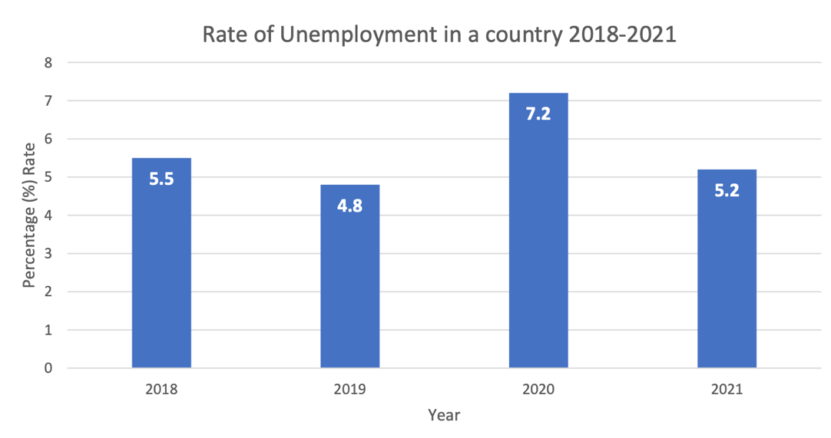
2024 Q5
Statement | True | False
The unemployment rate was closest to full employment in 2019. | ✓
The unemployment rate decreased in 2020 from the previous year. |  | ✓
There was a positive trend in the unemployment rate for 2021 when compared with the previous year. | ✓

Slide 22
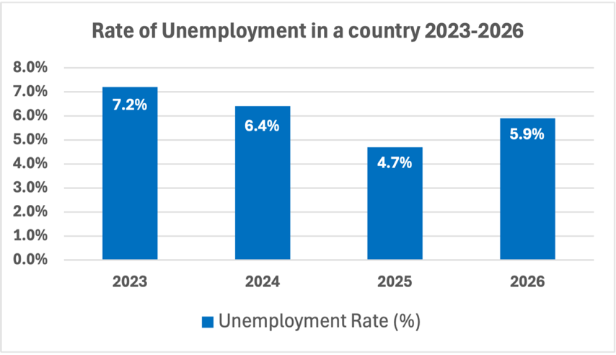
Based on the graph, state whether the following are True or False:
The unemployment rate was closest to full employment in 2026
The unemployment rate decreased in 2024 from the previous year
There was a positive trend in the unemployment rate for 2025 compared with the previous year
The highest rate of unemployment occurred in 2025

Slide 23
Workbook Q6 -> Q8

Slide 24
Interest Rates
Interest rates affect how much people are likely to save and how much they are likely to borrow.
Savings: Interest is the reward given by banks and financial institutions for saving money with them.
Borrowing: Interest is the financial cost/fee charged for borrowing money.
Interest is generally expressed as a percentage, such as an annual percentage rate (APR).

Slide 25
Impact Of Changing Interest Rates
Higher Interest Rates
Lower Interest Rates
Savings: Savings increase because banks pay a higher return on deposits.
Borrowing: Borrowing decreases because the cost of loans and mortgages become more expensive to repay.
Savings: Savings decrease because banks pay less interest on deposits. People may move money to riskier assets such as shares.
Borrowing: Borrowing increases because the cost of loans and mortgages are cheaper to repay.

Slide 26
Who Sets The Interest Rate In Ireland?
The European Central Bank (ECB) sets and adjusts interest rates for the EU. These rates influence the interest rates used by banks and financial institutions in Ireland.
The ECB may lower interest rates to encourage economic growth by reducing the cost of borrowing and increasing spending in the economy.
The ECB may raise interest rates to reduce inflation by making borrowing more expensive and slowing down spending.

Slide 27
Impact Of Interest Rates On Individuals
Low Interest Rates
(good trend)
High Interest Rates
(bad trend)
Individuals with loans have lower repayments, increasing their disposable income and standard of living.
Individuals may reduce their savings as the return is lower on deposits.
Individuals with loans have higher repayments, decreasing their disposable income and standard of living.
Individuals may increase their savings as the return is higher, so are better prepared for future emergencies.

Slide 28
Impact Of Interest Rates On Business
Low Interest Rates
(good trend)
High Interest Rates
(bad trend)
Businesses with loans will have lower repayments, so have more ability to expand.
Businesses with loans will have higher repayments, so expansion becomes more expensive.

Slide 29
Impact Of Interest Rates On The Economy
Low Interest Rates
(good trend)
High Interest Rates
(bad trend)
Lower interest rates encourage borrowing, so spending in the economy will increase, increasing economic growth.
Less borrowing reduces spending, which can slow economic growth in the economy.

Slide 30
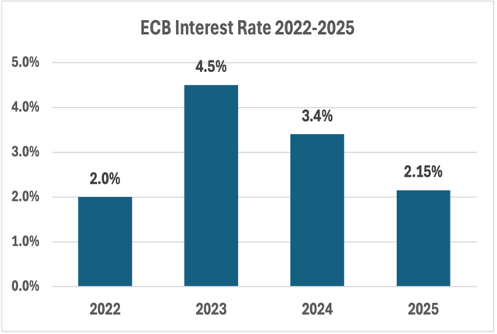
Statement | True | False
The ECB interest rate increased between 2022 and 2023
Savings would likely increase in 2023 from 2022
Interest rates fell between 2023 and 2024
Interest rates in 2025 were lower than in 2022

Slide 31
Explain how the increase in interest rates between 2022 and 2023 would affect:
Savings
Borrowing

Slide 32
Statement | True | False
Higher interest rates increase repayments reducing disposable income
Lower interest rates increase borrowing because loans are cheaper
Higher interest rates reduce consumer spending
Lower interest rates can increase economic growth by increasing borrowing and spending

Slide 33
Workbook Q9 -> Q13

Slide 34
National Income
National Income measures the total income earned by individuals and businesses in a country over a period of time. It shows the overall level of economic activity and helps us understand changes in living standards.
How Is It Measured?
GDP (Gross Domestic Product): the total value of goods and services produced within Ireland in a given period.
GNP (Gross National Product): GDP plus income earned by Irish companies abroad, minus income earned in Ireland by foreign companies.
GNI* (Modified Gross National Income): adjusts for the impact of multinational companies, giving a more accurate picture of the Irish economy.

Slide 35
Why Is Measuring National Income Useful?
Measuring national income every year helps us to:
Compare Ireland's economic performance over time
Compare Ireland with other countries
See if there are changes in living standards
An increase in National Income is a good trend, a decrease in National Income is a bad trend. National income is often shown per capita (per person) to allow fair comparisons between countries.

Slide 36
Workbook Q14

Slide 37
Economic Growth
Economic Growth measures the change in national income over time.
It is usually shown as a percentage change from one year to the next.
What Is A Normal Level?
A positive figure, typically 2%–4% per year, is a good trend as it shows the economy is growing steadily.
A lower rate than the previous year may indicate an economy slowing down.
A negative figure for two consecutive quarters is a bad trend called a recession.

Slide 38
Economic Growth
Economic Growth and other economic indicators are often linked together:
When economic growth increases: | When economic growth decreases:
Employment usually rises National income increases Tax revenue increases | Unemployment may increase Government borrowing may rise Consumer confidence may fall

Slide 39
How Does Economic Growth Impact Individuals?
Positive Economic Growth
(good trend)
Negative Economic Growth
(bad trend / recession)
Businesses expand, leading to more jobs and higher employment, increasing household incomes and living standards.
Job losses or reduced hours cause lower household income and reduced spending.

Slide 40
How Does Economic Growth Impact Businesses?
Positive Economic Growth
(good trend)
Negative Economic Growth
(bad trend / recession)
Increased demand for goods and services increases investor confidence so its easier to access finance to expand.
Falling sales and profits, increasing the risk of closures or downsizing.

Slide 41
How Does Economic Growth Impact our Economy?
Positive Economic Growth
(good trend)
Negative Economic Growth
(bad trend / recession)
Higher tax revenue (PAYE,VAT) and reduced government spending on jobseekers allowance will reduce the need for increased government borrowing.
Lower tax revenue (PAYE,VAT) and increased government spending needed for extra supports like more Jobseeker’s Allowance.

Slide 42
Workbook Q15 -> Q16

Slide 43
National Debt
National Debt is the total amount of money the government owes after borrowing to cover budget deficits.
Most countries have a national debt, as governments regularly spend more than they collect in tax revenue. The interest repaid on the debt is called servicing the national debt.

Slide 44
National Debt
Who Manages Ireland's National Debt?
The National Treasury Management Agency (NTMA) borrows money on behalf of the Irish government by selling government bonds to large investors such as banks and pension funds worldwide. It manages repayments and ensures interest is paid on time.

Slide 45
When Would National Debt Increase or Decrease?
National Debt Increases – when the government runs a budget deficit (spending > revenue):
Tax revenue falls, e.g. during a recession when fewer people are working and less income tax is collected.
Government spending rises, e.g. during an economic crisis or a global emergency such as COVID-19.
National Debt Decreases – when the government runs a budget surplus (revenue > spending):
The government uses the surplus to repay some of the money owed, reducing the overall debt.

Slide 46
How Does National Debt Impact Ireland?
Falling National Debt (good trend)
Individuals: Lower interest repayments mean the government has more money to spend on improving public services such as health and education.
Businesses: Creates a more stable economy which gives businesses confidence to invest and create new jobs.
Our Economy: Ireland will have a better credit rating, making it cheaper and easier to borrow in the future.

Slide 47
How Does National Debt Impact Ireland?
Rising National Debt (bad trend)
Individuals: The government may have to increase taxes (eg PAYE) to pay off the debt, leaving families with less disposable income.
Businesses: Higher debt can lead to greater economic uncertainty, making businesses less likely to expand.
Our Economy: A large slice of tax revenue is spent on interest on the debt, making it harder to improve budget deficits.

Slide 48
Workbook Q17

