Slide 1

Government Revenue & Expenditure
S3 Ch30
Learning Outcome 3.4
Differentiate between different sources of government revenue and government expenditure
LO 3.4: Government Revenue & Expenditure
BUSINESS
JC
HUB

Slide 2

Teacher Resources (Link)
(exam, handout, PP Qs, workbook with solutions…)
Student Revision Quizzes
S3 Ch30
LO 3.4: Government Revenue & Expenditure

Slide 3


The government spend money on public services like health and education, so should plan their expected revenue and expenditure like a household would.
BUSINESS
JC
HUB
Household
Government
Revenue: Taxation, EU Grants, semi-state companies
Spending: Paying doctors, building hospitals, jobseekers allowance
Income: Wages, dividends, rental income
Spending: Mortgage, car loan, groceries, holidays
STRAND 3
CH 30
LO 3.4 – Government Revenue & Expenditure

Slide 4


BUSINESS
JC
Introduction Activity
HUB
Corporation Tax collected from the profits of large multinational companies such as Apple, Google and Pfizer has more than doubled between 2021 and 2025, rising from €15.3 billion to €32.9 billion.
Therefore the government will take in more revenue than it will spend, so must decide what to do with it - to spend it , save it, or pay off some of our national debt.
STRAND 3
CH 30
LO 3.4 – Government Revenue & Expenditure

Slide 5

CLASS ACTIVITY
Class Activity - Introduction Ch30
a) Suggest how the government could use this extra revenue to:
  Help with homeless crisis
  Improve our health system
  Increase the number of children playing sports
  Make it easier for people to travel without driving petrol or diesel cars
b) Do you think the government should save some extra money for the future? Why?
c) Why might it be risky if the government depends too heavily on Corporation Tax from foreign companies like Apple and Google?
STRAND 3
CH 30
LO 3.4 – Government Revenue & Expenditure

Slide 6
BUSINESS
JC
Ireland’s National Budget
HUB
This is the Irish government’s annual financial plan for the year ahead, which is presented by the Minister for Finance and the Minister for Public Expenditure each year setting out:
Government Revenue: All money received by the government e.g. revenue received from PAYE or VAT
Government Expenditure: All money spent by the government e.g. money used to build a new children’s hospital or increase teachers’ salaries
STRAND 3
CH 30
LO 3.4 – Government Revenue & Expenditure

Slide 7
BUSINESS
JC
Types of Government Revenue
HUB
There are two main types of government revenue:
Current revenue – recurring income that continues to be earned over time
Capital revenue – non-recurring income often received as a one-off
STRAND 3
CH 30
LO 3.4 – Government Revenue & Expenditure

Slide 8
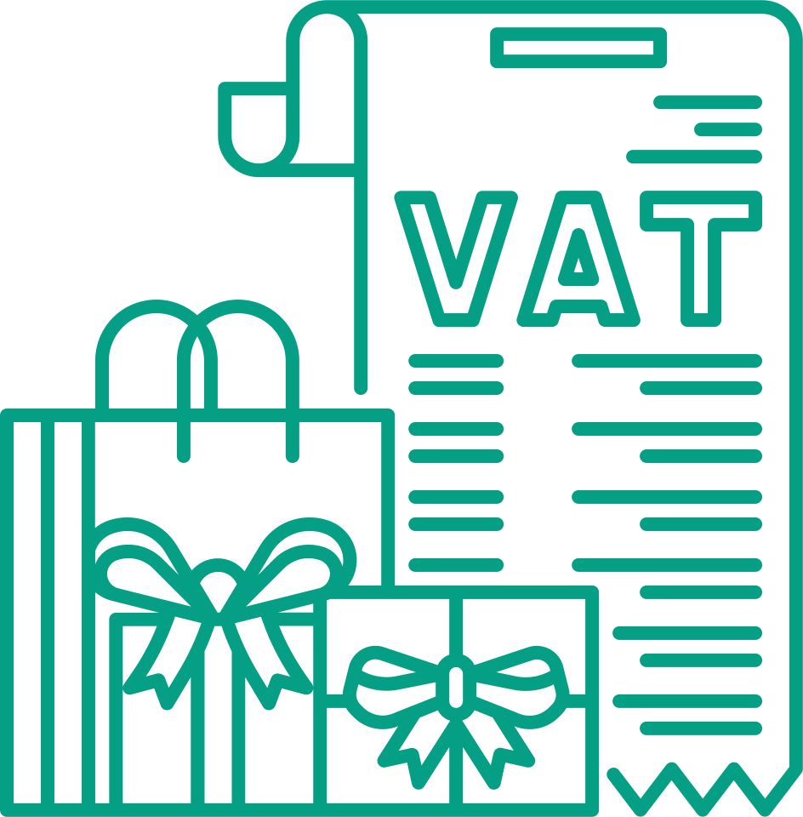

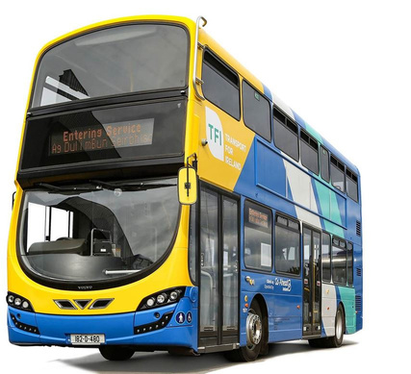
BUSINESS
Types of Current Revenue (recurring)
JC
HUB
TAXATION
FEES & CHARGES
STATE COMPANIES
Money collected through tax from people and businesses
Payments made for public services
Profits from government-owned companies
Examples: PAYE, VAT, Corporation Tax
Examples: Passport fees, driving test fees
Examples: Profit from ESB, An Post, Irish Rail
STRAND 3
CH 30
LO 3.4 – Government Revenue & Expenditure

Slide 9



BUSINESS
JC
Types of Capital Revenue (non-recurring)
HUB
EU GRANTS
LONG TERM LOANS
SALE OF STATE ASSETS
EU funding that does not have to be repaid
Money borrowed from the EU, banks or investors that must be repaid with interest
Selling government owned land, buildings, or assets
Example: EU Grants received for a new motorway
Examples: EU Loans, selling government bonds
Example: Selling government owned land
STRAND 3
CH 30
LO 3.4 – Government Revenue & Expenditure

Slide 10
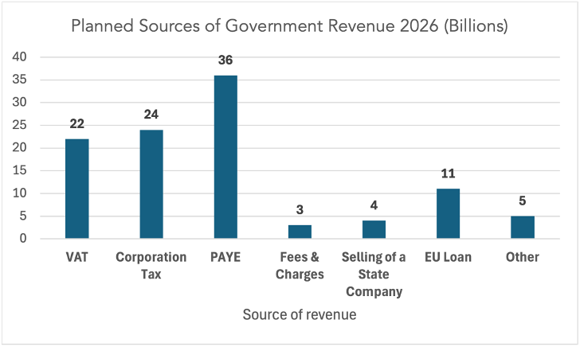
Differentiate between current and capital revenue
Explain sources/examples of government revenue other than tax
CLASS ACTIVITY 30.1
(a) What is the largest source of revenue for the government in 2026?
(b) By adding up the figures in the graph, we can calculate that the total planned revenue is €105bn for the government in 2026.
Calculate the percentage of total revenue that VAT makes up
Hint: Divide VAT by the total revenue figure and multiply the answer by 100 to find the percentage
STRAND 3
CH 30
LO 3.4 – Government Revenue & Expenditure

Slide 11
Differentiate between current and capital revenue
Explain sources/examples of government revenue other than tax
CLASS ACTIVITY 30.1
Planned Government Revenue for a Country In 2026
(a) Add the figures above to calculate the total government revenue for 2026.
(b) Identify one source of current revenue and one source of capital revenue in the figures above. Explain your choices.
(c) What source provides the most revenue for the government
Source of Revenue | € Billions
PAYE | 32
VAT | 21
Corporation Tax | 18
Fees & Charges | 6
Selling of a State Company | 4
EU Loan | 9
Other | 5
STRAND 3
CH 30
LO 3.4 – Government Revenue & Expenditure

Slide 12


Workbook Qs
Q1 -> Q5

Slide 13

BUSINESS
JC
Types of Government Expenditure
HUB
Government expenditure is the money the government spends to provide public services and run the country.
There are two main types of government revenue:
Current expenditure – recurring spending used to run day-to-day public services
e.g. paying doctors or bus drivers wages
STRAND 3
CH 30
LO 3.4 – Government Revenue & Expenditure

Slide 14


BUSINESS
JC
Types of Government Expenditure
HUB
Capital expenditure – non-recurring spending, often once-off, on long-term projects that will provide a long-term benefit
e.g. developing infrastructure by building a new motorway or hospital
STRAND 3
CH 30
LO 3.4 – Government Revenue & Expenditure

Slide 15
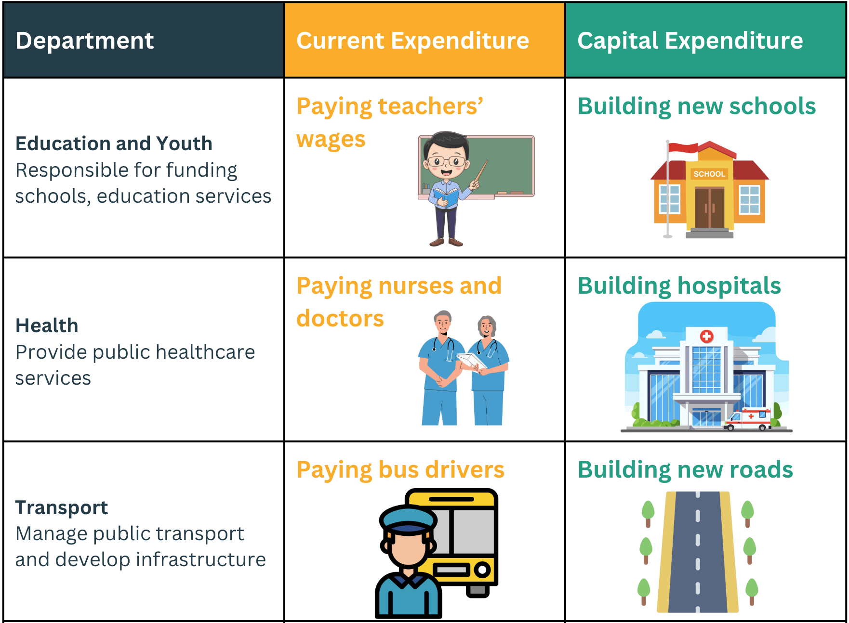
BUSINESS
JC
Examples of Government Expenditure by Department
HUB
LO 3.3: Demand & Supply
STRAND 3
CH 29:
LO 3.4 – Government Revenue & Expenditure
CH 30

Slide 16
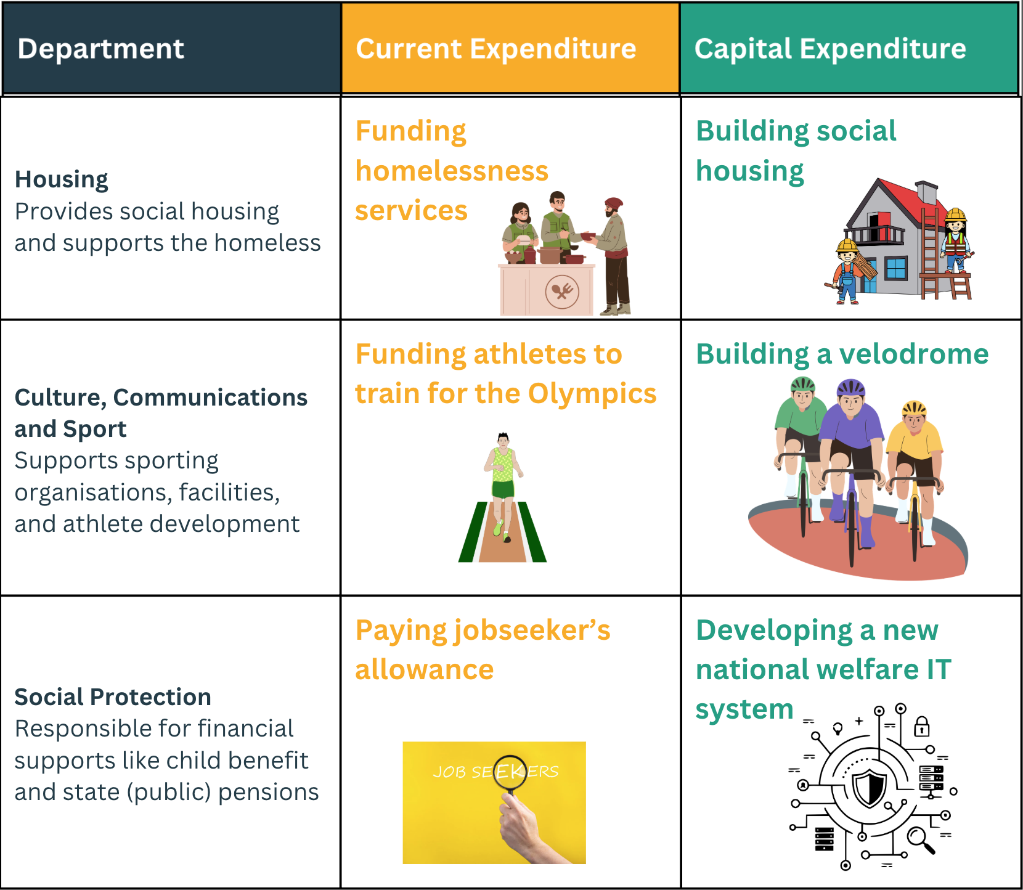
BUSINESS
JC
Examples of Government Expenditure by Department
HUB
LO 3.3: Demand & Supply
STRAND 3
CH 29:
LO 3.4 – Government Revenue & Expenditure
CH 30

Slide 17


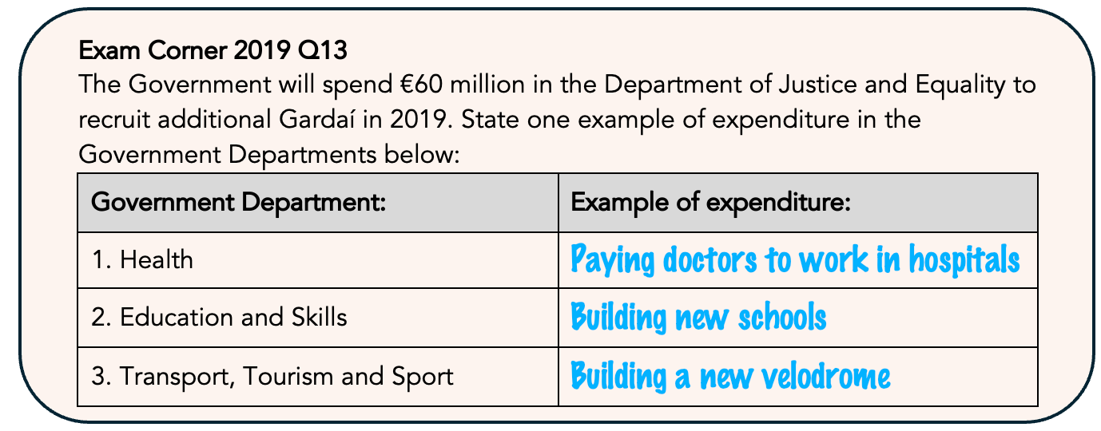

Exam Corner 2019 Q13
Top Tip: When dealing with government expenditure in different departments, do not just write “pay workers”. Be specific, for example: “Paying nurses in hospitals” or “Funding Irish athletes to train for the Olympics”. Similarly for social welfare payments, be specific and write “Jobseeker's Allowance”.

Slide 18
CLASS ACTIVITY 30.2
Differentiate between current and capital expenditure
A) Decide whether each item is an example of current or capital expenditure
  Paying hospital staff
  Building a new hospital
  Buying textbooks for schools
  Constructing a new motorway
  Funding Olympians with wages to help them train more
  Building a new velodrome for Olympian cyclists to train on
STRAND 3
CH 30
LO 3.4 – Government Revenue & Expenditure

Slide 19
CLASS ACTIVITY 30.2
Differentiate between current and capital expenditure
(B) Give an example of both current and capital expenditure for each of these government departments:
  Housing
  Social Protection
  Health
  Transport
STRAND 3
CH 30
LO 3.4 – Government Revenue & Expenditure

Slide 20
Workbook Qs
Q6 -> Q9

Slide 21
BUSINESS
JC
Surplus, Deficit and Balanced Budgets
HUB
To find out if a budget is a surplus or deficit, the government compares its planned total revenue to its planned total expenditure.
If revenue is higher than expenditure, there is a surplus.
If expenditure is higher than revenue, there is a deficit.
STRAND 3
CH 30
LO 3.4 – Government Revenue & Expenditure

Slide 22
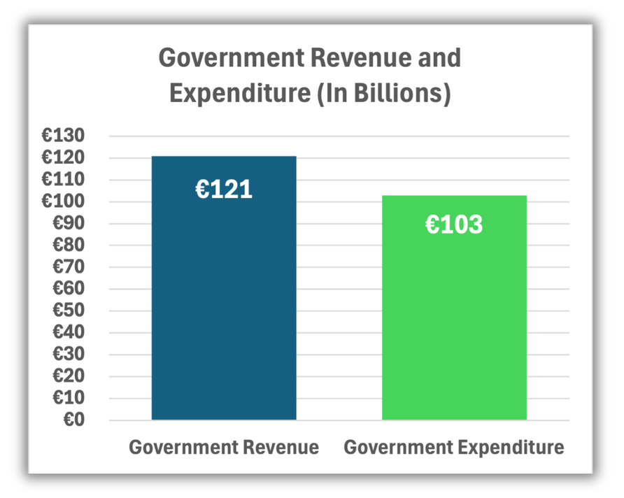
BUSINESS
JC
A Surplus Budget
HUB
A surplus budget occurs when government revenue (money coming in) is greater than government expenditure (money going out).
This means the government collects more than it spends.
In our graph, revenue is higher than expenditure, so there is a surplus of €18bn (€121bn minus €103bn).
Top Tip: When you are calculating the National Budget, always remember to use the € sign and state if it is in Billions, as well as writing “surplus” or “deficit” in your answer.
LO 3.3: Demand & Supply
STRAND 3
CH 30
LO 3.4 – Government Revenue & Expenditure

Slide 23
BUSINESS
JC
What Could the Minister for Finance Do With A Budget Surplus?
HUB
Reduce Our National Debt – Use the surplus to repay part of the national debt and reduce future interest costs.
Increase Spending on Public Services – E.g. spend to improve health or education.
Reduce Taxes for individuals or businesses – Lower certain taxes to increase disposable income for households and businesses.
Build Financial Reserves – Save the money to prepare for future economic difficulties.
LO 3.3: Demand & Supply
STRAND 3
CH 30
LO 3.4 – Government Revenue & Expenditure

Slide 24
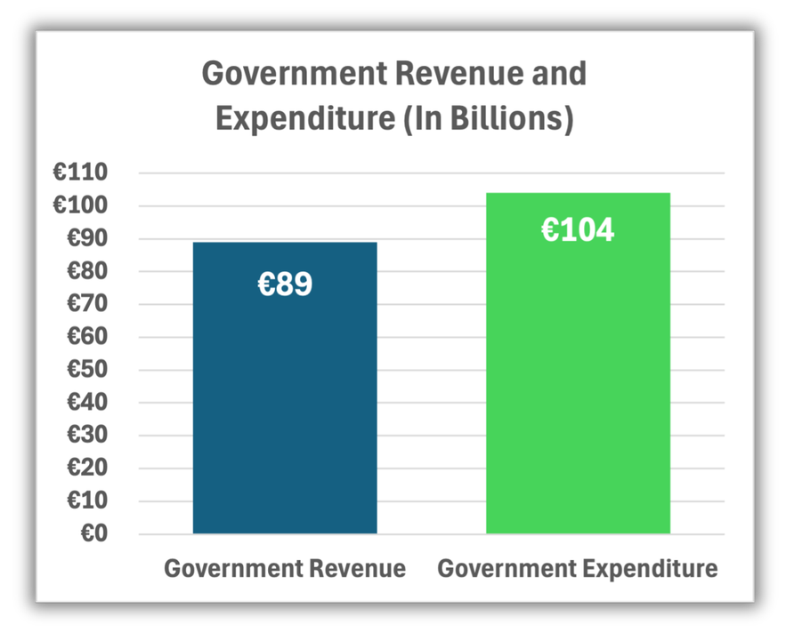
BUSINESS
JC
A Deficit Budget
HUB
A deficit budget occurs when government expenditure (money going out) is greater than government revenue (money coming in).
This means that the government will spend more than it will collect, so won’t have enough money available to pay for everything.
In our graph, expenditure is higher than revenue, so there is a deficit of €15bn (€89bn minus €104bn).
LO 3.3: Demand & Supply
STRAND 3
CH 30
LO 3.4 – Government Revenue & Expenditure

Slide 25
BUSINESS
JC
What Might the Minister for Finance Need to Do With a Budget Deficit?
HUB
Increase Borrowing – Borrow to cover the shortfall, which will need to be repaid with interest and increase our national debt
Increase Taxes – Raise taxes such as PAYE or VAT in order to increase future government revenue to cover the extra planned expenditure.
Reduce Spending – Decide to cut funding in certain areas to help reduce the deficit, reducing the quality of some public services.
LO 3.3: Demand & Supply
STRAND 3
CH 30
LO 3.4 – Government Revenue & Expenditure

Slide 26
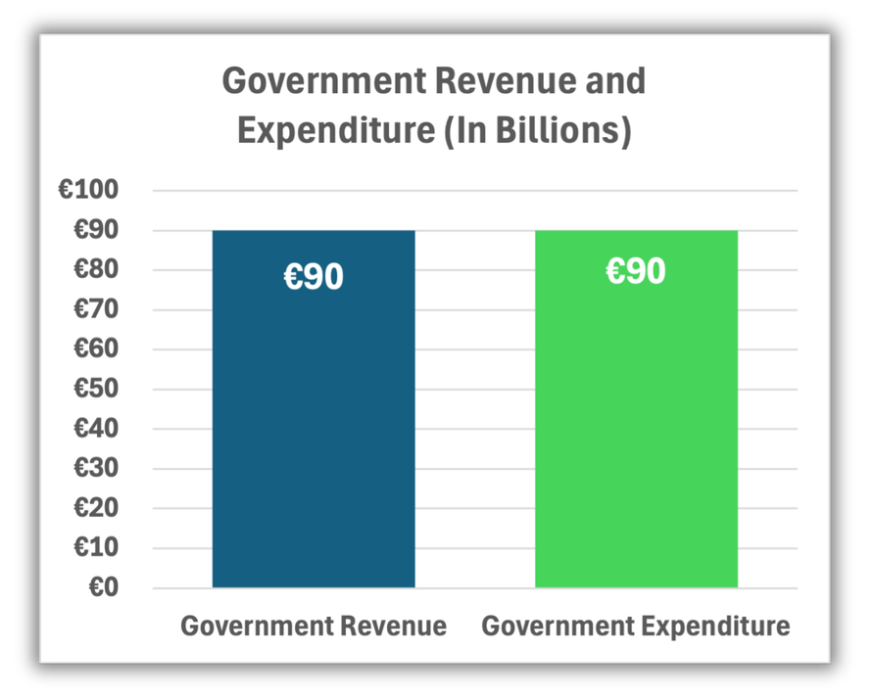
BUSINESS
JC
A Balanced Budget
HUB
A balanced budget occurs when government revenue equals government expenditure.
In our graph, revenue and expenditure are equal, so there is a neither a surplus or deficit. The Budget is balanced.
This means the country can:
Maintain Current Services – Continue funding services at existing levels.
Avoid Additional Borrowing – No need to increase the national debt
LO 3.3: Demand & Supply
STRAND 3
CH 30
LO 3.4 – Government Revenue & Expenditure

Slide 27
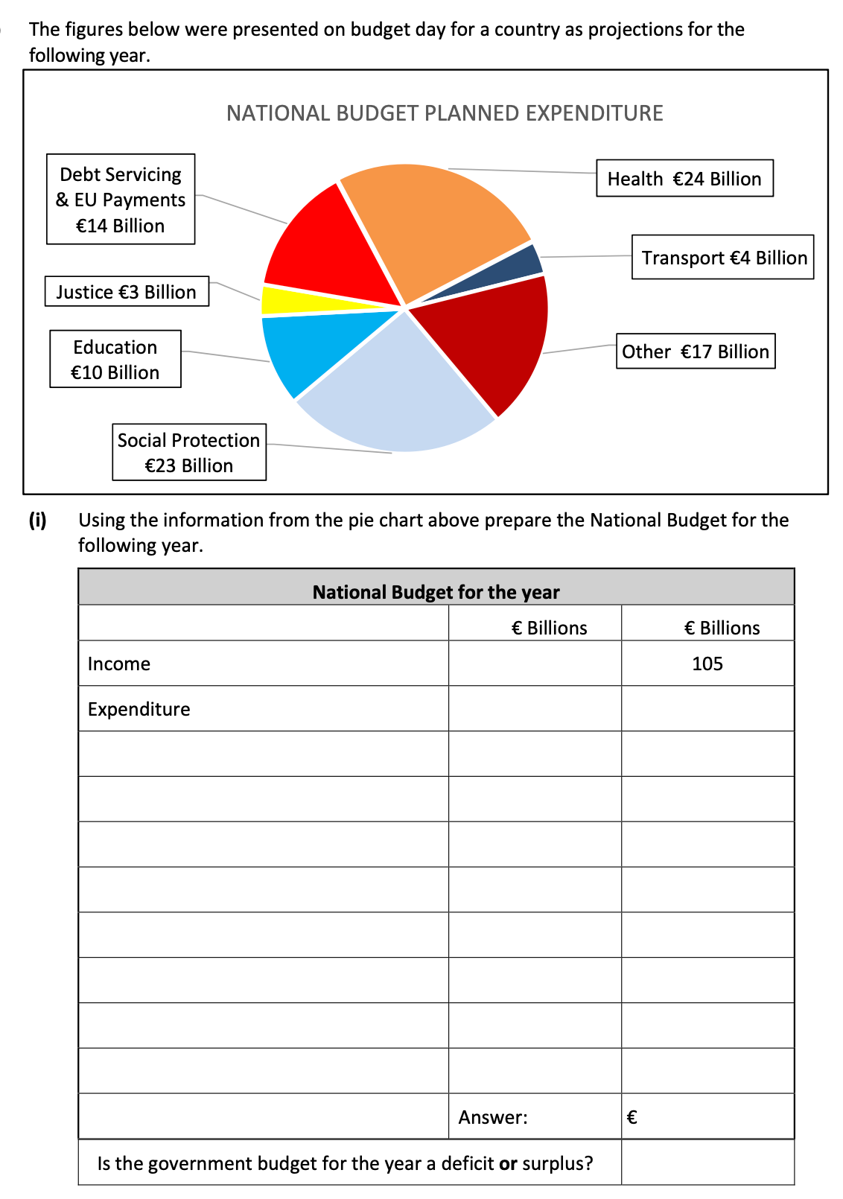

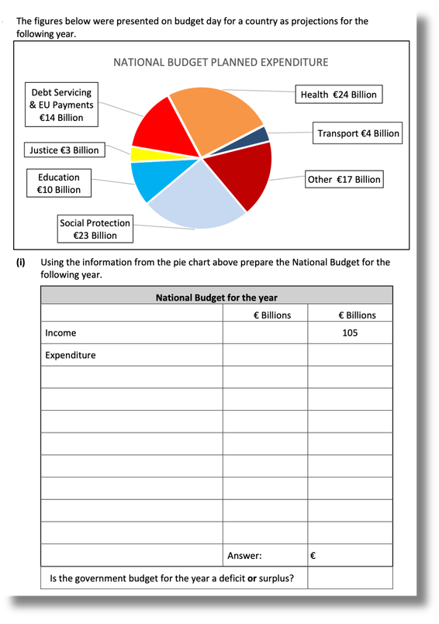

Exam Corner 2023 Q18 (c)
Top Tip: Read all titles in graphs provided in the exam – in this one it states that every figure in the pie chart is planned expenditure, which helped answer part (i)
Students had to use the diagram above to calculate a budget in an answer space provided

Slide 28
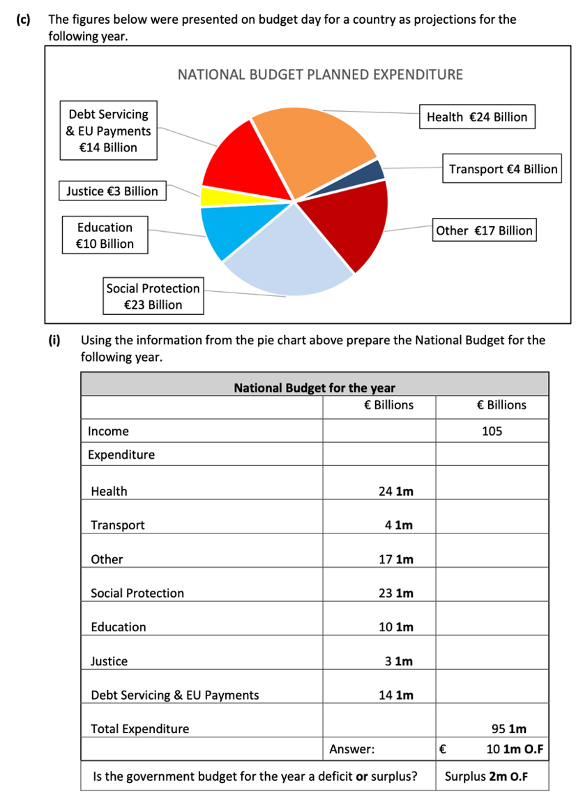
Exam Corner 2023 Q18 (c)
Top Tip: Show all your workings for each department and figure.
Income can be used as another name for revenue.
If revenue(income) is greater than expenditure, it is a surplus

Slide 29
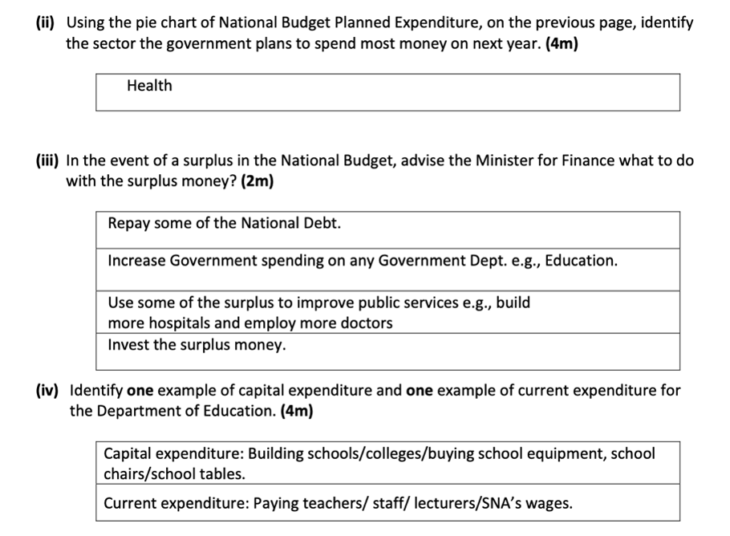
Exam Corner 2023 Q18 (c)

Slide 30
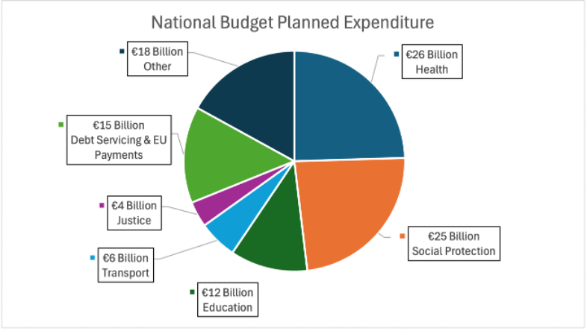
CLASS ACTIVITY 30.3
Calculate a National Budget and identify if it is a surplus or deficit budget
(a) Using the information from the pie chart above prepare the National Budget for the following year using the table below:
STRAND 3
CH 30
LO 3.4 – Government Revenue & Expenditure

Slide 31
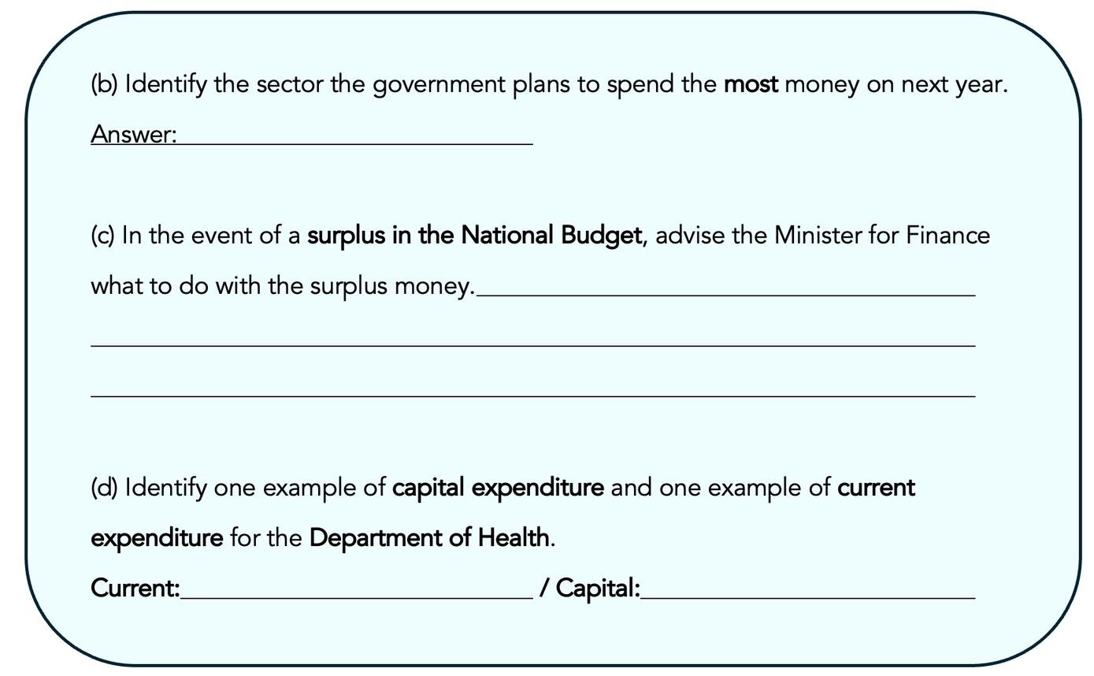
Advise the Minister for Finance on actions to take in the event of a deficit or surplus budget
CLASS ACTIVITY 30.3
Find the largest figure or segment in the pie chart
A surplus means the government has leftover money to use
Be specific with examples related to Health, don’t just say “pay wages”
STRAND 3
CH 30
LO 3.4 – Government Revenue & Expenditure

Slide 32
Workbook Qs
Q10 -> Q14

Slide 33



Click to play

