Slide 1


Demand & Supply
STRAND 3
Learning Outcome 3.3
CH 29:
Evaluate how changes in the supply and demand of goods and services in different markets can affect prices
LO 3.3: Demand & Supply
BUSINESS
JC
HUB

Slide 2
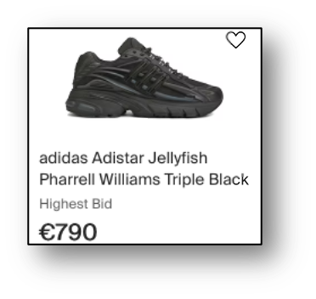
Introduction Activity (Pg1)
STRAND 3
Read the piece about Adidas announcing a "Surprise Drop" of a new limited-edition trainer on page 1 of the notes.
1. Why might so many people be desperate to buy these trainers?
2. Why would Adidas only release 500 pairs if they know the demand will be a lot higher with 50,000 people wanting to buy them?
CH 29:
LO 3.3: Demand & Supply
BUSINESS
JC
HUB

Slide 3
Introduction Activity (Pg1)
STRAND 3
3. What would happen to the price consumers are willing to pay on resale websites like Depop if:
(a) Adidas announce they are going to releases 5,000 more pairs of the trainers
(b) Nike release their version of a trainer that is a very similar style to Adidas, but is €100 cheaper
(c) A famous influencer posts about how cool the new Adidas trainer is on their social media channel with millions of followers
CH 29:
LO 3.3: Demand & Supply
BUSINESS
JC
HUB

Slide 4
Introduction Activity (Pg1)
STRAND 3
4. Can you think of any other situation where thousands of people are fighting over a limited number of items?
5. Try to pick two words from this list that could describe this situation where the demand is higher than the supply of an item:
Surplus Shortage Scarcity
Excess Equilibrium/Balanced
CH 29:
LO 3.3: Demand & Supply
BUSINESS
JC
HUB

Slide 5


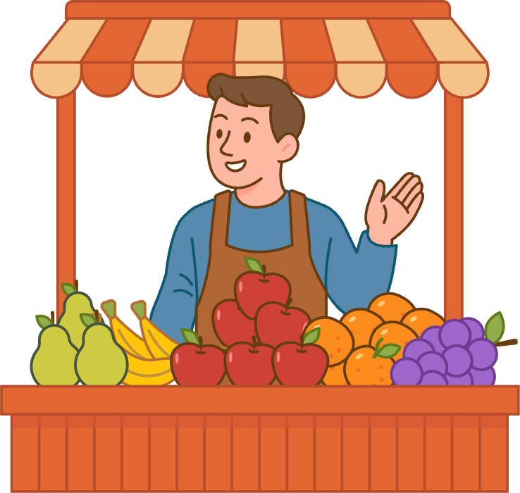
BUSINESS
JC
What is a Market?
HUB
A market is any place where buyers and sellers interact to exchange goods or services.
Buyers create demand in a market because they want to buy goods or services
Sellers create supply because they produce or sell goods or services
STRAND 3
CH 29:
LO 3.3: Demand & Supply

Slide 6

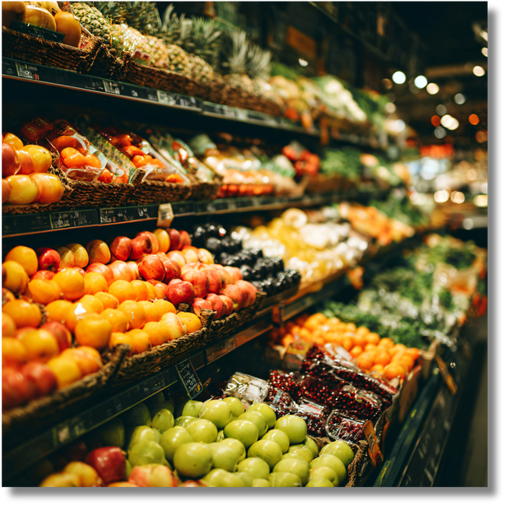

BUSINESS
JC
Examples of markets
HUB
Supermarkets like Aldi, Dunnes Stores and Tesco compete in the grocery market
You might take part in the second hand market, buying and selling items on Apps like Vinted
Tech companies compete in the mobile phone market
STRAND 3
CH 29:
LO 3.3: Demand & Supply

Slide 7
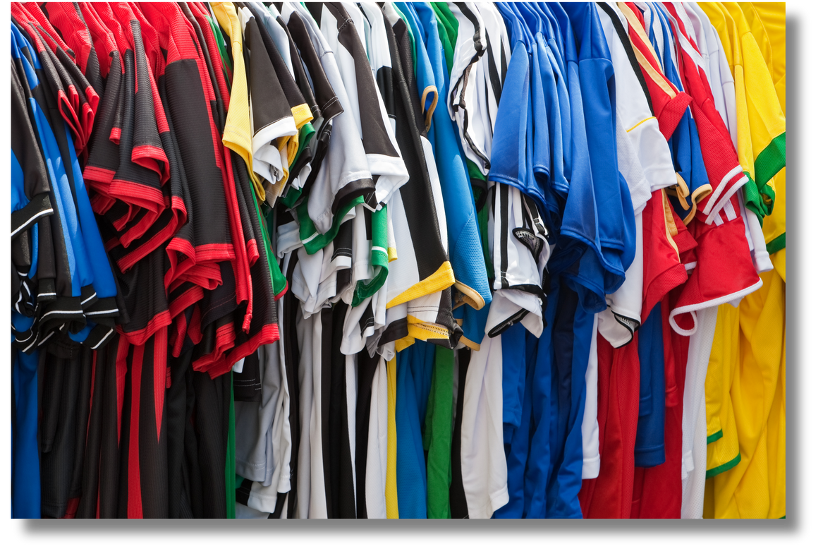
BUSINESS
JC
The Black (Shadow) Market
HUB
Fake football jerseys, dodgy boxes and counterfeit handbags are examples of black market activities.
Black Market: Illegal transactions that go unrecorded by Revenue so no tax is paid on them.
• It is illegal
• No VAT or tax is received by the government
• Consumers have no legal protection
• Harms legitimate businesses
STRAND 3
CH 29:
LO 3.3: Demand & Supply

Slide 8


Workbook Qs
Q1 -> Q3

Slide 9
BUSINESS
JC
Demand
HUB
Demand shows the amount of units (called the quantity demanded) that consumers are willing and able to buy at different prices.
The law of demand shows the relationship between price and quantity demanded:
When prices fall, the quantity demanded rises
When prices rise, the quantity demanded falls
STRAND 3
CH 29:
LO 3.3: Demand & Supply

Slide 10
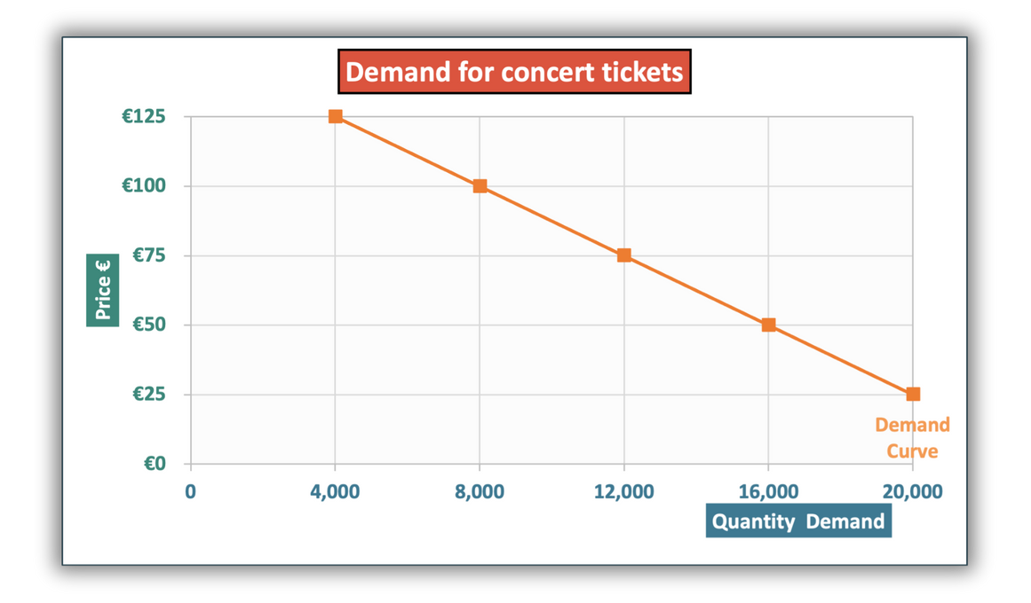
BUSINESS
JC
Demand Curves
HUB
Prices and quantity demanded can be plotted on a graph.
Prices are always shown on the (vertical) x-axis.
The quantity demanded is always shown on the (horizontal) y-axis.
On this demand curve, at the price €75, the quantity demanded for concert tickets is 12,000.
Top Tip: To find the quantity demanded, first find the price on the y-axis and then track across until you hit the demand curve and then track down to the x-axis to find the quantity.
STRAND 3
CH 29:
LO 3.3: Demand & Supply

Slide 11
BUSINESS
JC
Demand Curves
HUB
The demand curve is downward sloping as when the price increases, the quantity demanded decreases as less consumers want to buy it at a higher price.
If the price of concert tickets increased from €75 to €100, the quantity demanded for tickets would fall from 12,000 to 8,000 units.
When prices rise, the quantity demanded falls
STRAND 3
CH 29:
LO 3.3: Demand & Supply

Slide 12
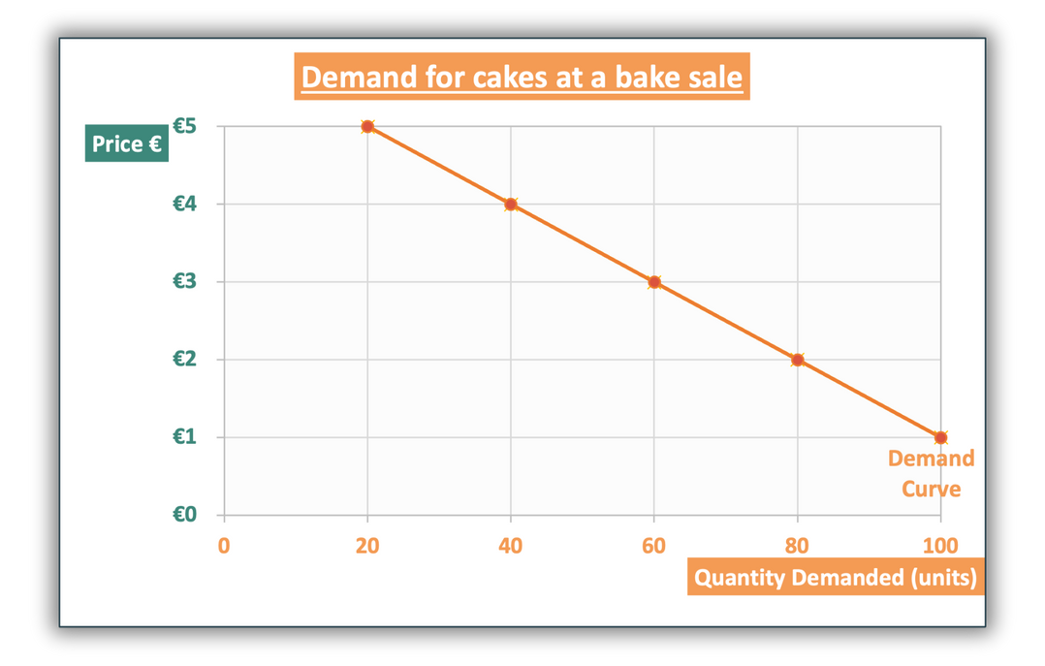


CLASS ACTIVITY 29.2
To find the quantity demanded, first find the price on the y-axis and then track across until you hit the demand curve and then track down to the x-axis to find the quantity.
29.2 Student Skill: Identify the quantity demanded or price level from a diagram. Use the diagram above to answer the following questions.
Q1. Identify the demand for cakes when the price is €4
Q2. At what price would 100 cakes be demanded?
Q3. Following a price change, do price and quantity demanded move in the same
direction or not? Use data from the diagram to help explain your answer.
STRAND 3
CH 29:
LO 3.3: Demand & Supply

Slide 13
Workbook Qs
Q4 -> Q5

Slide 14

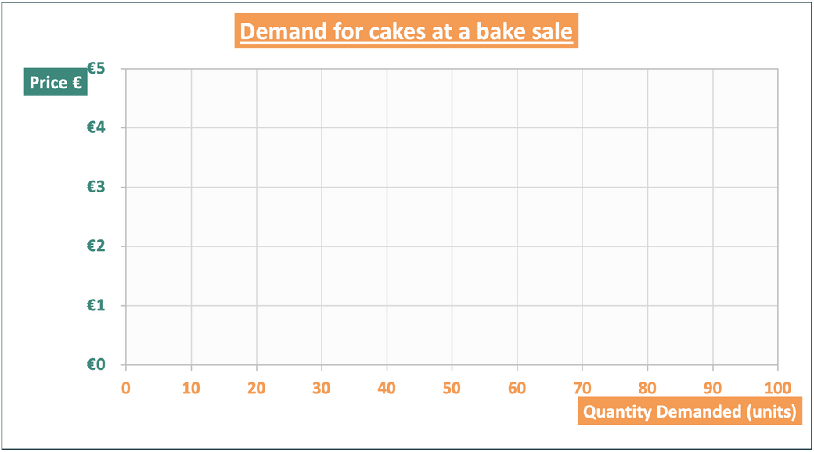
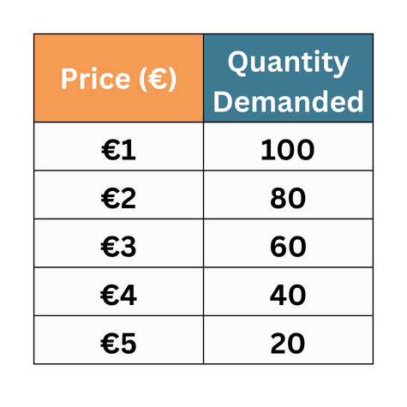

BUSINESS
JC
Plotting a Demand Curve
HUB
STEP 1: LABEL THE TITLE AND AXES CLEARLY
Let’s use the data below about the quantity demanded for cakes at different prices to plot a demand curve.
Always mention what you are measuring in the title e.g. write “demand for...”
Prices are shown on the y-axis
Demand is always on the x-axis
STRAND 3
CH 29:
LO 3.3: Demand & Supply

Slide 15
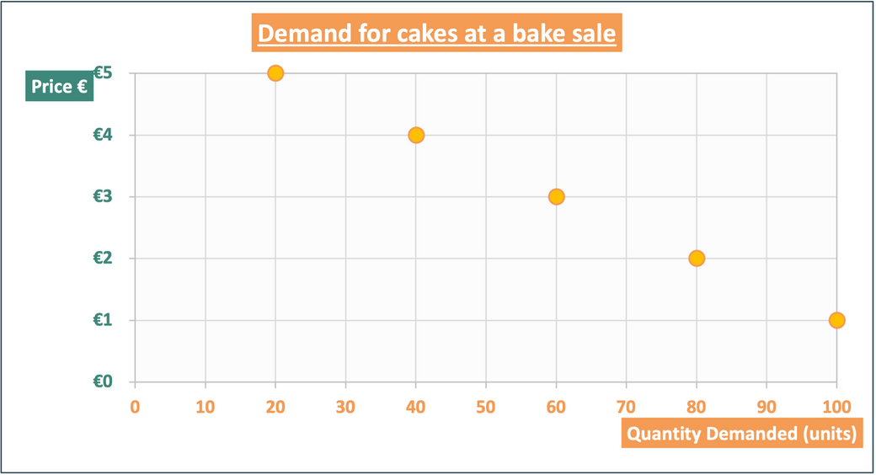
BUSINESS
JC
Plotting a Demand Curve
HUB
For each point, find where the points are for both axes - for the first point, move across the graph from €1 and move up the graph from 100 units, and place a dot where these meet.
Then repeat for the other points.
STEP 2: PLOT THE DATA FOR EACH POINT
STRAND 3
CH 29:
LO 3.3: Demand & Supply

Slide 16
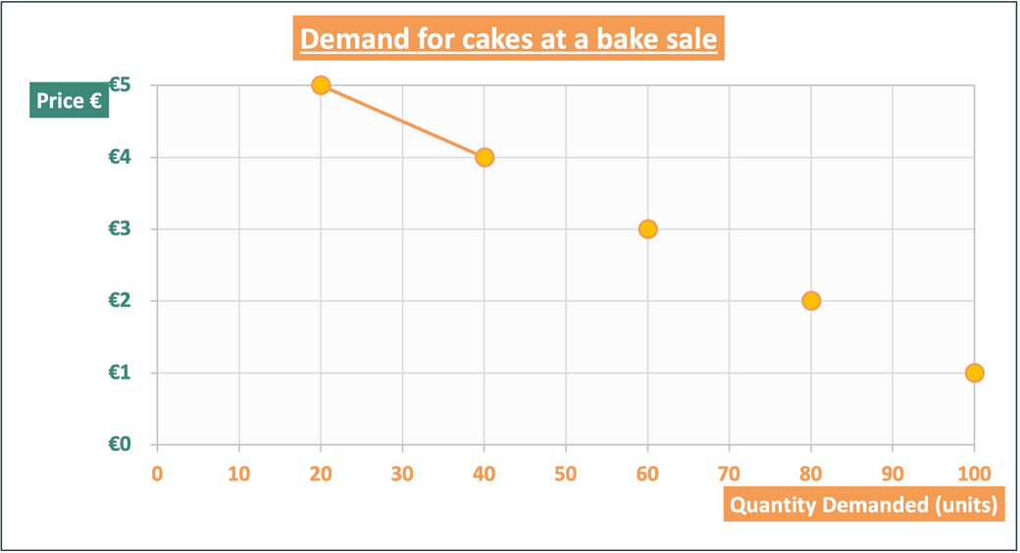
BUSINESS
JC
Plotting a Demand Curve
HUB
STEP 3: JOIN THE DOTS YOU HAVE PLOTTED
Connect the dots
STRAND 3
CH 29:
LO 3.3: Demand & Supply

Slide 17
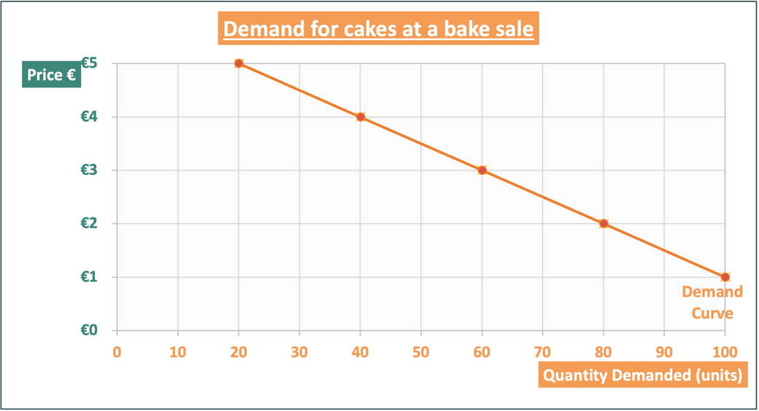
BUSINESS
JC
Plotting a Demand Curve
HUB
STEP 4: LABEL THE CURVE
Label the demand curve
STRAND 3
CH 29:
LO 3.3: Demand & Supply

Slide 18

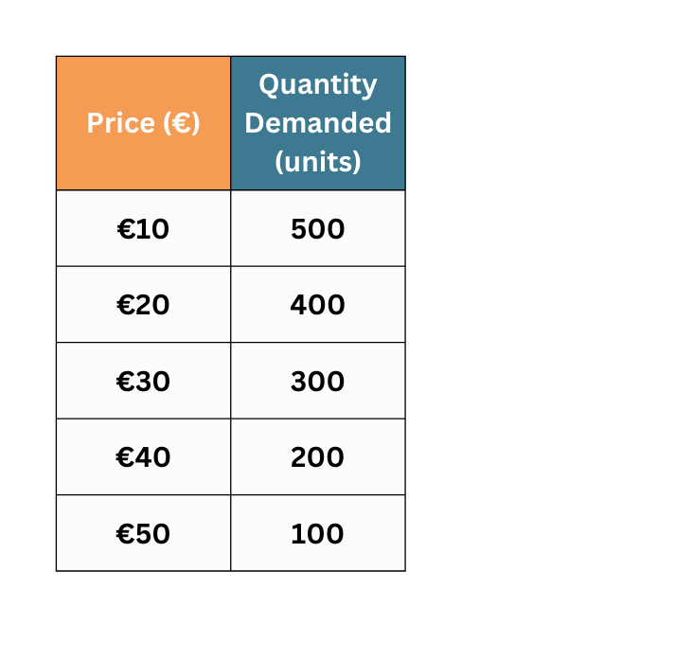

BUSINESS
JC
Plotting a Demand Curve
HUB
STRAND 3
CH 29:
LO 3.3: Demand & Supply

Slide 19



BUSINESS
JC
Substitute Goods
HUB
A substitute good can be used as a replacement or alternative for another good.
or
STRAND 3
CH 29:
LO 3.3: Demand & Supply

Slide 20

BUSINESS
JC
Complimentary Goods
HUB
A complementary good is a good that is used together with another good.
and
STRAND 3
CH 29:
LO 3.3: Demand & Supply

Slide 21


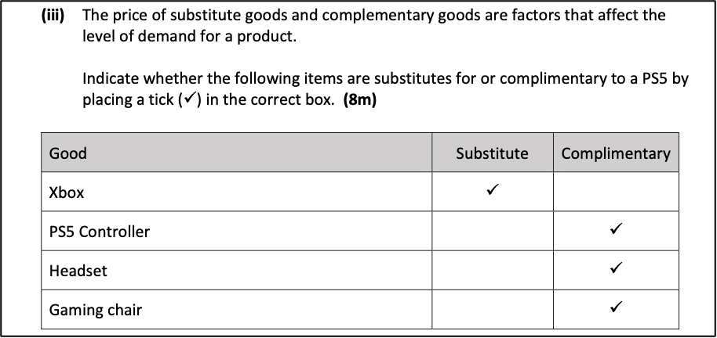
Exam Corner
2022 Q16 (iv)

Slide 22
Identify whether a good or service is a substitute good or a complementary good or service
CLASS ACTIVITY 29.3
When deciding if goods are substitutes or complementary, ask yourself:
Could this good be used in place of another good? If yes, it is a substitute good.
Could this good be used together with another good? If yes, it is a complementary good.
Always include an example of goods when explaining each term in an exam.
Q1 Indicate whether the following items are likely to be substitutes for or complementary to a Large Coke in McDonalds:
(i) Chips (ii) Sprite (iii) Vanilla Milkshake (iv) Big Mac
Q2 Choose whether the following pairs of items are substitutes for or complementary for each other:
(i) Coca-Cola and Pepsi
(ii) Cereal and milk
(iii) An iPhone App and an iPhone
(iv) Golf clubs and golf balls
STRAND 3
CH 29:
LO 3.3: Demand & Supply

Slide 23
Workbook Qs
Q7 -> Q12

Slide 24
BUSINESS
JC
Factors that increase or decrease demand
HUB
Certain factors make consumers change their mind about how much they want of certain goods/services – either increasing or decreasing the demand for the goods/services
STRAND 3
CH 29:
LO 3.3: Demand & Supply

Slide 25
BUSINESS
JC
Factors that increase demand for a good / service
HUB
  Lower Prices – When the price falls, more people can afford the product, so demand increases.
  Higher Price of Substitutes – If replacement products become more expensive, consumers switch to the cheaper alternative.
  Lower Price of Complements – When related products become cheaper, demand for this product rises.
STRAND 3
CH 29:
LO 3.3: Demand & Supply

Slide 26
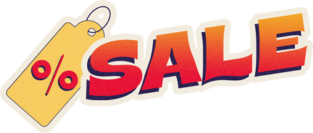
BUSINESS
JC
Factors that increase demand for cereal
HUB
  Lower Prices – If cereal is on special offer, more families buy it.
  Higher Price of Substitutes – If toast or breakfast bars become more expensive, people may switch to cereal instead.
  Lower Price of Complements – If milk becomes cheaper, more people buy cereal as its cheaper to use the two together.
STRAND 3
CH 29:
LO 3.3: Demand & Supply

Slide 27
BUSINESS
JC
Factors that increase demand for a good / service
HUB
  Rising Household Incomes – When people earn more, they can buy more goods and services.
  Trends, Advertising, and Social Media – Positive trends and strong marketing make products more popular.
  Unplanned Events – Weather or sudden events can increase demand for certain products.
STRAND 3
CH 29:
LO 3.3: Demand & Supply

Slide 28
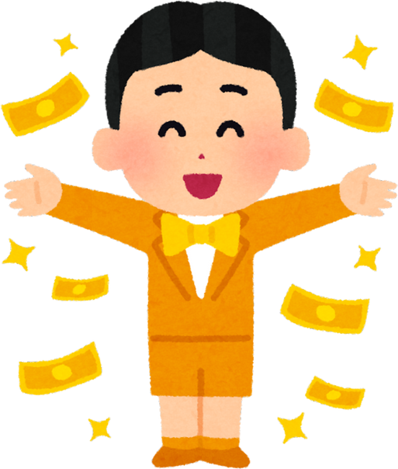


BUSINESS
JC
Factors that increase demand for cereal
HUB
  Rising Household Incomes – Families with higher incomes may buy more branded cereal.
  Trends, Advertising, and Social Media – A TikTok trend or TV ad makes a cereal popular with students.
  Unplanned Events – A food safety recall on bacon and sausages could cause consumers to switch to cereal.
STRAND 3
CH 29:
LO 3.3: Demand & Supply

Slide 29
BUSINESS
JC
Factors that decrease demand for a good / service
HUB
  Higher Price – If cereal becomes more expensive, fewer families buy it.
  Cheaper Substitutes – If rashers become cheaper, people switch.
  Dearer Complements – If milk costs more, people buy less of both.
  Falling Incomes – When incomes drop, households cut back on spending.
  Negative Trends or Advertising – Bad publicity or weak marketing reduces interest.
  Unplanned factor – Contamination scares for wheat could reduce the demand for cereal.
STRAND 3
CH 29:
LO 3.3: Demand & Supply

Slide 30
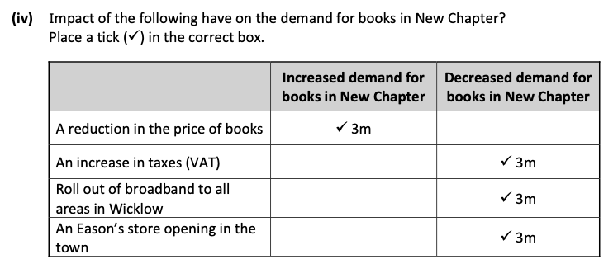
Exam Corner
2019 Q16 (iv)
Explainer
1. Cheaper books will increase demand for them
2. If VAT led to higher book prices demand would decrease
3. Broadband will allow Wicklow customers to order books online more easilty instead of New Chapter’s books
4. Eason’s are a substitute for New Chapter, decreasing the demand for their books.

Slide 31
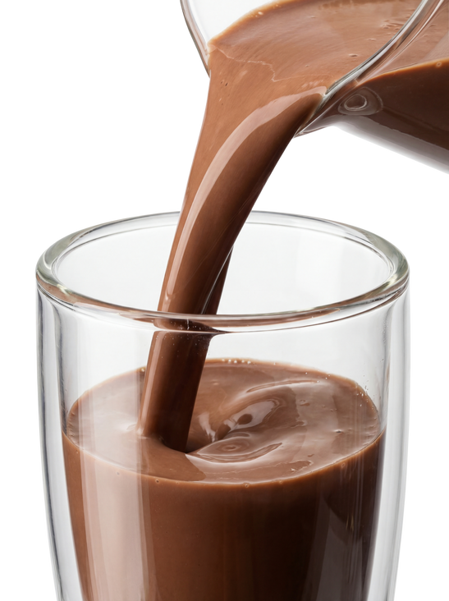
Identify whether a factor would increase or decrease the demand for a good or service
CLASS ACTIVITY 29.4
Q1 Choose the correct option to show whether each statement would lead to an increase or decrease in demand for Mooju chocolate milk.
  The price of an alternative chocolate milk drink Yazoo decreases
  An online trend on TikTok goes viral of people using Mooju to make smoothies at home
  A new report is released suggesting milk may not be suitable for lots of people to drink
  People get an increase in their disposable income
STRAND 3
CH 29:
LO 3.3: Demand & Supply

Slide 32
Identify whether a factor would increase or decrease the demand for a good or service
CLASS ACTIVITY 29.4
Q2. List two other reasons that the demand for Mooju might increase. Explain how each reason increases demand.
Q3. Choose a good or service that you and your friends use regularly.
Create TWO statements that could lead to an increase in demand for it, and TWO statements that could lead to a decrease in demand for it.
Then test your questions on other students in your class.
STRAND 3
CH 29:
LO 3.3: Demand & Supply

Slide 33



Click to play

Slide 34
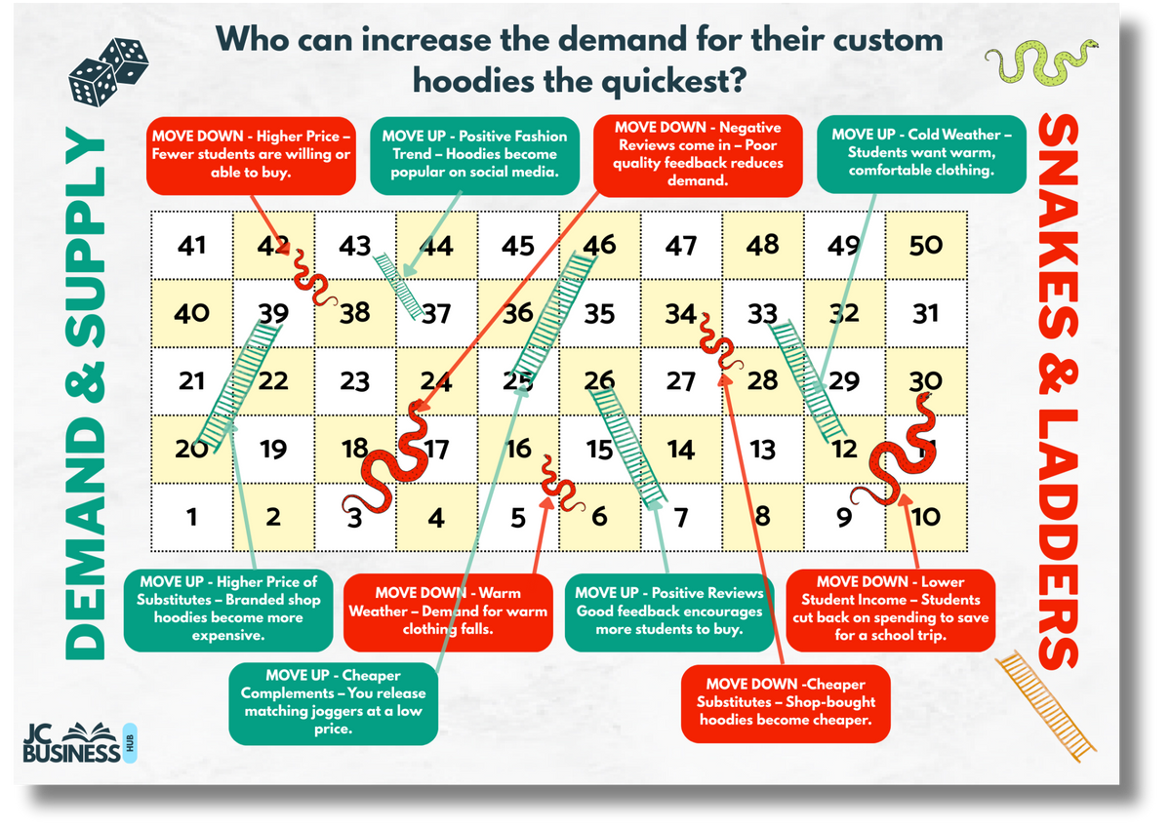

Print & Play
Worksheet!

Slide 35
Workbook Qs
Q13 -> Q16

Slide 36

BUSINESS
JC
Changes in Demand from a graph
HUB
We have already looked at how when the price of concert tickets increased from €75 to €100, the quantity demanded for tickets fell from 12,000 to 8,000 units.
A change in the price of a good or service will cause a movement along a demand curve.
movement
When prices rise, the quantity demanded falls
STRAND 3
CH 29:
LO 3.3: Demand & Supply

Slide 37
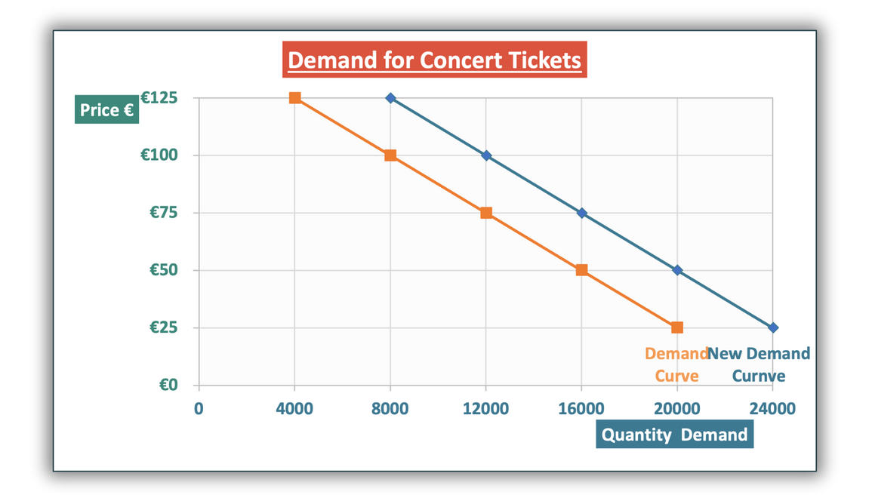
BUSINESS
JC
Increase in demand - rightward shift
HUB
An event may occur that increases the quantity demanded for concert tickets without the price changing.
E.g. the artist releases a sneak peak of the show that fans think looks incredible
This causes the amount demanded at all prices levels to increase.
An increase in quantity demanded is shown on a graph by a rightward shift, with demand increasing by 4,000 tickets at each price
STRAND 3
CH 29:
LO 3.3: Demand & Supply

Slide 38
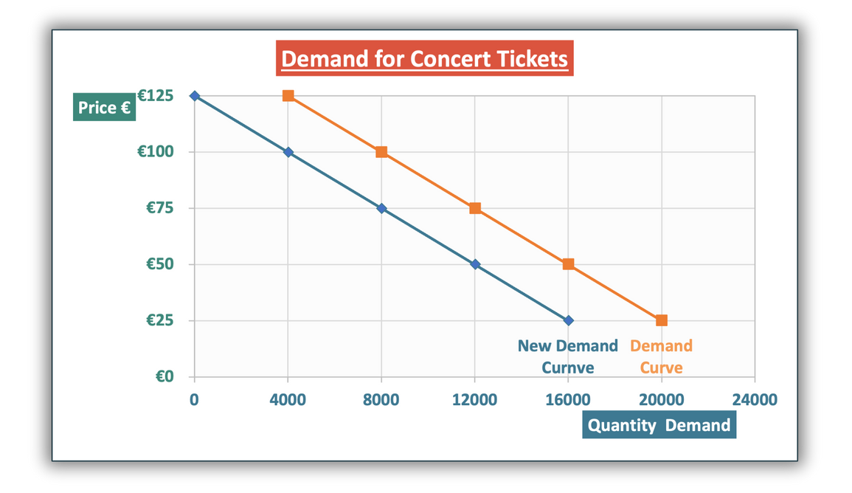
BUSINESS
JC
Decrease in demand - leftward shift
HUB
An event may occur that reduces the quantity demanded for concert tickets without the price changing.
E.g. a substitute concert is announced on the same date
This causes the amount demanded at all prices levels to fall.
A decrease in quantity demanded is shown on a graph by a leftward shift, with demand falling by 4,000 tickets at each price
STRAND 3
CH 29:
LO 3.3: Demand & Supply

Slide 39
BUSINESS
JC
Shifts in demand
HUB
STRAND 3
CH 29:
LO 3.3: Demand & Supply

Slide 40
Workbook Qs
Q17 -> Q18

Slide 41
BUSINESS
JC
Supply
HUB
Supply shows the amount of a good or service that sellers are willing and able to sell at different prices.
The law of supply shows the relationship between price and quantity supplied:
When prices decrease, the quantity supplied decreases
When prices increase, the quantity supplied increases
STRAND 3
CH 29:
LO 3.3: Demand & Supply

Slide 42
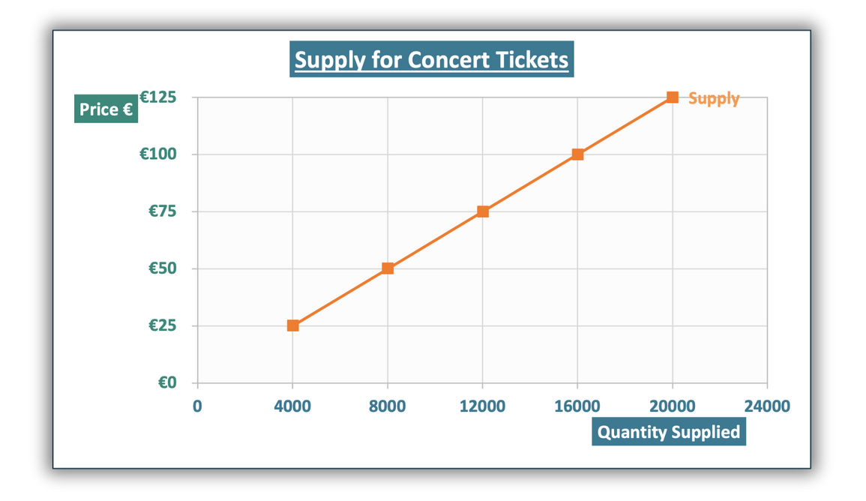
BUSINESS
JC
Supply Curves
HUB
Prices and quantity supplied can be plotted on a graph.
Prices are always shown on the (vertical) x-axis.
The quantity supplied is always shown on the (horizontal) y-axis.
On this supply curve, at the price €75, the quantity supplied of concert tickets is 12,000.
Top Tip: To find the quantity supplied, first find the price on the y-axis and then track across until you hit the supply curve and then track down to the x-axis to find the quantity.
STRAND 3
CH 29:
LO 3.3: Demand & Supply

Slide 43
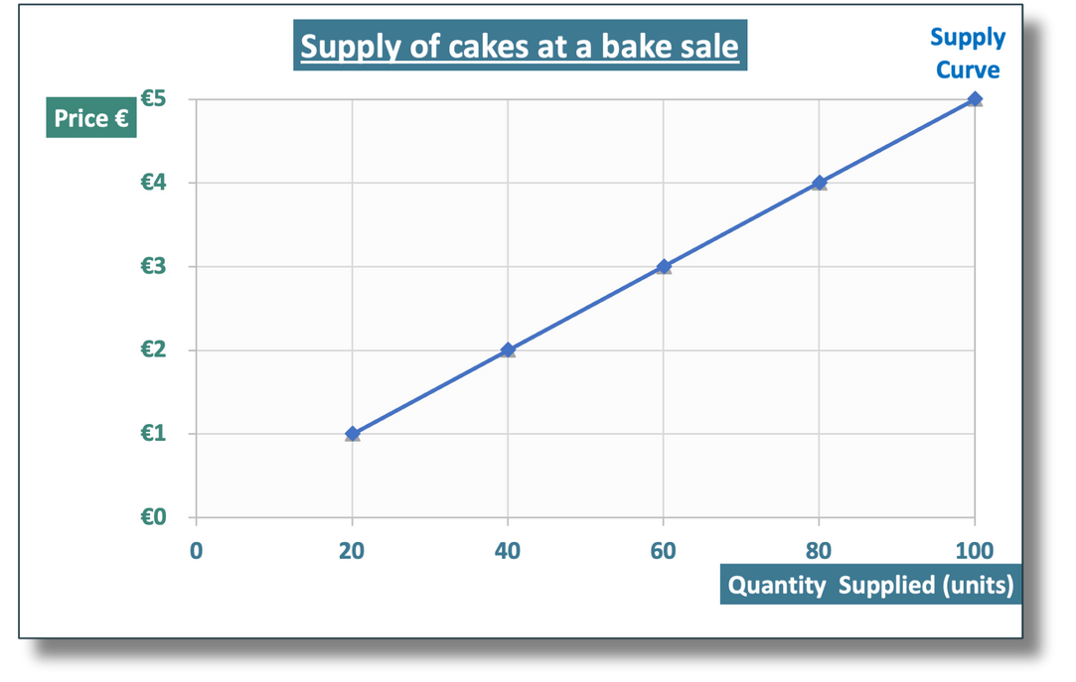
CLASS ACTIVITY 29.5
Identify the price or quantity for a good or service from a diagram
Students can often find supply confusing – it’s important to remember, the price is what sellers get for selling a good or service, not what it costs them to supply it.
Firms are more willing to supply a good when the selling price is higher, as this can increase their profit. A higher selling price doesn’t mean their costs have increased.
Q1. Identify the quantity supplied of cakes if the price was €4 on the diagram above
Q2. At what price would the quantity supplied be 100 cakes?
Q3. Following a price change, do price and quantity supplied move in the same direction or not? Use data from the diagram to help explain your answer.
STRAND 3
CH 29:
LO 3.3: Demand & Supply

Slide 44
Workbook Qs
Q19

Slide 45
BUSINESS
JC
Factors that increase or decrease supply
HUB
Certain factors, including the selling price, can cause firms to change how much of a good or service they are willing to sell.
STRAND 3
CH 29:
LO 3.3: Demand & Supply

Slide 46





BUSINESS
JC
Factors that increase the supply of a good / service
HUB
  Higher Price – When prices rise, firms earn more profit and are willing to supply more.
  Lower Taxes / VAT – Reduced taxes allow firms to keep more profit per unit, encouraging higher supply.
  Lower Costs of Production – Cheaper wages, energy, or materials make production more profitable.
  Improved Technology or Resources – Better machinery or access to skilled labour increases output.
  Favourable Unplanned Events – Good conditions, such as favourable weather, support higher production.
STRAND 3
CH 29:
LO 3.3: Demand & Supply

Slide 47


BUSINESS
JC
Factors that increase the supply of cereal
HUB
  Higher Price – If cereal prices rise, manufacturers increase supply to earn higher profits.
  Lower Taxes / VAT – Reduced VAT on cereal would allow firms to make more profit, increasing supply.
  Lower Costs of Production – Cheaper wheat used to make cereal reduces costs, increasing supply.
  Improved Technology or Resources – Automated factories that make cereal faster or cheaper, increases supply.
  Favourable Unplanned Events – Good harvest conditions lead to more wheat for companies, increasing supply.
STRAND 3
CH 29:
LO 3.3: Demand & Supply

Slide 48
BUSINESS
JC
Factors that decrease the supply of a good / service
HUB
  Lower Price – When prices fall, supplying the good becomes less profitable, so firms reduce output.
  Higher Taxes / VAT – New taxes or higher VAT reduce profit per unit and discourage production.
  Higher Costs of Production – Rising wages, energy, or raw material costs make production less profitable.
  Limited Technology or Resources – Lack of machinery, skilled labour, or materials restricts output.
  Negative Unplanned Events – Strikes, extreme weather, or disruptions reduce production capacity.
STRAND 3
CH 29:
LO 3.3: Demand & Supply

Slide 49
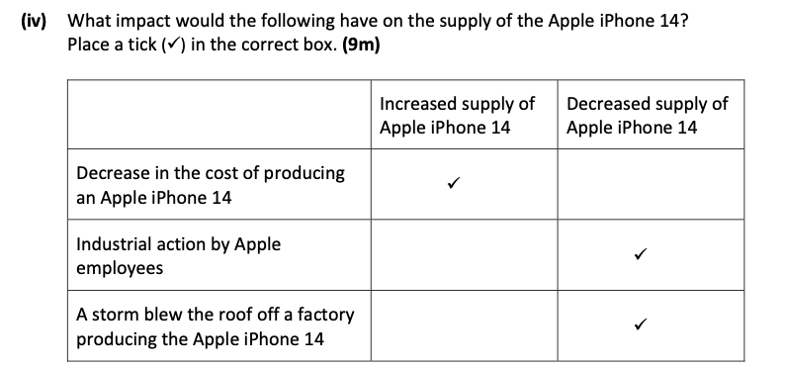
Exam Corner
2023 Q18 (iv)

Slide 50

Identify whether a factor would increase or decrease the supply for a good or service
CLASS ACTIVITY 29.6
Read each statement below. For each one, state whether the supply of Tasty Choc Bars would increase or decrease, and explain your answer.
1. The market price of Tasty Choc Bars increases.
2. The cost of cocoa and sugar used to make Tasty Choc Bars increases.
3. The government reduces VAT on chocolate bars.
4. A new machine is introduced that allows the company to produce Tasty Choc Bars more quickly and cheaply.
5. Workers at the Tasty Choc Bar factory go on strike for two weeks.
STRAND 3
CH 29:
LO 3.3: Demand & Supply

Slide 51

Identify whether a factor would increase or decrease the supply for a good or service
CLASS ACTIVITY 29.6
Decide if each statement would lead to an increased supply or decreased supply of Apple iPhones
  The cost of an important chip used to make iPhones doubles in price
  A breakthrough in technology means iPhones can now be made twice as fast
  The main iPhone production factory is damaged in a large fire
  The price iPhones can sell for increases
2. List two other reasons that could increase the supply of iPhones.
3. Pick a good or service you know, and create four statements related to supply changing. Then test your questions on other students in your class.
STRAND 3
CH 29:
LO 3.3: Demand & Supply

Slide 52
Workbook Qs
Q20 -> Q23

Slide 53
BUSINESS
JC
Changes in Supply from a graph
HUB
An artist was willing to put on 3 concerts in a 4,000 seater stadium if prices were €75.
If ticket prices increased to €100, the artist would be willing to put on another concert, increasing the supply of tickets from 12,000 to 16,000 for the concerts.
A change in the price of a good or service will cause a movement along a supply curve.
movement
When prices rise, the quantity supplied rise
STRAND 3
CH 29:
LO 3.3: Demand & Supply

Slide 54
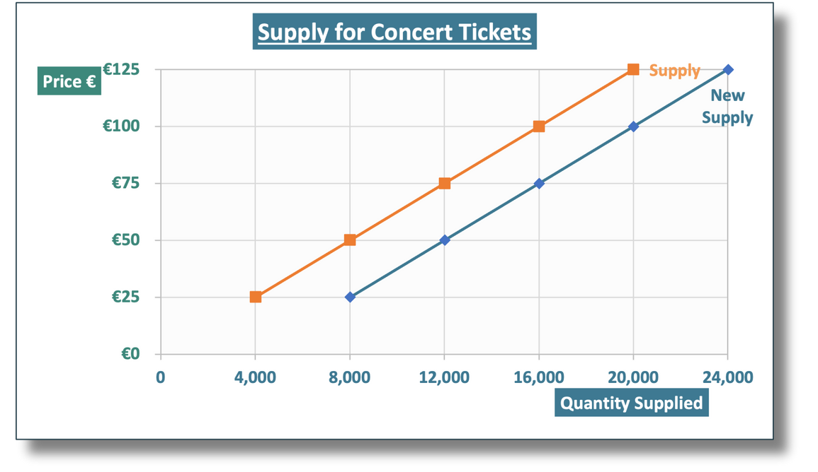
BUSINESS
JC
Increase in supply - rightward shift
HUB
An event may occur that increases the quantity supplied of concert tickets without the price changing.
E.g. the venue used lowers their costs making it more profitable to put on more concerts
This causes the amount supplied at all prices levels to increase.
An increase in quantity supplied is shown on a graph by a rightward shift.
STRAND 3
CH 29:
LO 3.3: Demand & Supply

Slide 55
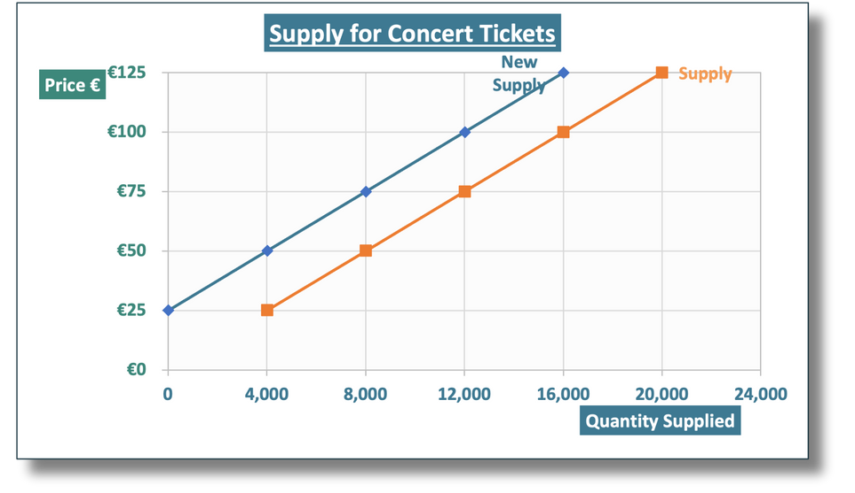
BUSINESS
JC
Decrease in supply - leftward shift
HUB
An event may occur that reduces the quantity supplied of concert tickets without the price changing.
E.g. the artist gets sick and can’t perform as many concerts on their upcoming tour.
This causes the amount supplied at all prices levels to fall.
A decrease in quantity supplied is shown on a graph by a leftward shift.
STRAND 3
CH 29:
LO 3.3: Demand & Supply

Slide 56
Workbook Qs
Q24

Slide 57
BUSINESS
JC
Market Equilibrium
HUB
A price will be set in a market depending on the level of demand (how much and how many people want it) and the level of supply (how many people are willing to provide the good or service).
Market equilibrium is the price and quantity where the level of demand is equal to the level of supply in a market.
STRAND 3
CH 29:
LO 3.3: Demand & Supply

Slide 58
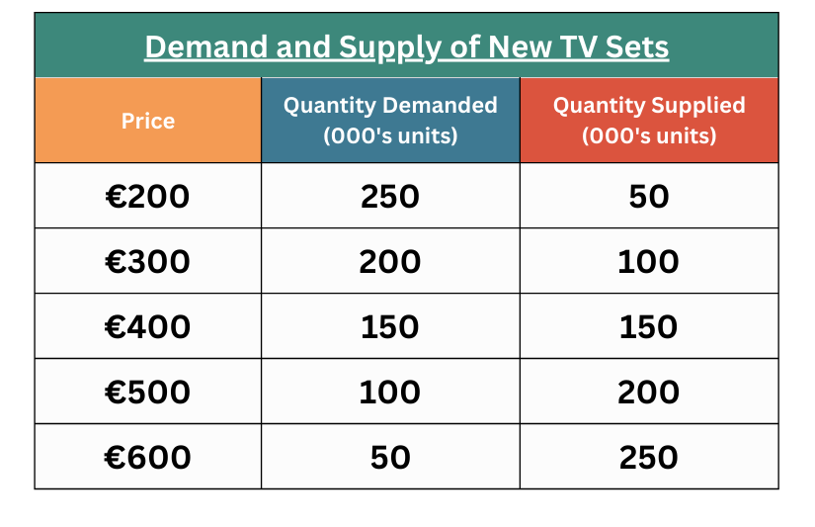



BUSINESS
JC
Market Equilibrium
HUB
Quantity supply of TVs
As prices increase, we would expect sellers to want to supply more TVs.
When price increases from €400 to €500, supply increases from 150,000 TVs to 200,000 TVs.
Quantity demand for TVs
As prices increase, we would expect less demand TVs.
When price increases from €400 to €500, demand decreases from 150,000 TVs to 100,000 TVs.
STRAND 3
CH 29:
LO 3.3: Demand & Supply

Slide 59
BUSINESS
JC
Market Equilibrium
HUB
At €200, the demand is 250,000 TVs and supply is 50,000 TVs.
So the market is not in equilibrium at €200 as demand is not equal to supply
A table or diagram will often shorten the figures to make it easier to read – in the table above units are “000’s units” meaning 100 in the table is 100,000 units.
STRAND 3
CH 29:
LO 3.3: Demand & Supply

Slide 60
BUSINESS
JC
Market Equilibrium (table)
HUB
To identify the equilibrium price and quantity, we need to find the price where the quantity demanded is equal to the quantity supplied in the market
At €400, the demand is 150,000 TVs and supply is 150,000 TVs.
So the market is in equilibrium at €400 and 150,000 TVs as demand is equal to supply
STRAND 3
CH 29:
LO 3.3: Demand & Supply

Slide 61
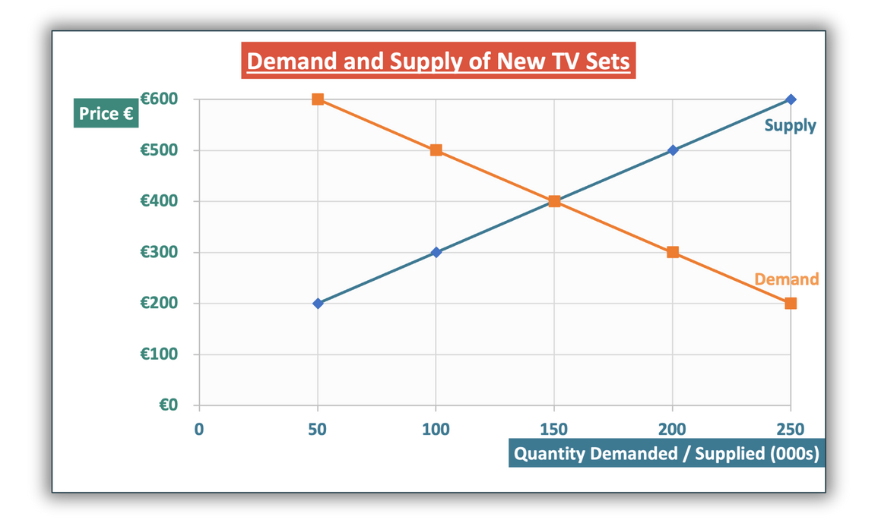
BUSINESS
JC
Market Equilibrium (graph)
HUB
To identify market equilibrium from a graph, we need to find the price where the demand and supply curves cross-over and are equal to each other.
If we track across from where demand and supply crossover, the price is €400.
If we track down from where demand and supply crossover, the quantity is 150,000 units.
STRAND 3
CH 29:
LO 3.3: Demand & Supply

Slide 62
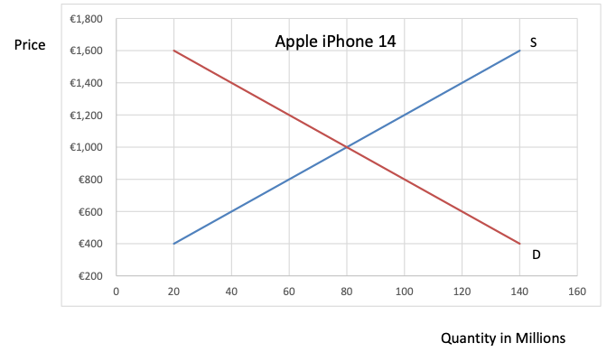
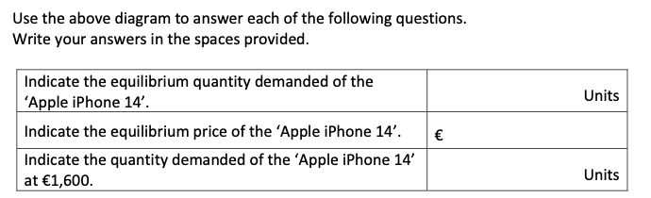
Exam Corner 2023 Q18 (b) (i)
To identify market equilibrium from a graph, we need to find the price where the demand and supply curves cross-over and are equal to each other.
Make sure to write the units correctly - in this question it was shown in “millions”, so you need to write it in full or write 80m units.
80,000,000
1,000
20,000,000

Slide 63
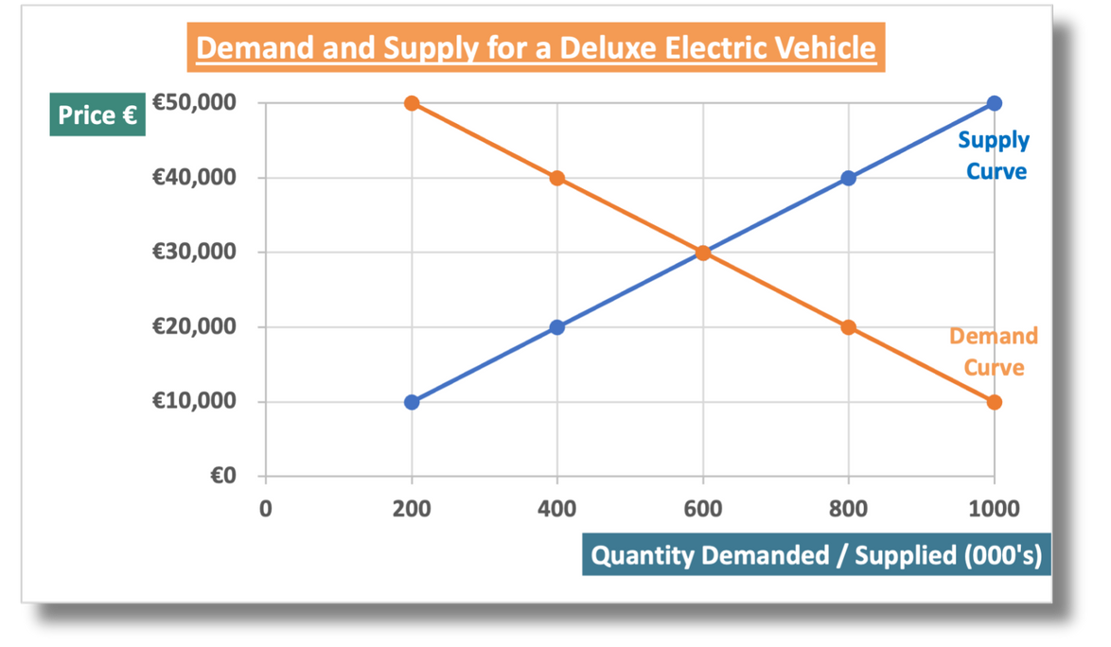
CLASS ACTIVITY 29.7
Identify the equilibrium price and quantity in a market from a graph
(i) Indicate the equilibrium quantity for Deluxe Electric Vehicles
(ii) Indicate the equilibrium price for Deluxe Electric Vehicles
(iii) Indicate the quantity demanded when the price is €20,000
(iv) Indicate the price level when the quantity supplied for
Deluxe Electrical Vehicles is 200,000 cars
STRAND 3
CH 29:
LO 3.3: Demand & Supply

Slide 64
Workbook Qs
Q25 -> Q26

Slide 65
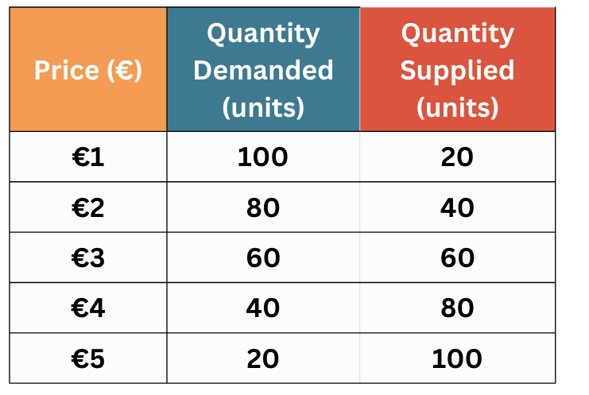
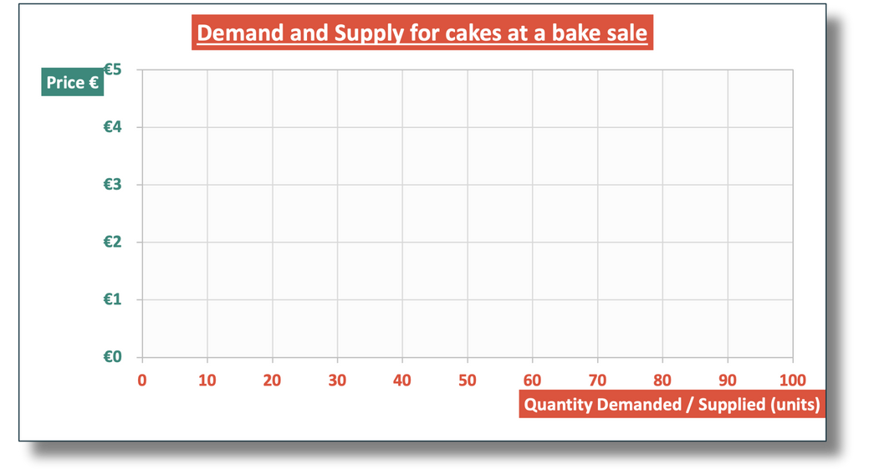
BUSINESS
JC
Drawing Market Equilibrium
HUB
Let’s use the data below about the quantity demanded and supplied of cakes at different prices to plot the market and find the equilibrium.
STEP 1: LABEL THE TITLE AND AXES CLEARLY
Always mention what you are measuring in the title e.g. write “demand and supply for...”
Prices are shown on the y-axis
Demand and supply is always on the x-axis
STRAND 3
CH 29:
LO 3.3: Demand & Supply

Slide 66
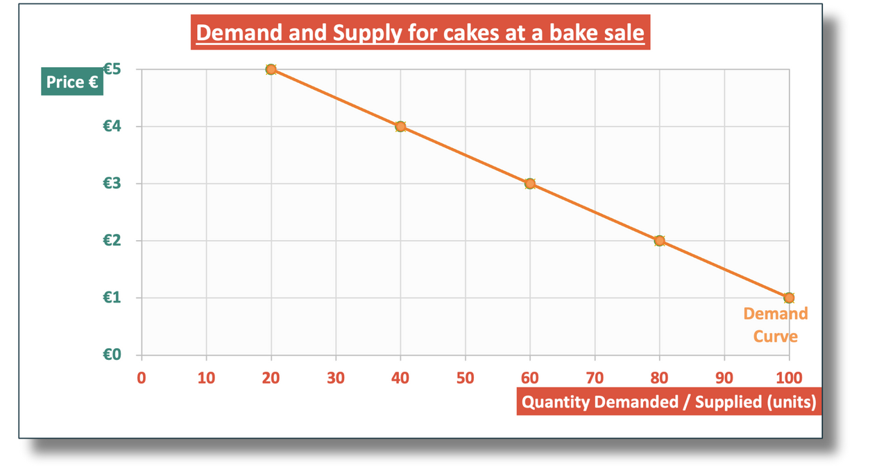
BUSINESS
JC
Drawing Market Equilibrium
HUB
  Plot each point of data for demand.
  Connect the dots with a line
  Label the line “Demand”
STEP 2: PLOT THE DEMAND CURVE, JOIN THE DOTS AND LABEL IT
STRAND 3
CH 29:
LO 3.3: Demand & Supply

Slide 67
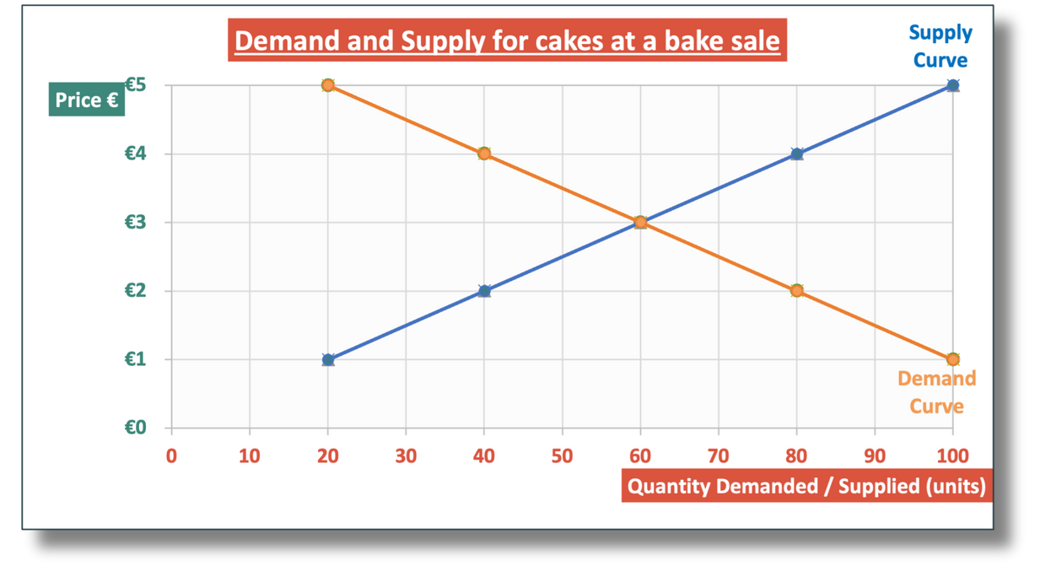
BUSINESS
JC
Drawing Market Equilibrium
HUB
  Plot each point of data for supply.
  Connect the dots with a line
  Label the line “Supply”
STEP 3: PLOT THE SUPPLY CURVE, JOIN THE DOTS AND LABEL IT
STRAND 3
CH 29:
LO 3.3: Demand & Supply

Slide 68

BUSINESS
JC
Drawing Market Equilibrium
HUB
  Locate where demand and supply crossover.
  Track across to find the price
  Track down to find the quantity
STEP 4: IDENTIFY THE EQUILIBRIUM PRICE AND QUANTITY IN THE MARKET
Remember that you can also identify market equilibrium from your table, if you find the price where the quantity demanded and supply are equal
STRAND 3
CH 29:
LO 3.3: Demand & Supply

Slide 69
BUSINESS
JC
Drawing Market Equilibrium
HUB
Demand and Supply for White Fox hoodies
Price | Quantity Demanded (000's units) | Quantity Supplied (000's units)
€25 | 30 | 10
€50 | 25 | 15
€75 | 20 | 20
€100 | 15 | 25
€125 | 10 | 30
STRAND 3
CH 29:
LO 3.3: Demand & Supply

Slide 70
Workbook Qs
Q27 -> Q28

Slide 71
BUSINESS
JC
How prices change in a market
HUB
A change in the demand or supply of a good or service will put a market out of equilibrium and leave the market in a shortage (more demand than supply) or a surplus (more supply than demand).
A shortage occurs when demand is greater than supply in a market
A surplus occurs when supply is greater than demand in a market
STRAND 3
CH 29:
LO 3.3: Demand & Supply

Slide 72
BUSINESS
JC
A Market Shortage
HUB
When the demand is above the supply in a market, it creates a shortage or scarcity of the goods or services – more people want to buy the goods/services than is available, so prices will increase.
A shortage occurs when demand is greater than supply in a market
A shortage causes prices to increase
STRAND 3
CH 29:
LO 3.3: Demand & Supply

Slide 73
BUSINESS
JC
A Market Surplus
HUB
When the demand is below supply in a market, it creates a surplus of goods or services – there are unsold goods leftover or unused services, so prices will decrease as sellers try to sell it.
E.g. the items that end up in the bargain bin were in a surplus.
A surplus occurs when supply is greater than demand in a market
A surplus causes prices to decrease
STRAND 3
CH 29:
LO 3.3: Demand & Supply

Slide 74
Recognise how changes in the supply or demand will affect prices for a good or service
CLASS ACTIVITY 29.8
A market surplus will cause prices to decrease
A market shortage will cause prices to increase
There is huge demand in Ireland for Taylor Swift concert tickets.
She initially announces only two concert dates, even though demand
is high enough to sell out many more shows.
As a result, tickets begin to appear on resale websites at very high prices.
Q1. What would happen to market prices on resale sites if Taylor Swift announces three additional concert dates in Ireland?
Would this create scarcity or a surplus of tickets? Would market prices increase or decrease?
Q2. Taylor Swift posts videos of her new concert show on social media, and fans react very positively.
Does this increase demand or supply for tickets? Does this lead to greater scarcity or surplus? What would likely happen to market prices on resale sites?
STRAND 3
CH 29:
LO 3.3: Demand & Supply

Slide 75
Click to play

Slide 76
Workbook Qs
Q29 -> Q30

